Slide 1
ANIMAL EVOLUTION

Slide 2
What Evolution IS
A physical change in a population of organisms over time.
the process by which different kinds of living organisms are thought to have developed and diversified from earlier forms during the history of the earth.

Slide 3
What Evolution is NOT
Aiming for a “perfect” organism
  Only an organism with physical traits that are best suited to the environment in which it lives.
Purposeful
  There is no end goal. The physical traits that are the most successful are passed on to offspring and then on through generations.
VIDEO

Slide 4
EVIDENCE OF EVOLUTION
PHYSIOLOGIC ADAPTATIONS: Change in a metabolic process
  Temperature control or tolerance
  Skin tone
STRUCTURAL ADAPTATIONS
  mimicry
  camouflage
  Takes place over thousands or millions of years
http://evolution.berkeley.edu/evolibrary/home.php
http://science.howstuffworks.com/animal-camouflage2.htm
Life Sciences-HHMI Outreach. Copyright 2006 President and Fellows of Harvard College.

Slide 5
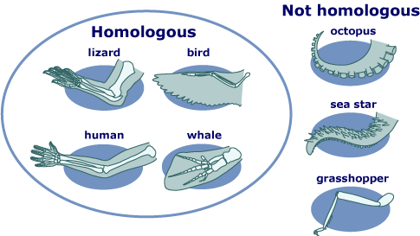
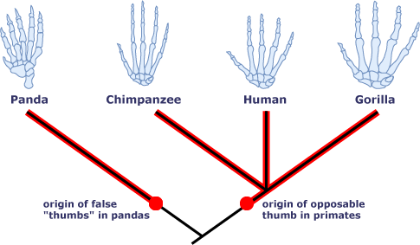
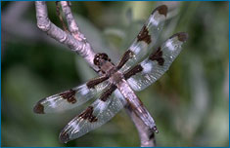
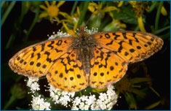
OTHER EVIDENCE OF EVOLUTION
FOSSILS
EMBRYOLOGY
VESTIGIAL STRUCTURES
ANATOMY
  HOMOLOGOUS and ANALOGOUS STRUCTURES
      Body parts that are similar
http://evolution.berkeley.edu/evolibrary/home.php
Life Sciences-HHMI Outreach. Copyright 2006 President and Fellows of Harvard College.

Slide 6
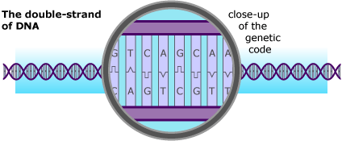
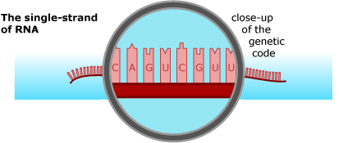
OTHER EVIDENCE OF EVOLUTION
BIOCHEMISTRY
  All organisms use the same amino acids for DNA and RNA
http://evolution.berkeley.edu/evolibrary/home.php
Life Sciences-HHMI Outreach. Copyright 2006 President and Fellows of Harvard College.

Slide 7
GEOLOGIC TIME
The Earth formed from an accretion disk orbiting the Sun about 4.5 billion years ago (bya)
  No atmosphere
  Geologically chaotic (volcanos)
  Water was present from the start

Slide 8
Geologic Time Hierarchy
Scientists organize geologic time into
Eons
  Eras
    Periods
      Epochs
Usually they are delineated by a major extinction or geological event
  Appearance of continents
  Dinosaur extinction
  Ice ages
  Appearance of life

Slide 9
Video!

Slide 10
Assignment
Animal Evolution Timeline
Using the links below and any other internet resources you can find, fill in the timeline with the major events of animal evolution. Mark on the vertical line between the Period and the Event and write when it happened. You must include all of the bulleted items, plus anything else you find interesting.
http://sci.waikato.ac.nz/evolution/AnimalEvolution.shtml
http://sci.waikato.ac.nz/evolution/EvolutionOfLife.shtml
http://www.ucmp.berkeley.edu/help/timeform.php
Also answer the questions following the timeline

