Slide 1
Starter Questions: Get your computer. Answer on Google classroom.
What are the three forms of animal body symmetry?
Assymetrical, radial, bilateral
What are the levels of organization in animal bodies?
Cells→tissues→organs→organ systems
Physiologically and structurally speaking, what are the simplest animals?
sponges

Slide 2
Kingdom Animalia Phyla Project
As we go through each of the phyla in the kingdom Animalia, you will construct a presentation on either Prezi or Google Slides.
Go to Prezi.com, click Get Started, scroll down to the bar that says for educators and students, click “Learn More”. Sign up with your student email (csddocs.org)
The first slide must list the characteristics for the kingdom Animalia
Each phylum’s will have its own slide/section (this is why Prezi is easier) and must include:
Basic Characteristics
The classes included in the phylum (orders must be present in the subphylum Vertebrata), with a description of their characteristics and pictures of example animal species. You must include their scientific binomial nomenclature.
Example: http://prezi.com/_fcemakvemxh/?utm_campaign=share&utm_medium=copy&rc=ex0share (Links to an external site.)Links to an external site.

Slide 3
Phylum Porifera
The simplest, oldest animals

Slide 4
Sponges (Phylum Porifera)
Basic characteristics:
All are sessile
Mostly marine (98%)
Asymmetrical body plan with no tissues or organs

Slide 5
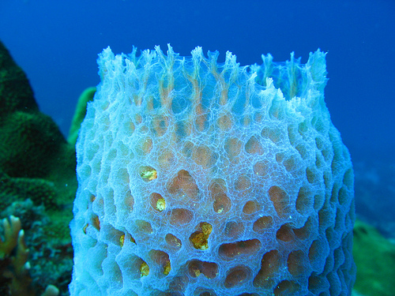
Phylum Porifera
Porifera means “pore-bearing”
Their bodies are perforated with holes (called ostia) that lead to an inner water chamber
They pump water through these pores and expel it out through the osculum

Slide 6
Sponges (Phylum Porifera)
Types of sponge cells:
Choanocytes (collar cells)
line interior canals
flagella create a water current that brings in food particles
collar on choanocyte traps food particles.
Pinacocytes - flattened cells that cover exterior of body
Porocytes – cells with a pore to allow water to pass into body
Ameobocytes – motile cells that perform many functions

Slide 7
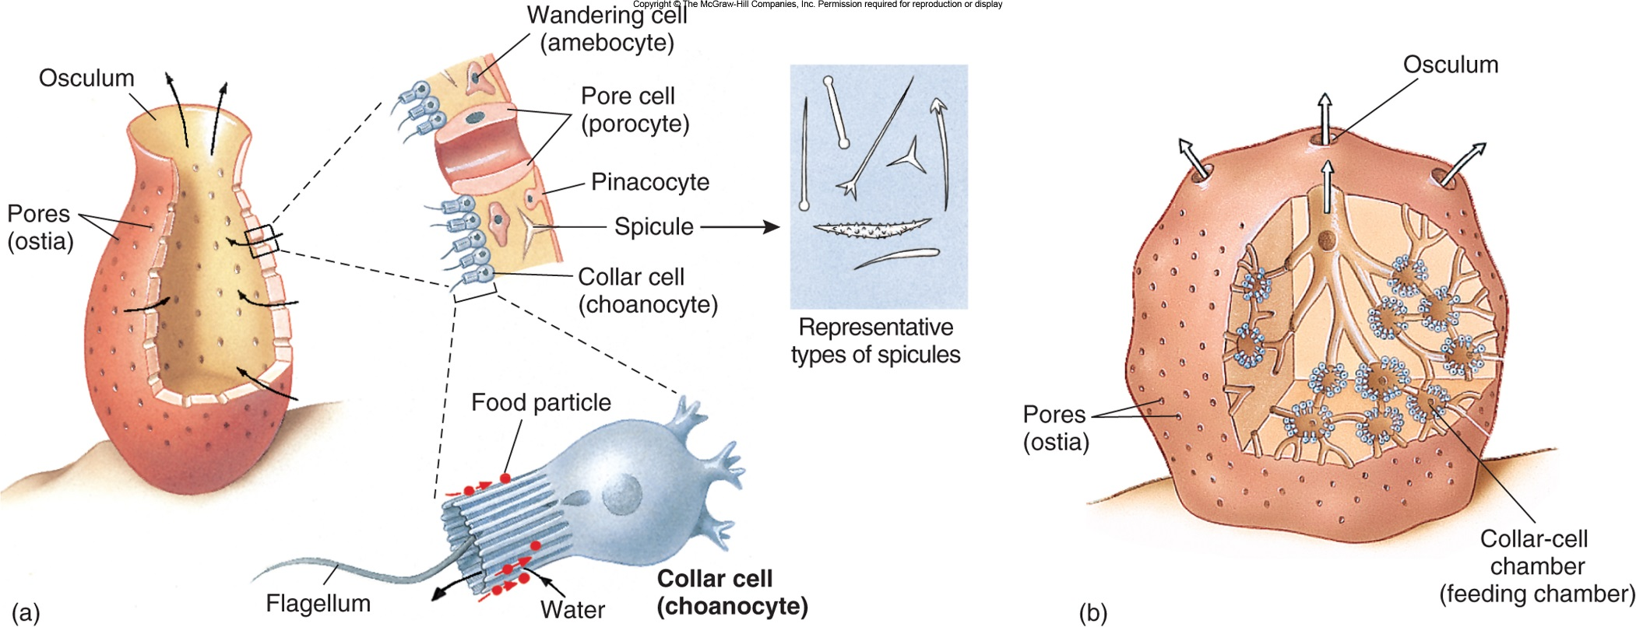

Slide 8
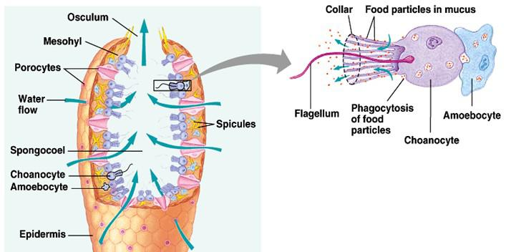
Water flow in sponges
Ostia Spongocoel Osculum

Slide 9
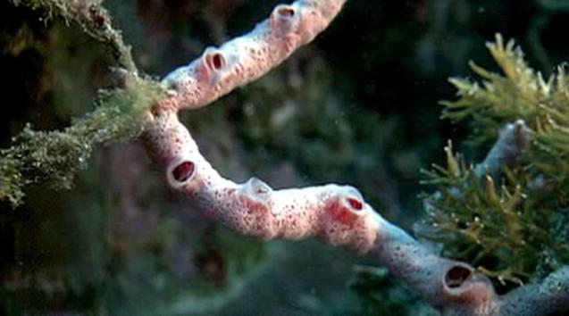
Feeding and Digestion
No digestive system.
Nutrients pass cell to cell
What do they eat? (Nutrition)
Filter feeders
Filter bacteria, protists, and small crustaceans from the water

Slide 10
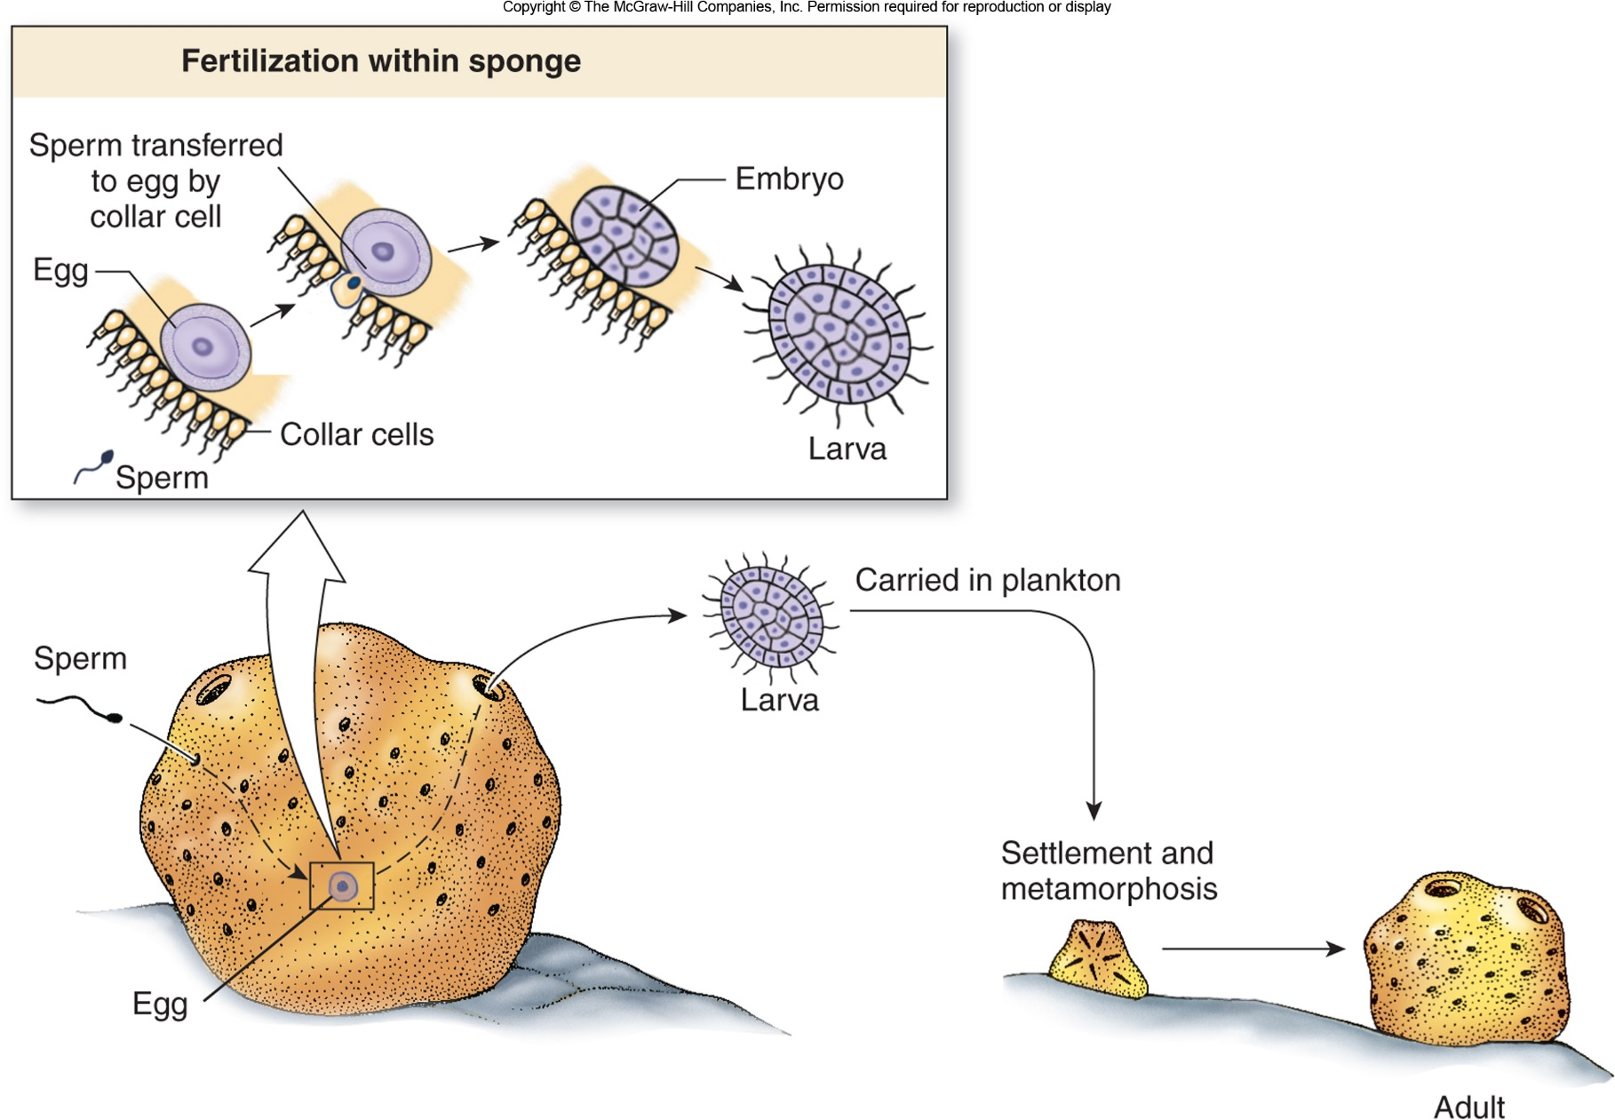
Movement
How do they move?
Mobile only as larvae
Sessile (do not move) as adults

Slide 11
Reproduction
Asexually:
Budding:Produce internal buds called gemmules which grow into new sponges
Regeneration:Able to regrow missing parts
Sexually:
Hermaphrodites: Both male and female
sex cells made by amoebocytes
Sperm released from osculum of one sponge and enters the pores of another sponge = sperm of one sponge fertilizes the egg of another sponge.

Slide 12
Not Really a skeleton: Spicules
structural elements found in most sponges.
provide structural support and deter predators.
Made of silica

Slide 13
Video
http://viewpure.com/m8a0oNsDEx8?start=0&end=0
Or
https://www.youtube.com/watch?reload=9&v=m8a0oNsDEx8

Slide 14
Assignment
Coloring Book pg 8, 9
Start your Prezi!

