Slide 1
Starter Questions
What kind of symmetry do cnidarians have?
Explain the differences between polyps and medusae
Name the three body layers of cnidarians

Slide 2
Phylum Cnidaria: Siphonophores, Jellies, Corals, Anemones
Day 2: The Classes

Slide 3
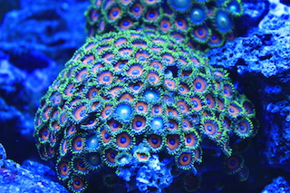
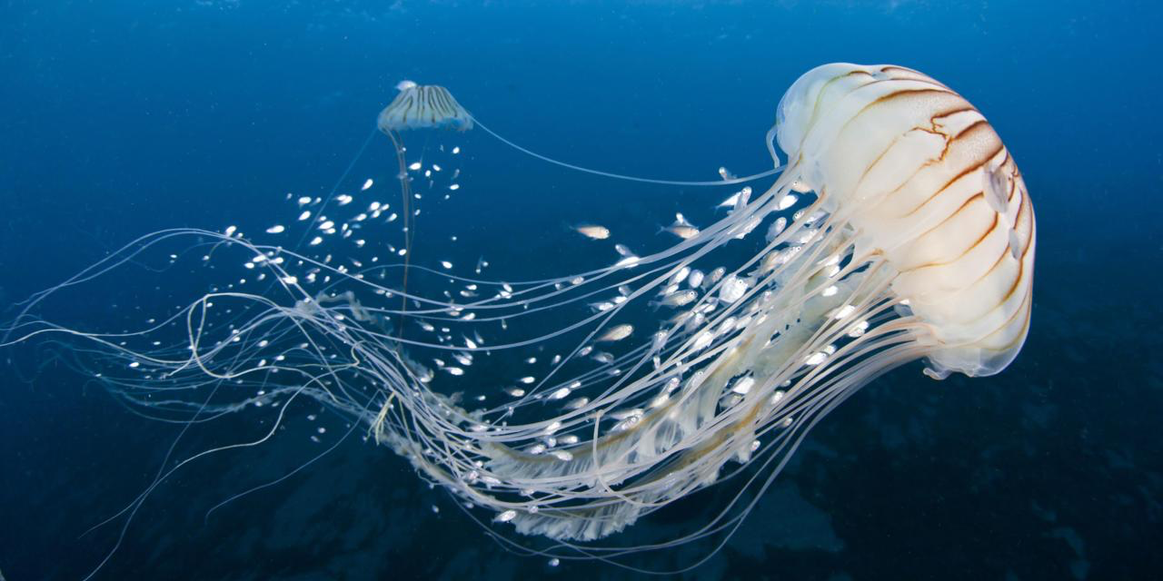
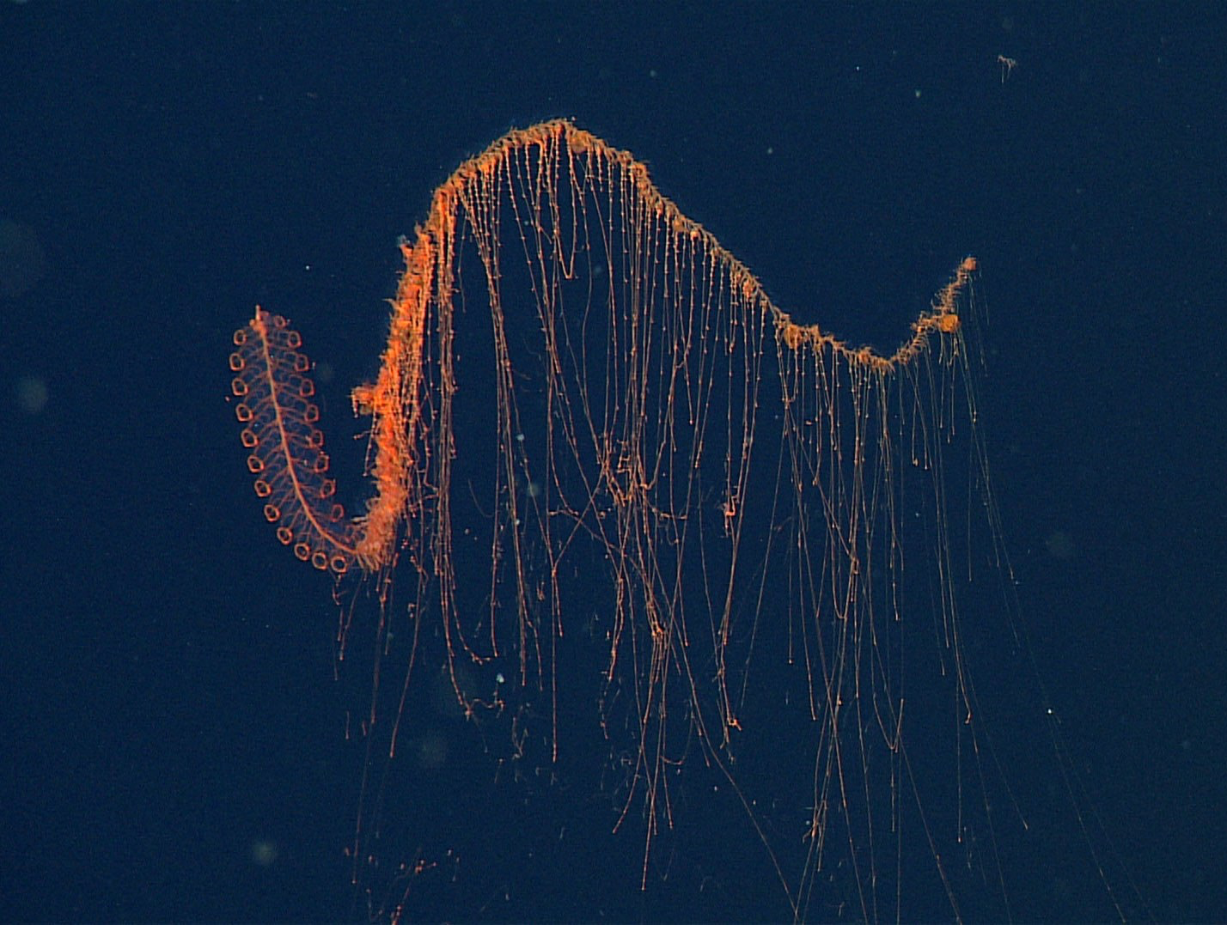
Phylum Cnidaria
Coral
Anemone
Siphonophore
Jelly

Slide 4
Cnidarians (Phylum Cnidaria)
Basic characteristics:
Stinging cells
Radial symmetry
Mostly marine, about 10,000 species known
Two body forms:
Medusa – free-swimming form that is transported by water currents, mouth with surrounding tentacles positioned downwards
Polyp – attached form with mouth and tentacles positioned upwards
Two tissue layers, no organs
Epidermis covers body surface
Gastrodermis lines internal body cavity; specialized for digestion

Slide 5
Cnidarians Characteristics Continued
Nematocysts (stinging cells) within specialized cells (cnidocytes) on tentacles. Used for protection and feeding
Digestive system is incomplete (sac-like with mouth only)
Nerve net throughout body coordinates movements
Have light sensing cells, but no eyes

Slide 6
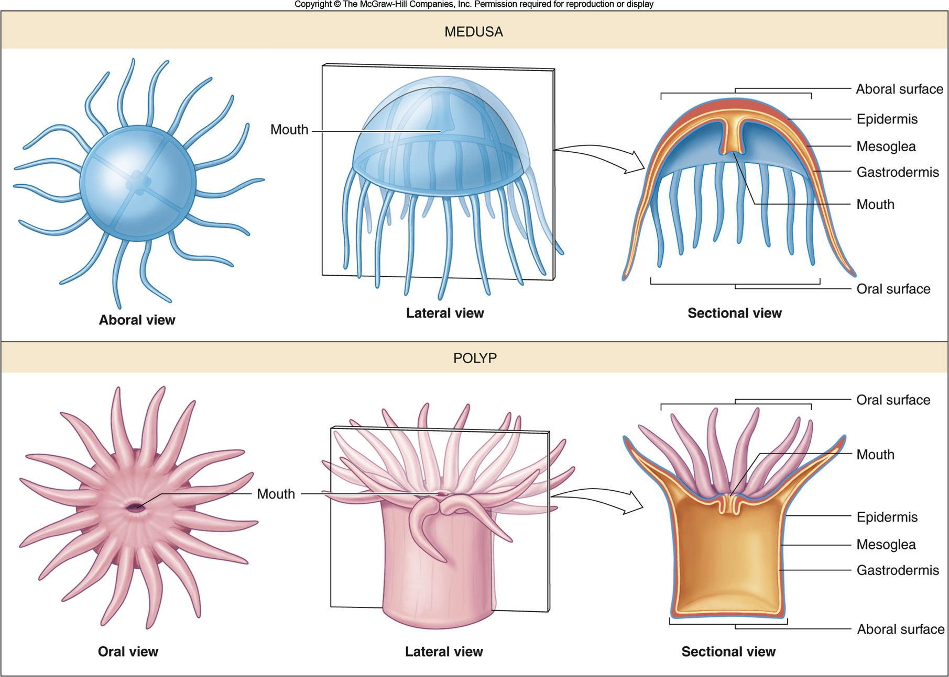

Slide 7
Classes of Cnidarians
Hydrozoans (Class Hydrozoa)
Most consist of colony of polyps, with small reproductive medusae
Siphonophores – hydrozoans that form drifting colonies of polyps
Portuguese man-of-war (Physalia) – siphonophore carried by a gas-filled float; some of the polyps with long tentacles armed with stinging nematocysts

Slide 8
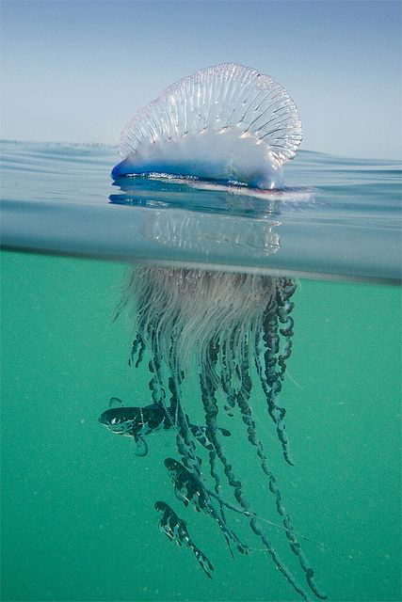
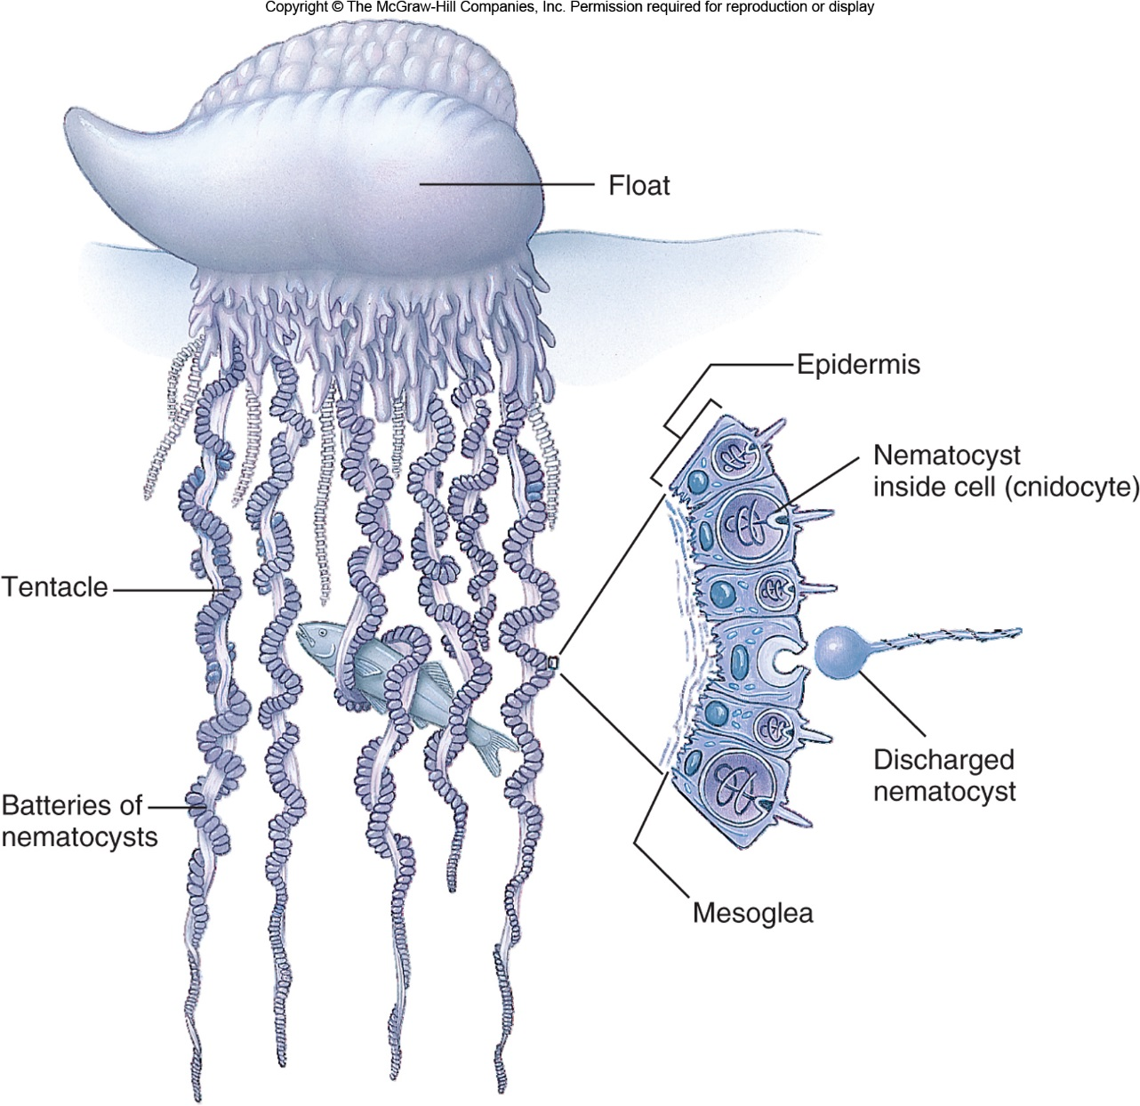
Portugese Man 0’ War
Video: http://viewpure.com/RRk3VqE9Zoc?ref=bkmk

Slide 9
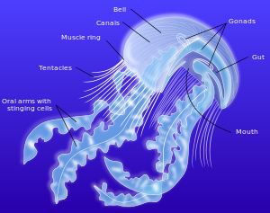
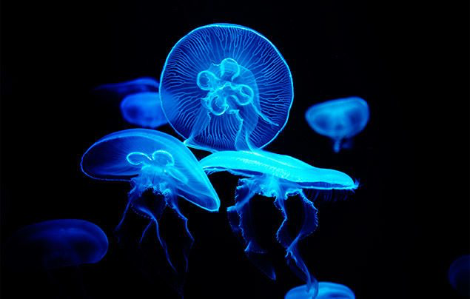
Class Scyphozoa
- jellyfishes (sea jellies)
- Large medusae with minute sessile polyps
Move by rhythmic muscular contractions of the bell, but carried by water currents

Slide 10
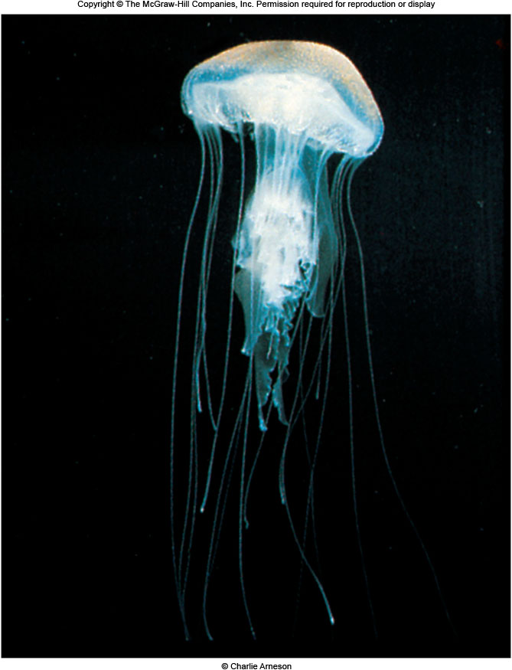
Video

Slide 11
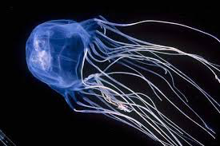
Class Cubozoa
Cubomedusae -Small medusae with tentacles armed with very powerful nematocysts that may cause death in humans
Called the Box jellyfish or sea wasp

Slide 12
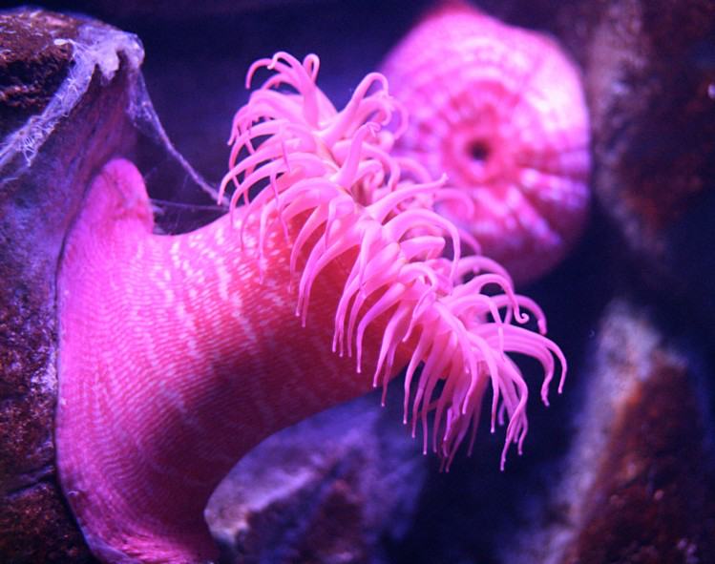
Anthozoans (Class Anthozoa)
- Corals, sea anemones, gorgonians (sea fans)
Single or colonial polyps without a medusa
Most reef-building corals are colonial: interconnected polyps that develop asexually from a single polyp
.
Anemone Video
And they WALK

Slide 13
Assignment:
Cnidarian Article on Google Classroom (Advanced)
Answer the questions on Canvas
Cnidarian Prezi

