Slide 1
Starters
What are the classes of mollusks?
What type of symmetry do mollusks have?
What is the radula used for?
What does the mantle produce?

Slide 2
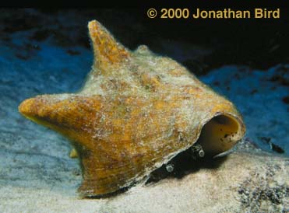
Phylum Mollusca
Snails, slugs, clams, mussels, octopus, squid, and so many more!!

Slide 3
Characteristics
Soft body
Bilateral symmetry
Body plan: coelom, organ level organization
Digestive system with 2 openings (complete gut with coelom)
Muscular Foot structure defines each class
Radula – in mouth – tongue like organ with rows of teeth used to drill, scrape, grate or cut food, in Gastropods and Cephalopods
Reproduce sexually and most have separate sexes

Slide 4
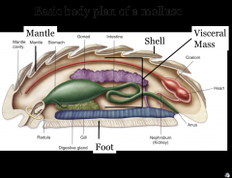
Mantle – a membrane that surrounds the internal organs of the mollusk. In shelled mollusks mantle secretes the shell.

Slide 5
Circulatory system
Well developed circulatory system with a 2-3 chambered heart.
Heart pumps blood through an open circulatory system – blood moves through vessels into open spaces around organs. Exposing body organs directly to blood with oxygen and nutrients taking away carbon dioxide and waste.
Some mollusks have a closed circulatory system (Octopus) - blood remains entirely enclosed in vessels taken to organs for gas exchange.

Slide 6
Nervous System
While many mollusks don't appear to have obvious sensory organs, most actually have a more than adequate sensory and nervous system. Not all mollusks contain a true brain, but all have either two or three pairs of nerve bundles (ganglia) that are contained within their visceral mass.

Slide 7
Bivalve nervous system
Video
Gastropod nervous system
Cephalopod nervous system: almost a brain!

Slide 8
Characteristics continued
Respiration – gills; land snails and slugs have primitive lungs
Excretion – Nephridia – organs that remove metabolic wastes from animal’s body. Mollusks have 1 or 2 nephridia that collect waste from coelom then discharge it into the mantle cavity and expel it from the body.

Slide 9
Class Bivalvia – 2 valves
Soft body enclosed between 2 valves (shells)
Examples: clams, oysters and scallops
Filter feeders
Use muscular foot to dig in mud or sand at bottom of ocean or lake
Gills with cilia that beat to draw water in through an incurrent siphon. As water moves over gills food and sediment become trapped in mucus. Cilia push food to mouth and larger particles (sediment) to mantle for expulsion.
Video: https://www.youtube.com/watch?v=Z-32RfYNbOY

Slide 10
Nacre:
Also known as mother-of-pearl, is an organic-inorganic composite material produced by some mollusks as an inner shell layer by the mantle, that also makes up the outer coating of the pearls. It is strong, resilient, and iridescent.
https://www.youtube.com/watch?v=m07OvPEoR6g

Slide 11
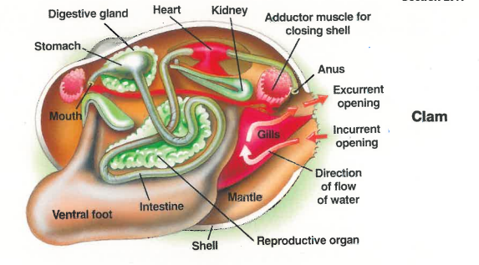

Slide 12
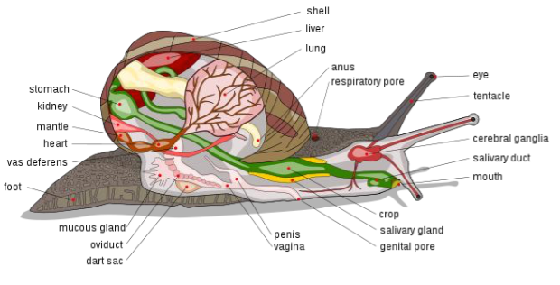
Class Gastropoda – stomach foot
Most have 1 shell except slugs
Single, coiled shell that sits above visceral mass.
Radula for grazing
Includes: snails, abalones, conchs,
periwinkles, whelks, limpets,
cowries, cones and slugs, nudibranchs
Found in fresh water, salt water and moist terrestrial habitats

Slide 13
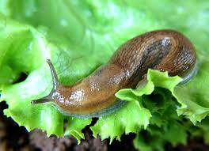
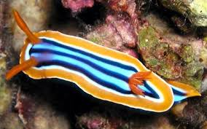
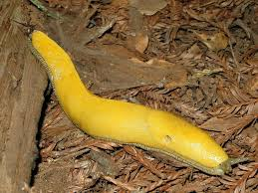
Slugs and nudibranchs: the shell-less gastropods
Slugs instead of being protected by a shell, they are protected by thick layer of mucus.
Nudibranchs are colorful sea slugs that feed on jellyfish and incorporate jellyfish tentacles into their own tissues without causing these cells to discharge.

Slide 14
Abalone video: https://www.shapeoflife.org/video/mollusc-animation-abalone
Feel free to look at Mrs. Fravel’s abalone shells

Slide 16
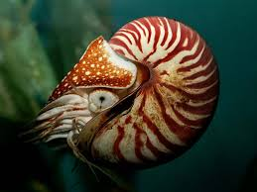
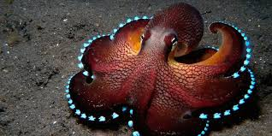
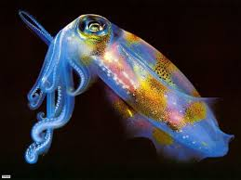
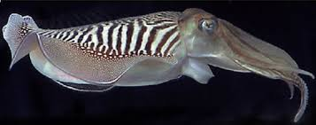
Class Cephalopoda – head footed
Octopus, squid, cuttlefish and chambered nautilus (only one with shell)
Tentacles with suckers, hooks or adhesive structures to capture prey
Beak like jaw to tear apart prey
Siphon to expel water – move quickly
“ink” squid and octopus expel to confuse predators
Notes:
https://www.youtube.com/watch?v=hcyzr3zJol4&list=PL2C20B1087548DD76&index=12

Slide 17
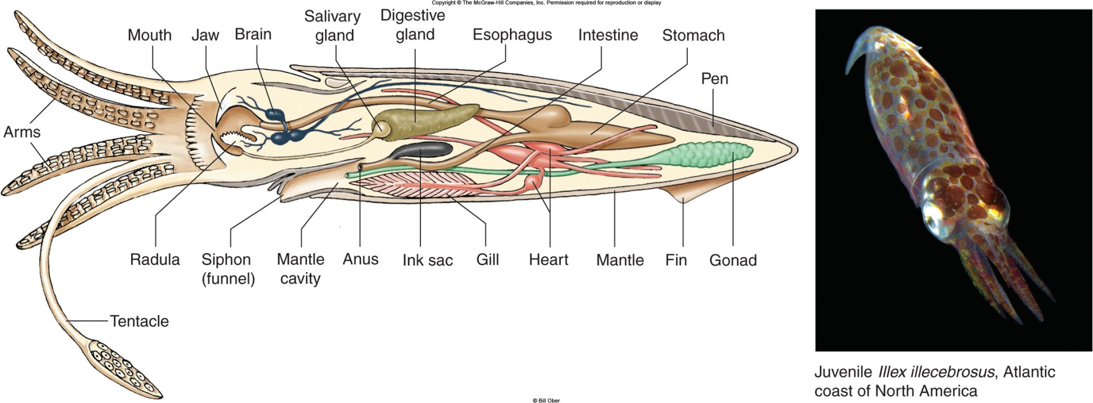
https://www.youtube.com/watch?v=rZwV0PCW2w8
https://www.shapeoflife.org/video/molluscs-survival-game

Slide 18
