Slide 1
Aquarium Field Trip Make-up
You may use a 3x5 inch card.
Download this power point, and enter your answers as a Text Entry.

Slide 2
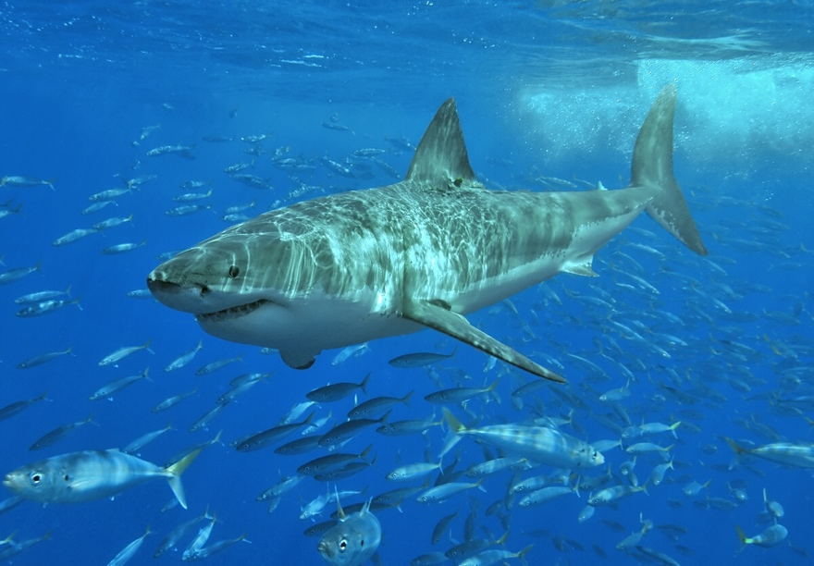
For each animal pictured, list the class and order. Describe one characteristic to justify your answer.
1
3
2

Slide 3
For each animal pictured, list the class and order. Describe one characteristic to justify your answer.
5
6
4

Slide 4
For each animal pictured, list the class and order. Describe one characteristic to justify your answer.
7
8

Slide 5
Turtle, tortoise, or terrapin?
10
11
9

Slide 6
Order Crocodilia
12. List 2 differences between alligators and crocodiles.
13. How are crocodilians’ skulls different from other reptiles?
14. What is special about crocodilians’ parenting habits?
Order Rynchocephalia:
15. How many species of Sphenodonts are extant?

