Slide 1
Starter Questions: Google classroom Please check the graded work basket and take your papers!
1. What phylum includes a dorsal nerve cord and a notochord?
Chordata
2 . What are the three subphyla in that phylum?
Urochordata, Cephalocordata, Vertebrata
3. What are the distinguishing characteristics of vertebrates?
Vertebral column and a head
4. What are the three classes of fishes?
Agnatha, Chondrichthyes, Osteichthyes

Slide 2
Fishes!!!

Slide 3
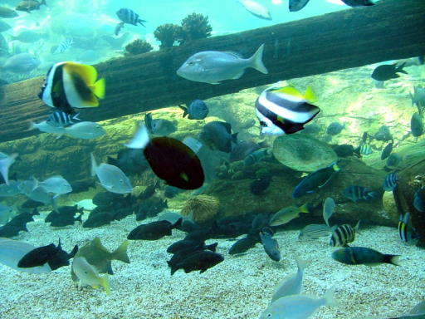
Fish
First appear in the Paleozoic Era
Devonian Period is “The Age of Fishes”: 419 million years ago to 358 mya.
Devonian
Today

Slide 4
Fish are more advanced over their invertebrate ancestors, in that they were the first to possess:
Skull
Bones (either cartilaginous or calcified)
Jaws (which evolved from gill slits)
Fins (paired appendages, different from the appendages of the invertebrates)

Slide 5
Basic Characteristics of all fish
Gills – used for respiration
Scales - shield the body of the fish from the environment, protect the fish from predators, reduce drag for more efficient movement
Fins – for movement and stability
Live in water
Ectothermic (cold blooded)- body temperature is sensitive to surrounding water.

Slide 6
3 Classes of Fishes
Agnatha: jawless fish
Chondrichtheys: sharks, rays, chimaera
Osteichtheys: lobe-finned and ray-finned fish

Slide 7
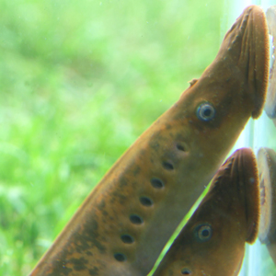
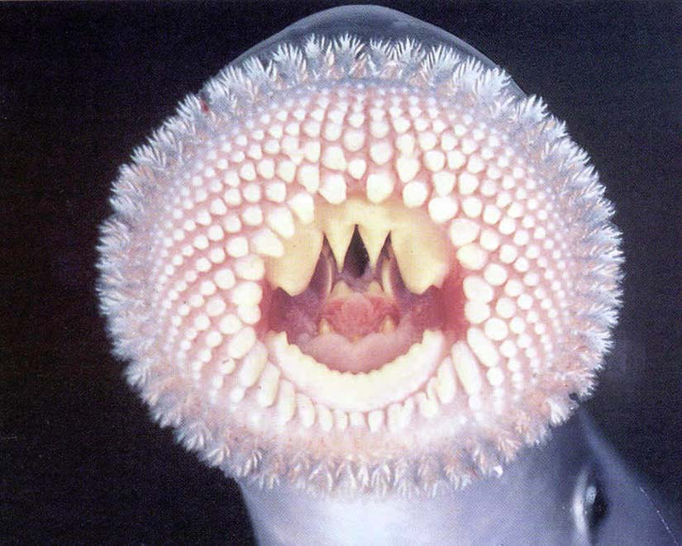
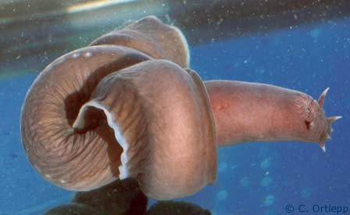
Class Agnatha: Lampreys & hagfish
Characteristics:
No paired fins
No scales
No jaws – jawless
Cartilage skeletons

Slide 8
Assignments
On Canvas:
Agnatha reading and questions
Agnatha flyer
Due Tuesday 2/19

