Slide 1
Starter: Mollusca Quiz on Canvas

Slide 2
Phylum Echinodermata

Slide 3
Echinoderms (Phylum Echinodermata)
Basic characteristics:
Pentamerous (based on five parts) radial symmetry
Water vascular system with tube feet for locomotion and feeding
Skin gills for respiration
Nervous system is decentralized: brain is absent, no head
Exoskeleton; bony plates embedded in skin.
Many can easily regenerate lost body parts
All 7,000 species are exclusively marine

Slide 4
Types of Echinoderms
Sea stars (Class Asteroidea)
Characteristics:
Move with tube feet
Have a central disc in center of body surrounded by five arms (or multiples of 5 with as many as 50 arms)
Internal organs extend through the entire body, including the arms
Calcium carbonate plates are loosely embedded in spiny skin making them slightly flexible
Pedicellariae – pincer-like organs that keep skin clean
Mostly carnivores

Slide 5
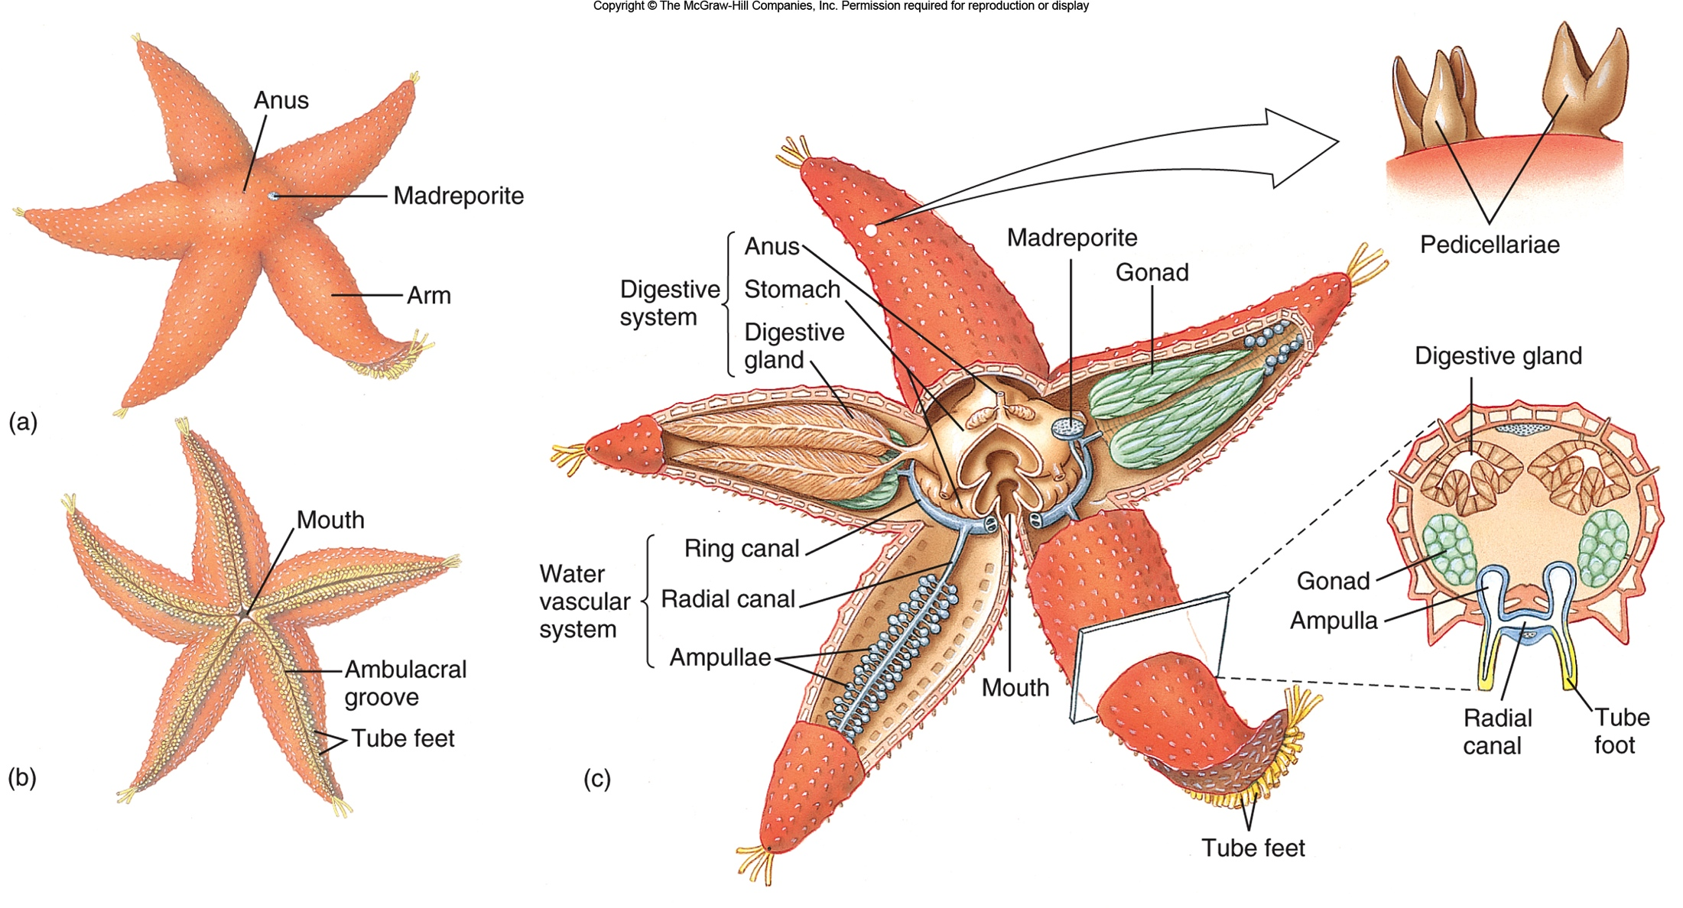
Sea Star (Asterias vulgaris)

Slide 7
Types of Echinoderms
Sea Urchins, Sand Dollars (Class Echinoidea)
Characteristics:
Conspicuous, movable spines (short in sand dollars)
Rigid plates fused into a solid test
Move with tube feet
Mouth on the bottom, anus on top of body
Biting mouth for grazing with Aristotle’s lantern, a feeding structure of jaws and muscles
Feed on seaweeds, detritus, and encrusting organisms they scrape off surfaces

Slide 8
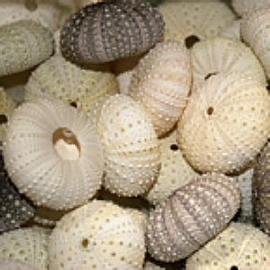
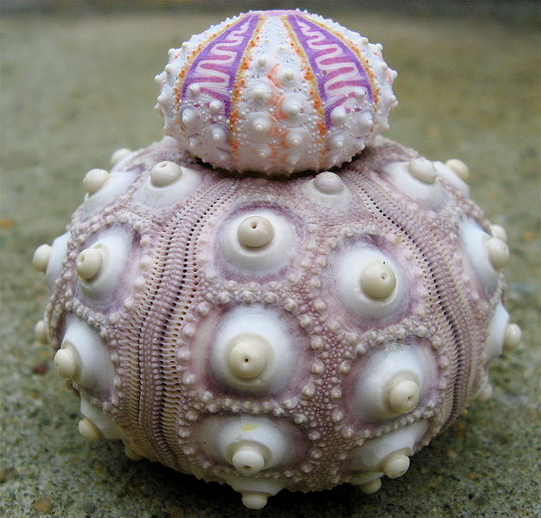
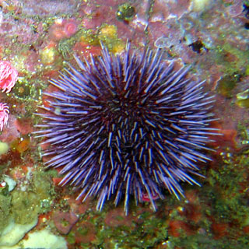
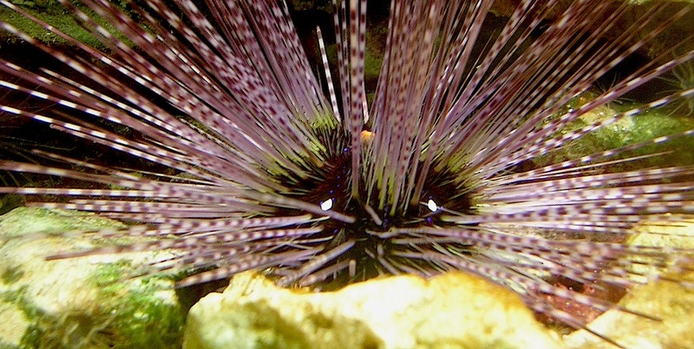
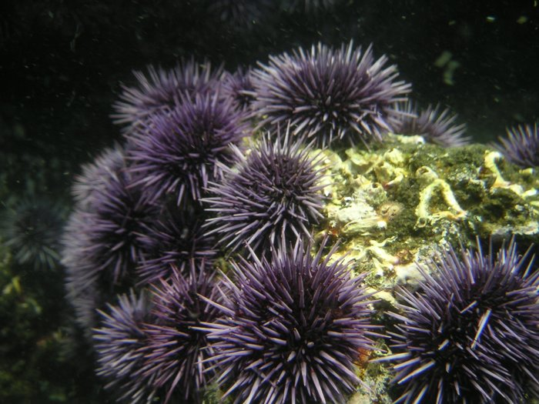

Slide 9
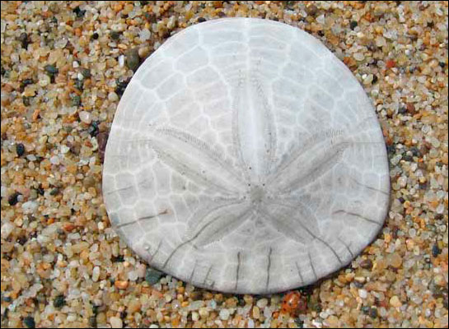
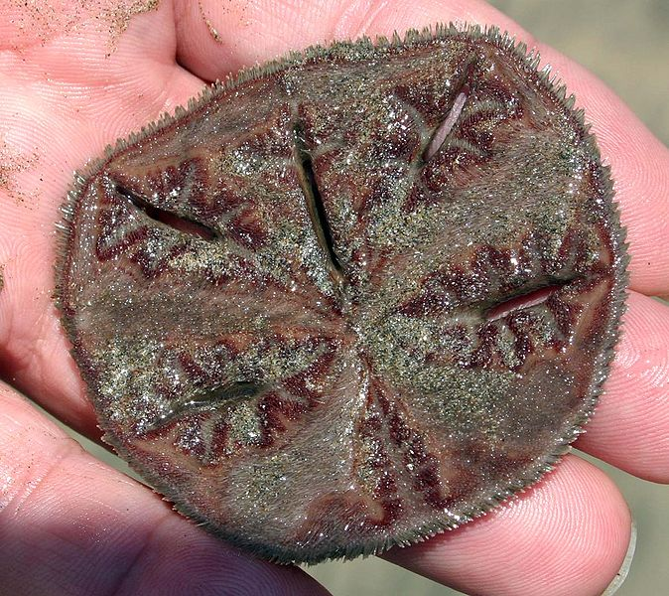
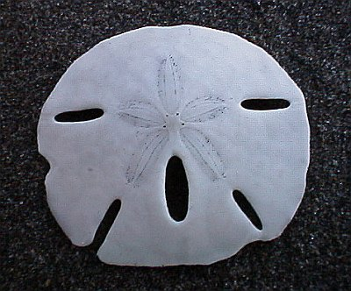
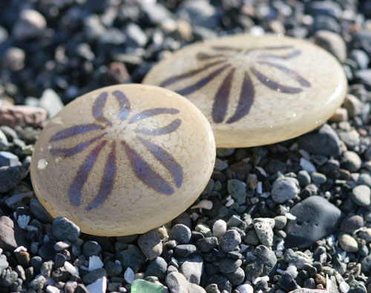
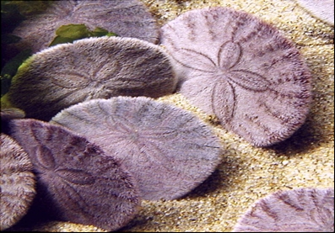

Slide 10
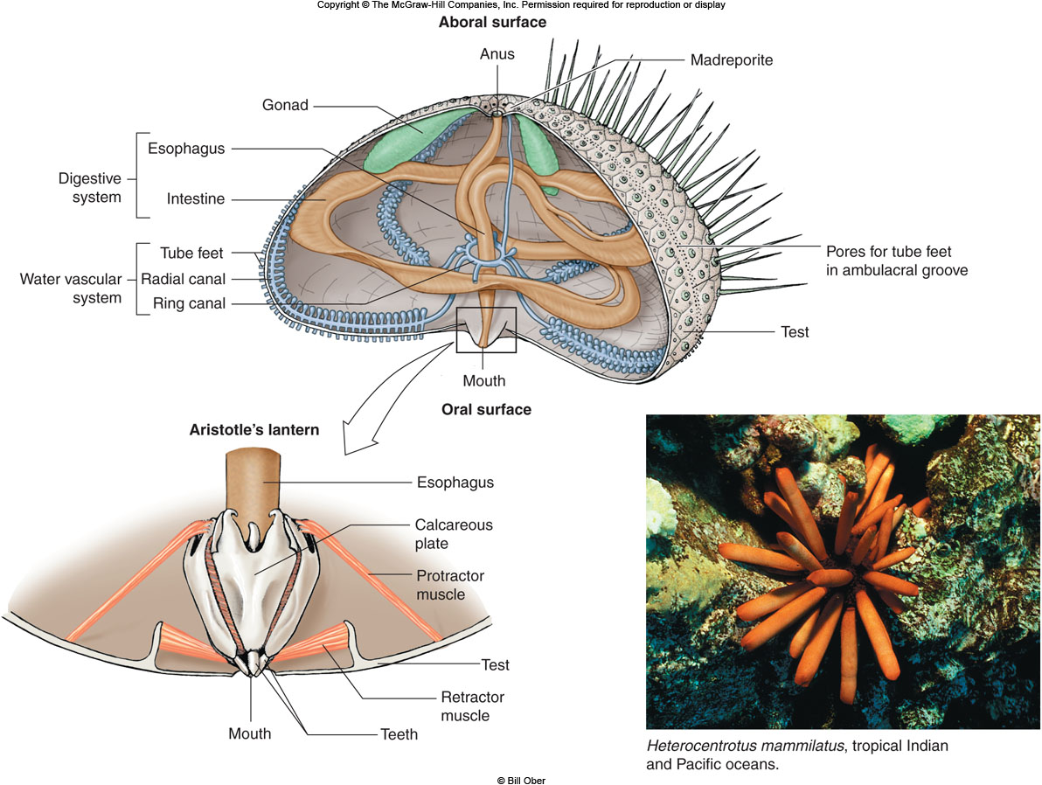

Slide 11
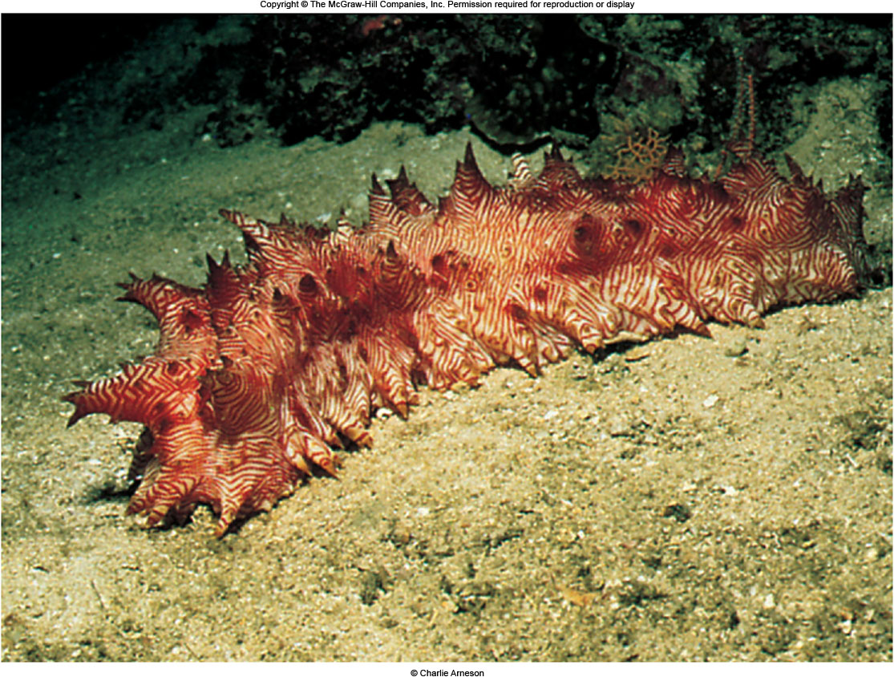
Types of Echinoderms
Sea cucumbers (Class Holothuroidea)
Worm-like, with mouth and anus on opposite ends and five rows of tube feet restricted to one side
Still radially symmetrical even if superficially appearing to have bilateral symmetry
Skin embedded with calcareous spicules, no spines
Deposit feeders, most species obtaining organic matter from ingested sediment
Evisceration - expulsion of the internal organs when disturbed; internal organs regenerate back.

Slide 12
Evisceration

Slide 13
Types of Echinoderms
Crinoids (Class Crinoidea)
Sea lilies live attached in deep water, feather stars crawl on the bottom and live mostly in shallow-water coral reefs
Five or more arms that branch out for suspension feeding
Mostly in deep water but many inhabit coral reefs inhabitants in the tropics
Some use a mucous net to aid in food capture

Slide 14
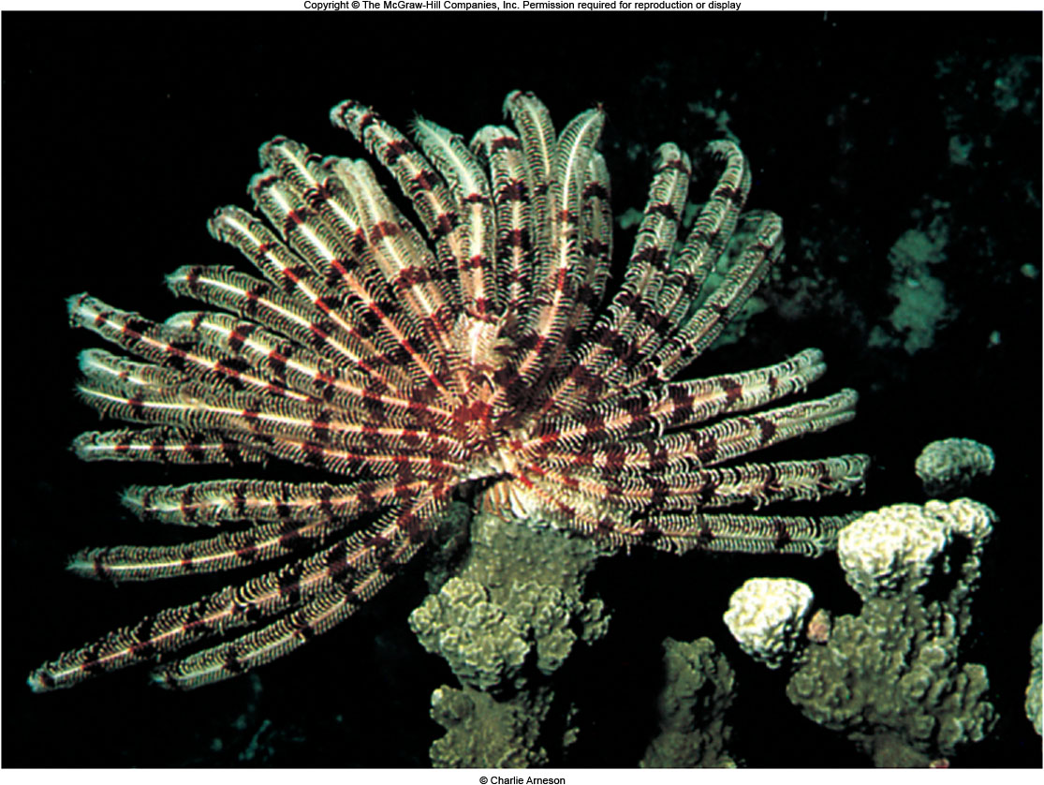
VIDEO

Slide 15
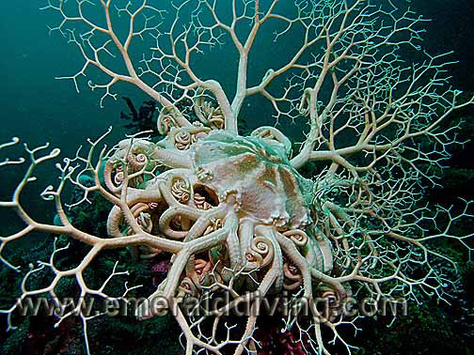
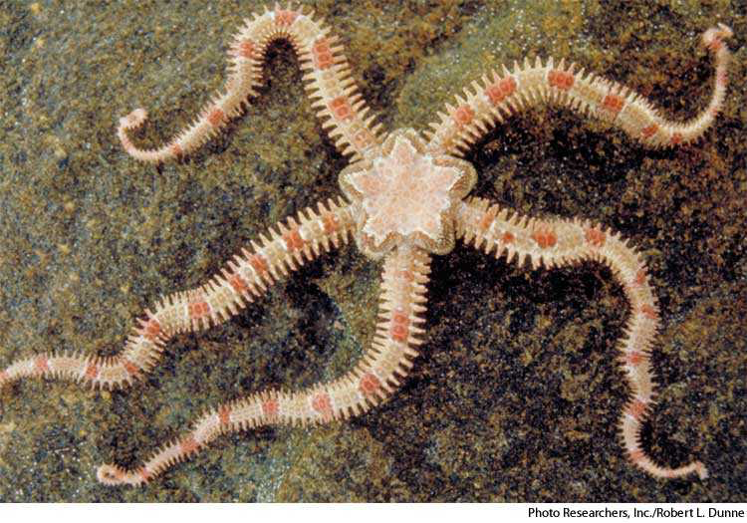
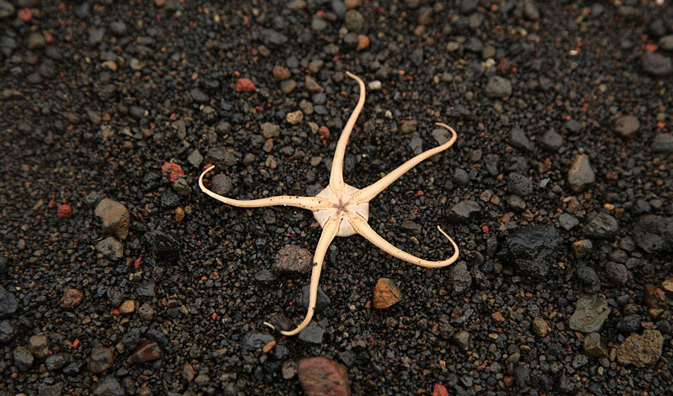
Ophiuroideans
Brittle Stars and Basket stars (Class Ophiuroidea)
Central disc surrounded by thin, flexible arms
Internal organs are restricted to the central disc
Tube feet without suckers used for feeding on detritus and small animals
Echinoderm video

Slide 16
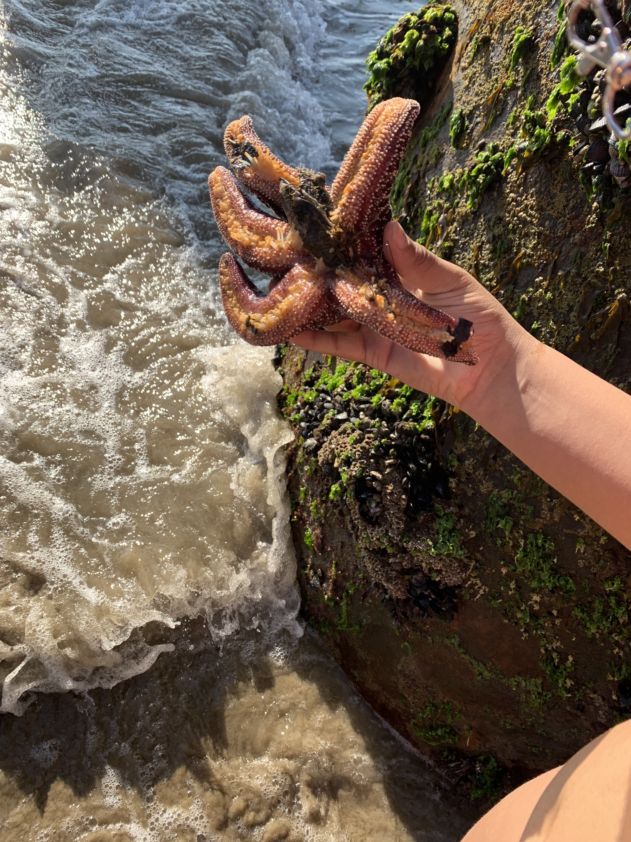
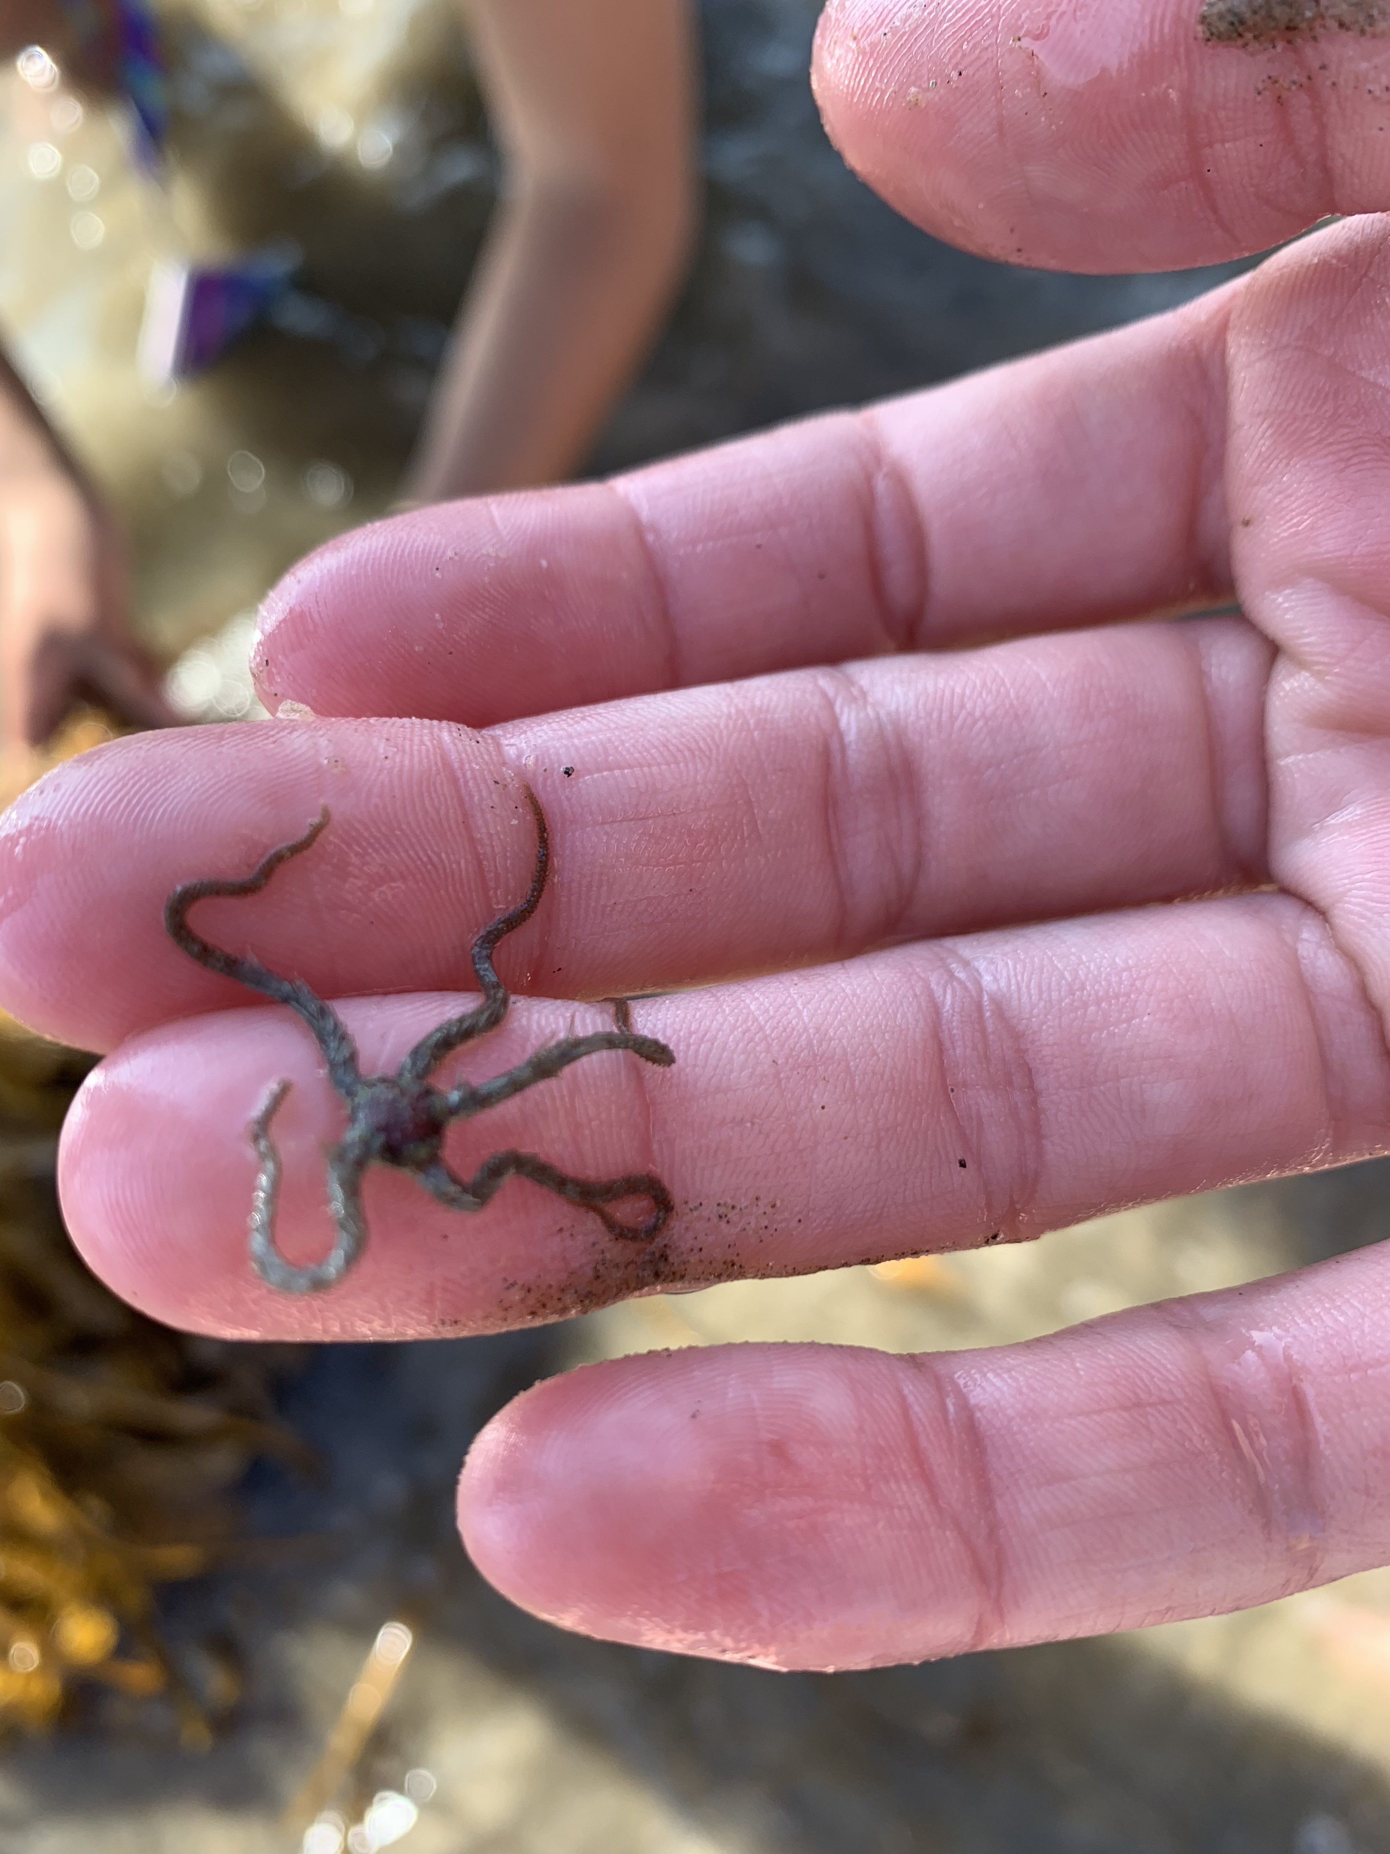
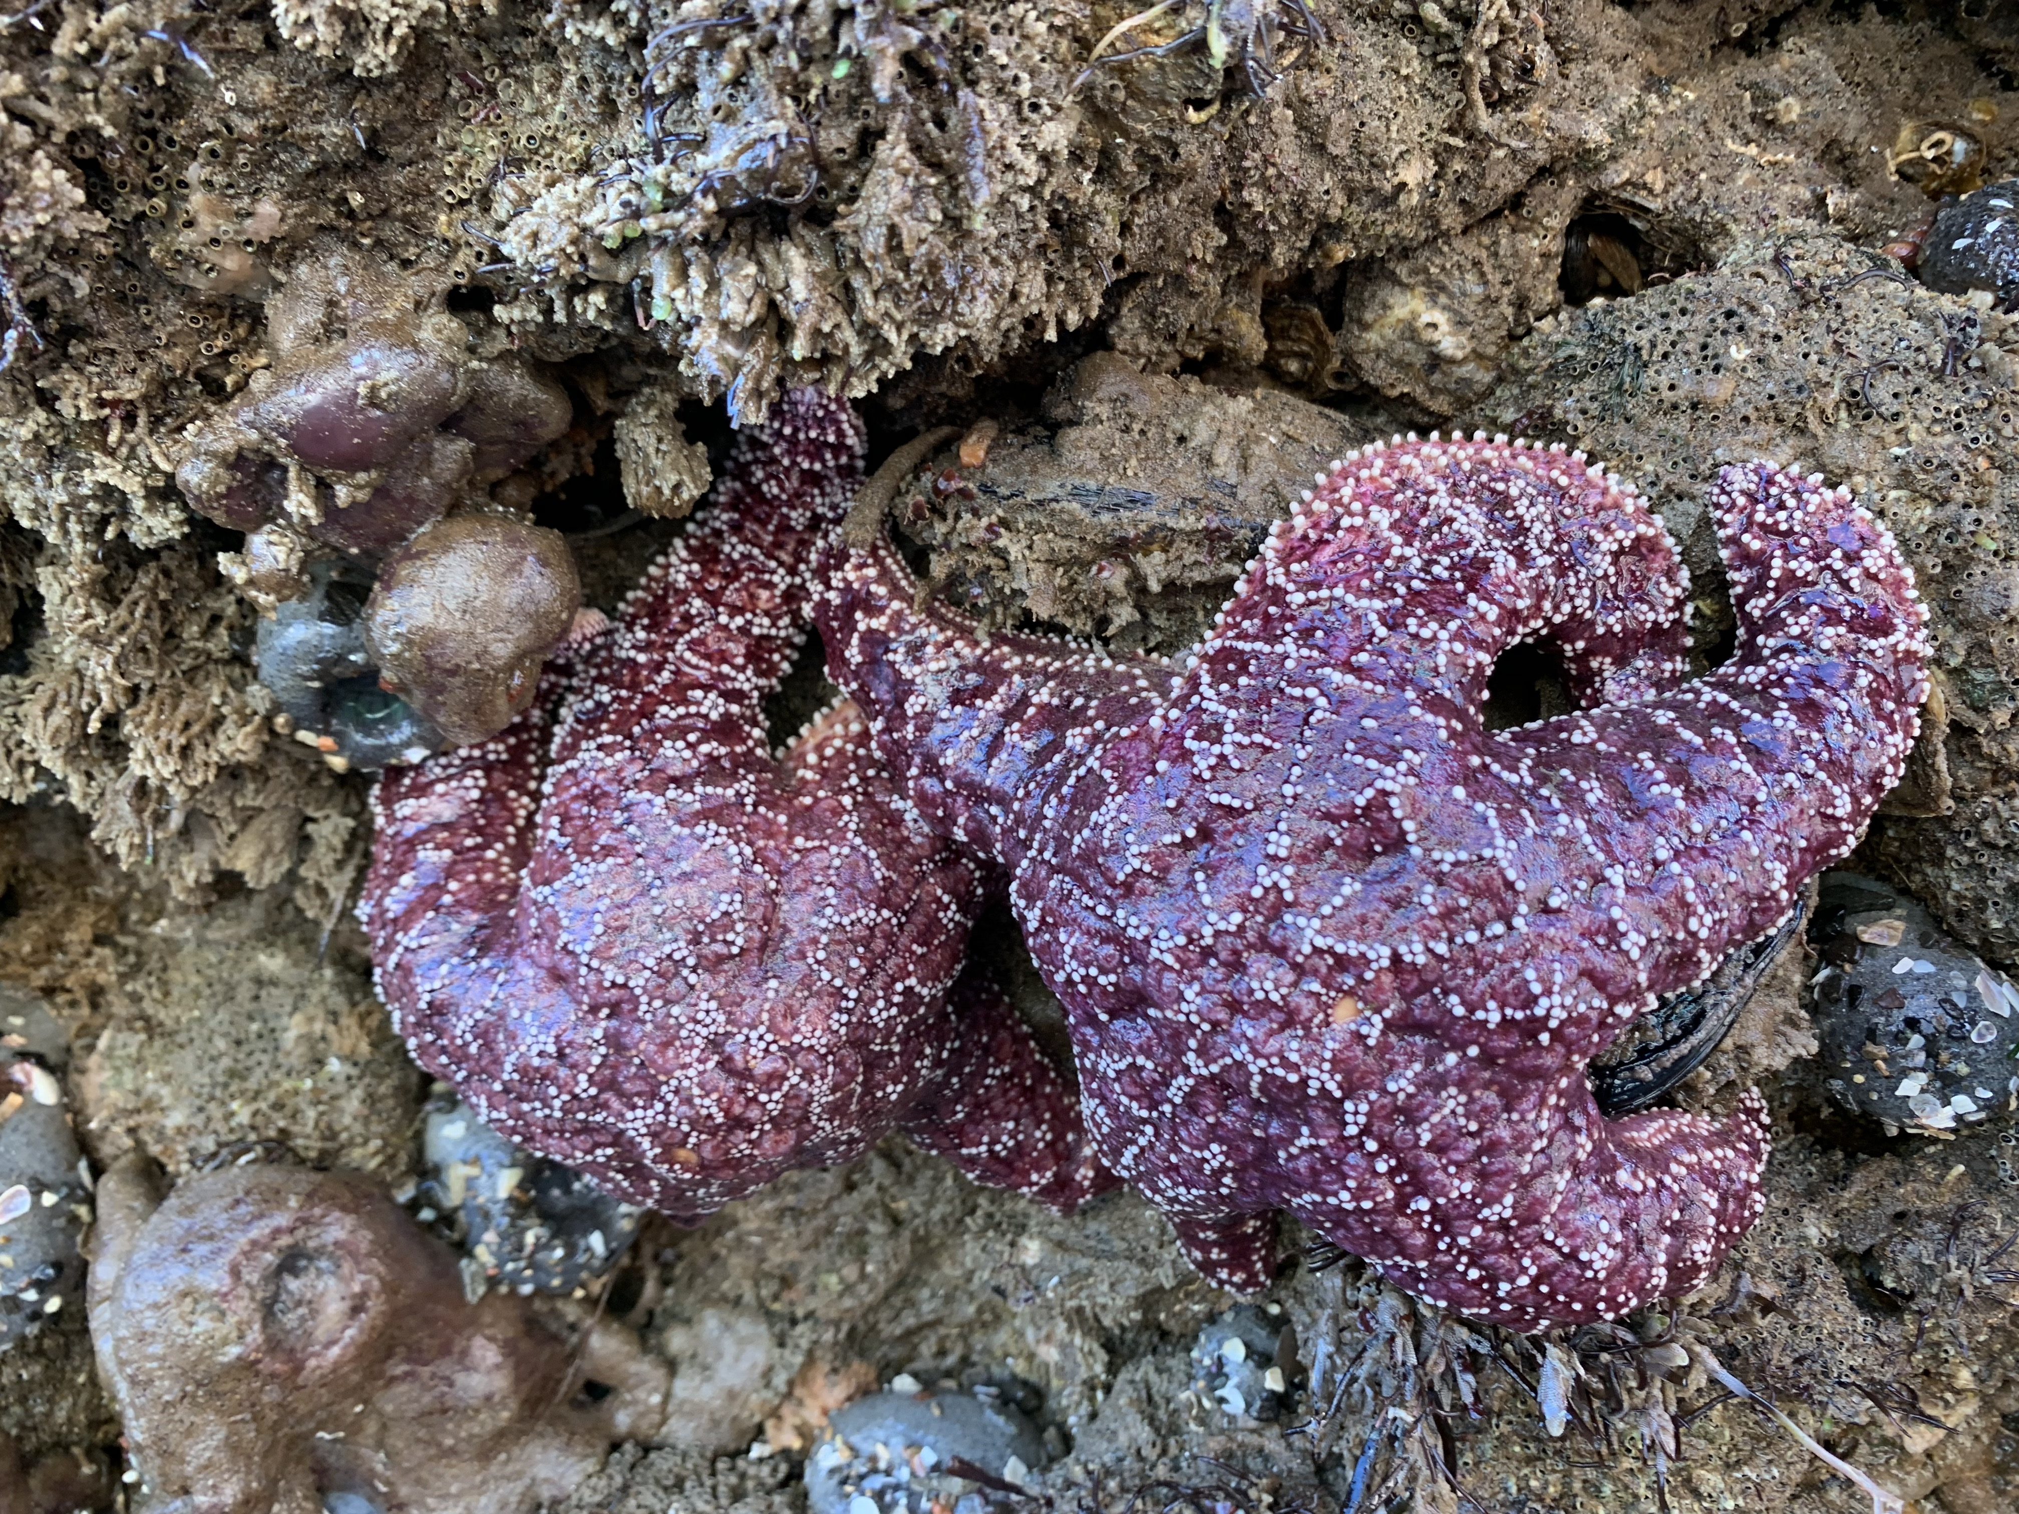
My echinoderm encounter in Carpinteria, CA

Slide 17
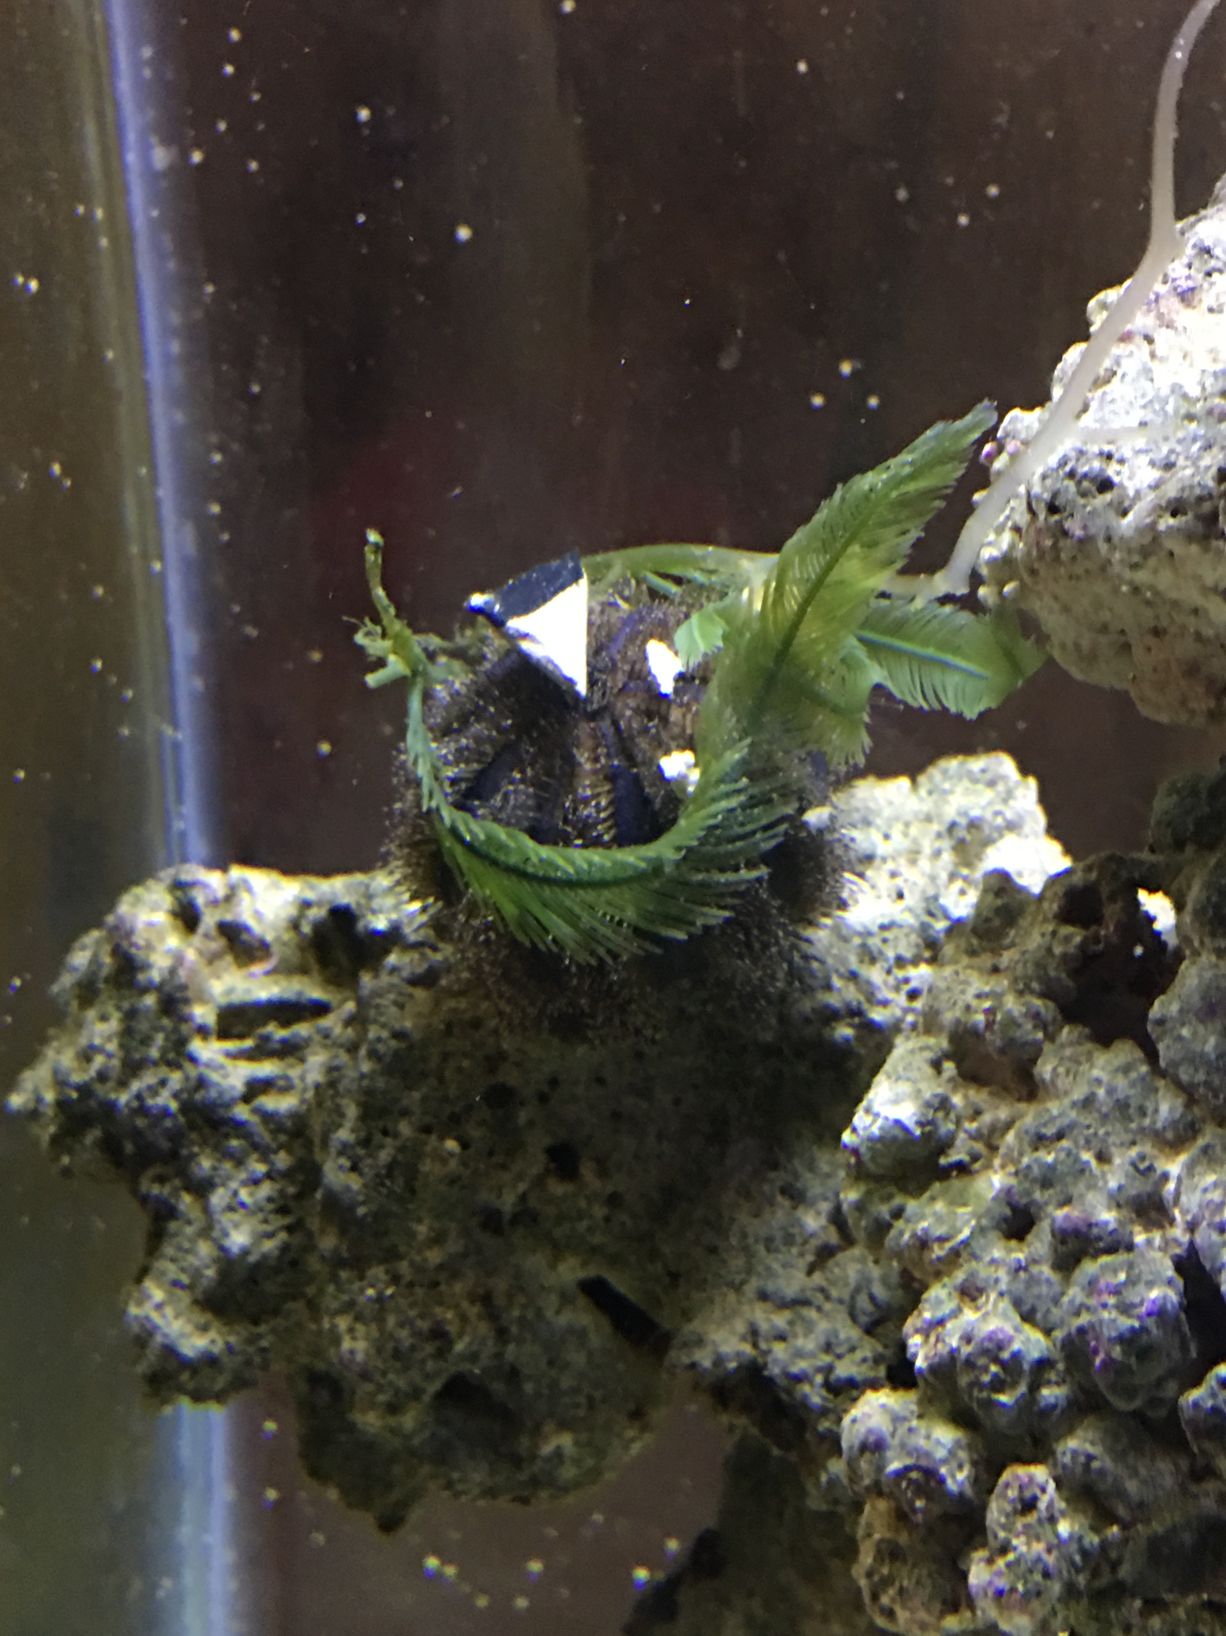
Fancy the tuxedo collector urchin (RIP)

Slide 18
Assignments: Due Thursday 11/7
Turn in your notes
Echinoderm packet

