Slide 1
Starter Question
Get your computer
Go to classroom.google.com
Answer the 3 starter questions that are due today

Slide 2
Starter Questions
What kingdom do all animals fall into?
Animalia
What are the phyla in the kingdom Animalia?
Porifera, Cnidaria, Platyhelminthes, Nematoda, Annelida, Arthropoda, Mollusca, Echinodermata, Chordata
What is the name of the process of cell division? What is the name of the process that creates gametes?
mitosis
meiosis

Slide 3
Animal Bodies and Systems

Slide 4
What Is An Animal?
Kingdom Animalia divided into two major groups:
Invertebrates
An invertebrate is an animal without a backbone.
About 98 percent of all animals are invertebrates.
Vertebrates
Only about two percent of all animals are vertebrates
Belong to the Phylum Chordata
include fish, amphibians, reptiles, birds, and mammals

Slide 5
Animal Characteristics
1. multicellular and have eukaryotic cells
2. heterotrophic.
3. Reproduce sexually and have embryonic development
4. motile during at least part of their life cycle
5. quick response to stimuli

Slide 6
Levels of Physical Organization
Animals have different levels of organization.
Cellular organization: just an aggregate of different cell types
Poriferans (sponges)
Tissue level organization only
cnidarians
Others are complex with organs and organ systems.

Slide 7
Levels of Organization: Cells
Animal Cells:
Eukaryotic with protoplasmic organization (have organelles and cytoskeletons)
Cell membrane, no cell wall
Flexible and can take many shapes
Lysosomes and centrosomes

Slide 8
Life Cycles
All animal life cycles consist of haploid and diploid cell stages
As a fertilized zygote, a juvenile, and an adult= diploid
Egg and sperm (Sex cells) = haploid
All animals have sex cells that are haploid and are produced by meiosis.

Slide 9
Embryonic Development
Fertilization leads to the formation of a zygote
Cleavage: mitotic cell divisions transform the zygote into a hollow ball of cells, a blastula.
Gastrulation, forming a gastrula (hollow ball of cells) with either two or three layers (the germ layers).
,these progenitor cells differentiate into all adult tissues and organs
VIDEO: salamander development
1. Blastula
2. Gastrula

Slide 10
Germ layers
a primary layer of cells that form during embryonic development
Give rise to all the tissues and organs
Diploblastic
Some animals have 2: the ectoderm and endoderm
Triploblastic
animals that have 3 layers: ectoderm, mesoderm, endoderm

Slide 11
Behold, the gastrula!
The ectoderm gives rise to the skin covering, to the nervous system, and to the sense organs.
The mesoderm produces the muscles, excretory organs, circulatory organs, sex organs (gonads), and internal skeleton.
The endoderm lines the alimentary canal and gives rise to the organs associated with digestion and, in chordates, with breathing.

Slide 12
The Blastopore: formation of a gut and body cavities
The gastrula folds in on itself
Protostome: blastopore develops into the mouth of the organism
Playtyhelminthes, nematodes, mollusks, annelids, arthorpods
Deuterostome: blastopore develops into the anus
Echinoderms and Chordates

Slide 13
Coelom
Body cavity: tube within a tube
Holds the organs other than the digestive tract
Organs formed inside a coelom can freely move, grow, and develop independently of the body wall while fluid cushions and protects them from shocks.
And now, a video of all of that again, from someone more interesting.

Slide 14
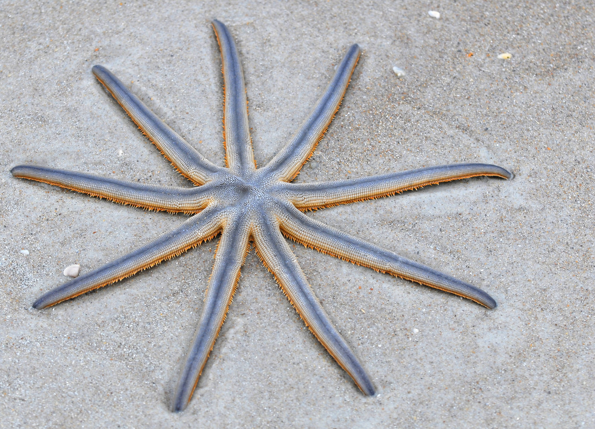
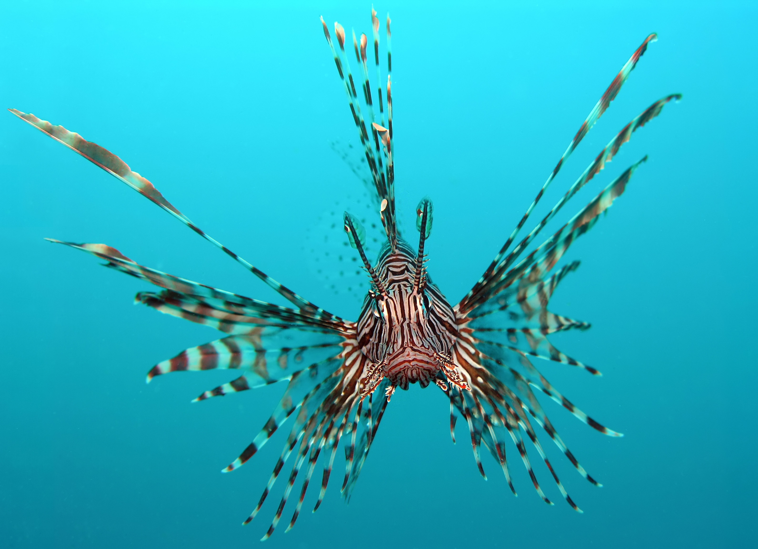
Animal Body Plans and Symmetry
Symmetry - The arrangement of an animal’s body parts
Asymmetrical – No body plan.
Radial symmetry - body parts are arranged in a circle around a central point.
Bilateral symmetry - body consists of two similar, mirrored halves.

Slide 15
Assignment
1. Body Plans and Evolution worksheets
Get a Biology book!

