Slide 1
Phylum Arthropoda Subphylum Chelicerata
Classes Arachnida, Pycnogonida, Meristomata

Slide 2
Subphylum Chelicerata (arachnids, horseshoe crabs & sea spiders)
Body divided into 2 regions
Abdomen
Cephalothorax (fused head & thorax)
OR: prosthoma and opisthoma with telson
Lack jaws
Have 6 appendages in pairs & no antennae

Slide 3
Defining Appendages
Chelicerae: mouthparts
Commonly referred to as "jaws” (but aren’t true jaws)
some chelicerae, such as those found in spiders, are hollow and contain venom glands, and are used to inject venom into prey or a threat.
Pedipalps: used to aid in getting food to mouth
Walking appendages: legs

Slide 4
Class Arachnida (Spiders, Scorpions, Ticks & Mites)
Very diverse class
Most species parasitic or predatory
Many possess book lungs for gas exchange
Spiders are able to produce a strong biopolymer - silk
Chelicera in form of fangs that may deliver venom
Video on spider silk: http://www.viewpure.com/qrBBW0aoujw?ref=bkmk

Slide 5
Spiders…
Cute spider: http://www.viewpure.com/5qkzwG2lLPc?ref=bkmk
AND MERRY CHRISTMAS: http://www.viewpure.com/HYFQQB9vqPw?ref=bkmk
Tarantula
Black Widow

Slide 6
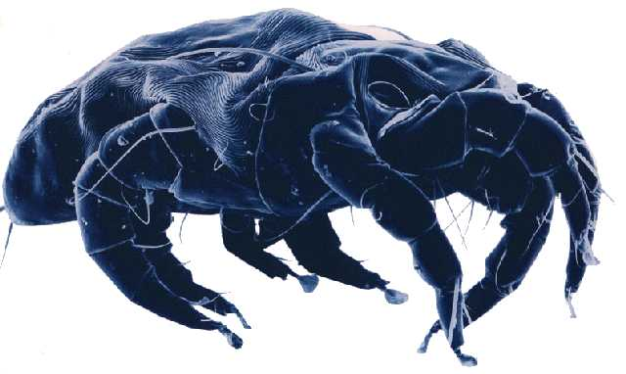
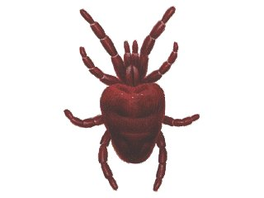
Ticks & Mites: parasites

Slide 7
Scorpions
Pedipalps have been modified to include pincers

Slide 8
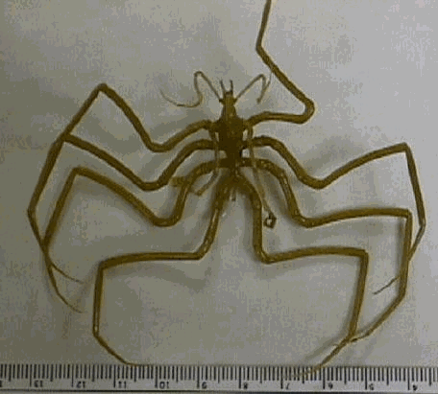
Class Pycnogonida (Sea Spiders)
Characteristics:
four pairs of long legs attached to four trunk segments..
The mouth, a triangular opening at the end of an elaborate suctorial appendage (proboscis), is often longer and larger than the body
The body size ranges from 3 millimetres (¹/₈ inch) in tropical shallow-water species to 50 centimetres (20 inches) in deepwater species
http://www.viewpure.com/NGI6UfwbNo8?ref=bkmk

Slide 9
Class Merostomata (Horseshoe Crabs)
The body of a horseshoe crab is covered by a smooth greenish to dark brown thick exoskeleton.
Aquatic, mostly found on Atlantic & gulf coasts of United States
Ancient group of species; has changed little over 350 million years
Video: http://www.viewpure.com/1Zdt7-S3kbc?ref=bkmk

Slide 10
Horseshoe crab appendages and body regions

Slide 11
Assignments:
On your existing Prezi project, add the following sections as subtopics for Phylum Arthropoda:
Subphylum Chelicerata: Characteristics.
Class Arachnida: characteristics for each class, plus an example species. Be sure to include the example species' common name, scientific name, habitat and range (where in the world it is found)
Merostomata: List the characteristics, but you don't need to do an example species (unless you want to)
Pycnogonida List the characteristics, but you don't need to do an example species (unless you want to)

