Slide 1
Phylum Arthropoda
Subphylum Uniramia

Slide 2
Starter 12/17
Please go on to Canvas and do the peer reviews for both the Crustacea and the Chelicerata Prezi assignments. If you have turned them in, you should get a review assignment for each.
If you haven’t turned them in, WHY NOT?!

Slide 3
Subphylum Unirami
(3 Classes)
Class Insecta/Hexapoda (insects)
Class Chilopoda (Centipedes)
Class Diplopoda (Millipedes)

Slide 4
Class Insecta
(the insects)
Far & away the most diverse of animal groups
  More types of insects alone than all other animal groups combined
  Mostly terrestrial, although some inhabit freshwater as part or all of their life cycle
  Success largely attributed to coevolution with flowering plants.

Slide 5
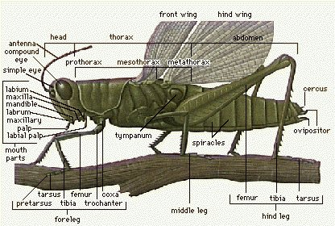
Class Insecta Characteristics and special appendages
Insects have 6 legs, 1 or 2 pairs of wings, and specialized mouthparts
  Jaw-like appendages: mandibles and maxilla; proboscis
3 body parts
  Head
  Thorax
  Abdomen
Most have wings, however in many species these are vestigal
Have advanced excretory system composed of malphygian tubules
Exchange gasses through a complex tracheal system

Slide 6
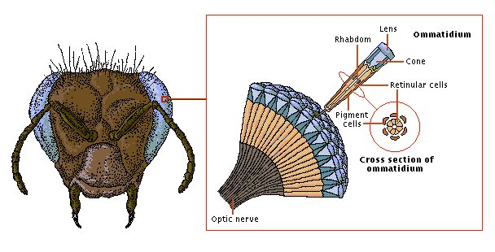
Vision
Have complex compound eye which is usually extremely sensitive to motion and allows 360⁰ vision
Most insects see well into the UV spectrum

Slide 7
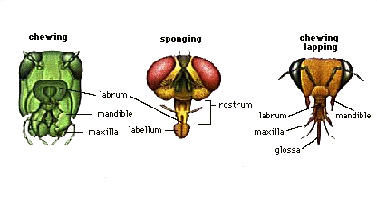
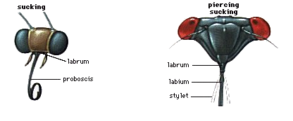
Feeding / Mouthparts
Insects usually have specialized jaws/mouthparts suited to their ecological niche
Video: https://www.ted.com/talks/anika_hazra_a_simple_way_to_tell_insects_apart?language=en

Slide 8
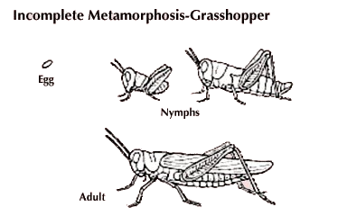
Metamorphosis
Most insects undergo a process of metamorphosis - 2 types
1: Incomplete metamorphosis
  Larva similar to adult, with differing body proportions
  Undergoes a series of molts resulting in adult morphology

Slide 9
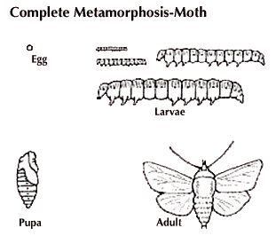
Complete Metamorphosis
Larva is very unlike adult morphology
Larvae molt many times as they grow
Final molt: Envelopes self in a coccoon or chrysalis where body breaks-down and reforms into adult form.
Bee: http://www.viewpure.com/f6mJ7e5YmnE?ref=bkmk
Butterfly: http://www.viewpure.com/euuCrnqEoeU?ref=bkmk

Slide 10
Assignment
Insects Reading and Questions on Canvas
Due next class

