Slide 1
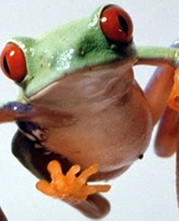
Amphibians Class Amphibia Phylum Chordata Subphylum Vertebrata

Slide 2
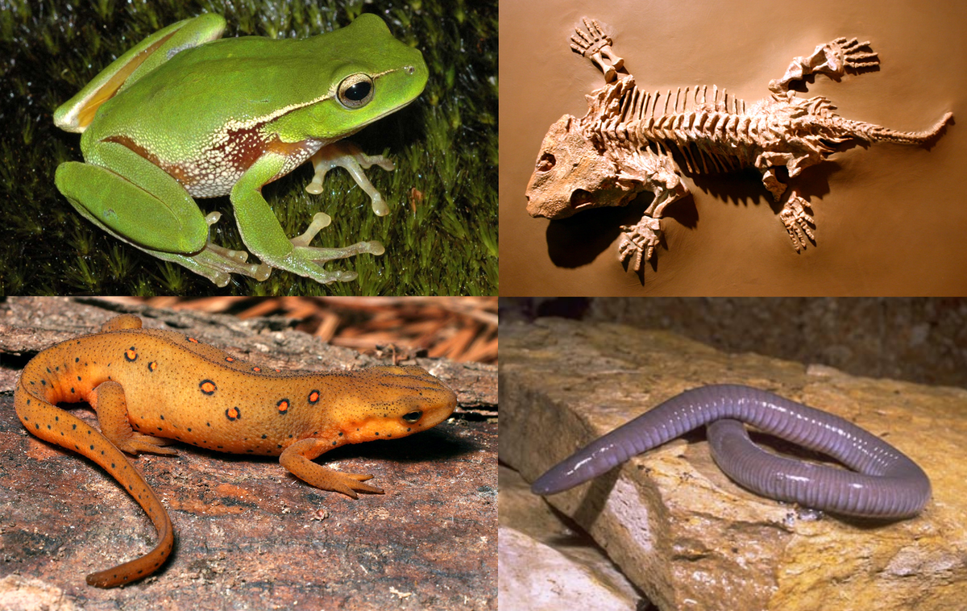
Amphibians
Animals that can live on land and in water

Slide 3
Amphibians General Characteristics
Tetrapods
Soft, scale-less skin that absorbs oxygen and water
Oviparous; lay soft non-amniotic eggs
Ectothermic

Slide 4
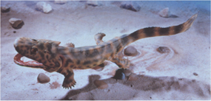
Acanthostega: the first tetrapod vertebrate
Found in 360 million year-old rocks in Greenland
Had lungs and eight-toed legs,
gills and a lateral line system.
Video

Slide 5
Adaptations help amphibians live on land
Large shoulder and hip bones help support more weight.

Slide 6
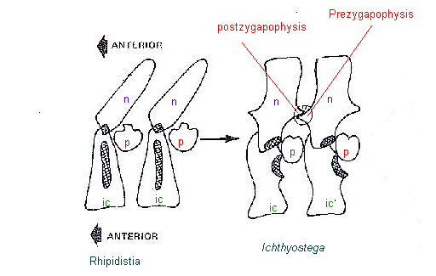
Adaptations for land
Interlocking projections on the vertebrae help keep the backbone from twisting and sagging.

Slide 7
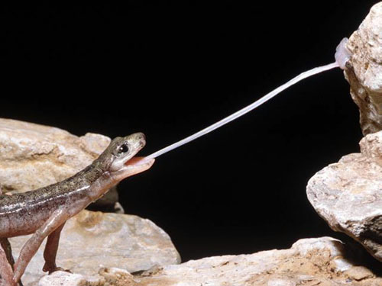
Adaptations
Mobile, muscular tongue allows amphibians to capture and manipulate food.
Video

Slide 8
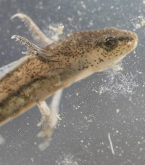
Respiration
Breathe through the skin (gas diffusion through capillary walls and skin cells)
gills or lungs

Slide 9
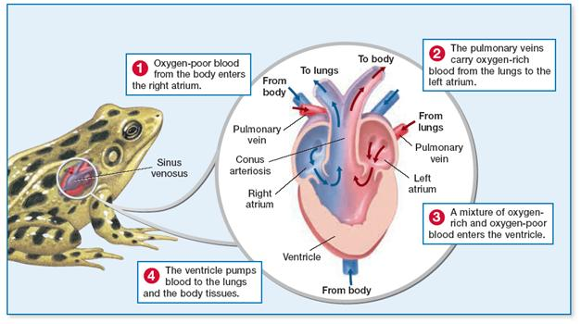
Circulatory system
Amphibians have a three-chambered heart

Slide 10
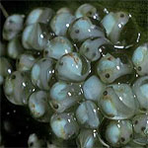
Reproduction
Internal or external fertilization depending on species
Amphibians return to the water to reproduce
Eggs do not have shells or amnion
Will dry out if not in water

Slide 11
Strategies to keep eggs wet:
Laying eggs directly in water
Laying eggs on moist ground
Wrapping eggs in leaves
Brooding eggs in pockets on the female’s back

Slide 12
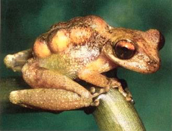
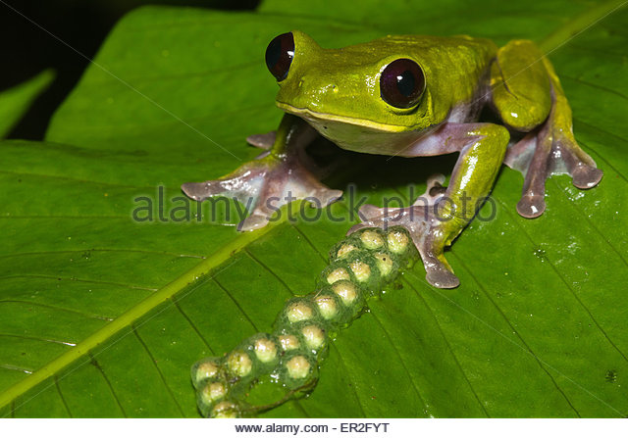
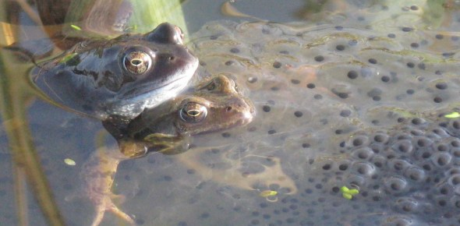
Pygmy Marsupial Frog Flectonotus pygmaeus
Suriname sea toad
Video
Laying eggs on leaf in rainforest
Laying eggs in water

Slide 13
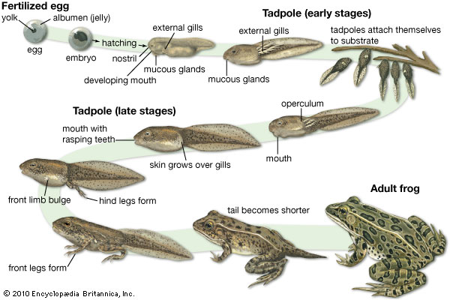
Amphibian Metamorphosis
Change in form and habits of an animal
Egg→tadpole→adult

Slide 14
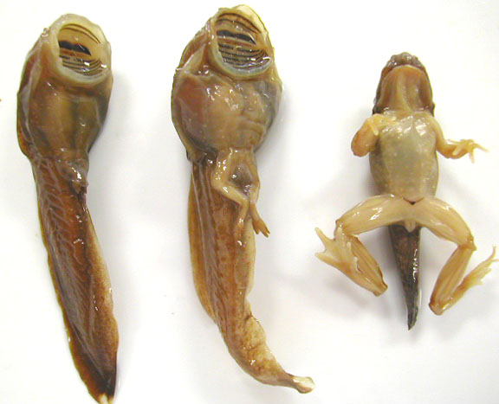

Slide 15
Tadpole into Adult Frog
It affects nearly every organ in the tadpole’s body
Gills are reabsorbed and lungs develop
Circulatory system is reorganized to send blood to the lungs
Tail fin is reabsorbed

Slide 16
Tadpole into Adult Frog
Body grows limbs and completely reorganizes its skeleton, muscles, and parts of the nervous system.
Digestive system is rebuilt to handle a carnivorous diet.

Slide 17
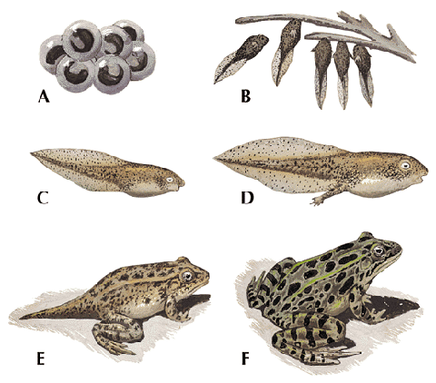

Slide 18
Three Orders of Modern Amphibians
Salamanders: Urodela or Caudata
Frogs: Anura
Caecilians: Gymnophiona

Slide 19
Assignment
Amphibian R & Q on Canvas

Slide 20
Starter Questions
1. List the general characteristics for all amphibians
Tetrapods
Soft, scale-less skin that absorbs oxygen and water
Oviparous; lay soft non-amniotic eggs
Ectothermic
2. Why was Acanthostega an important animal?
It shows the transition between fish and true land tetrapods
3. How do amphibians achieve gas exchange?
Gills, lungs, and skin

Slide 21
Amphibians Day 2: Orders

Slide 22
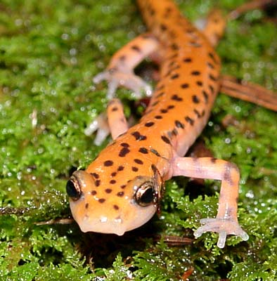
Order Caudata or Urodela: Salamanders
More than 300 species
Long body
Four walking limbs of equal size
Tail
True teeth on both jaws

Slide 23
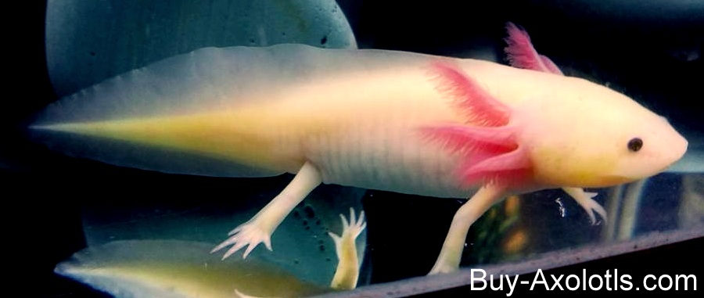
Salamanders
Walk with a side-to-side movement that may be similar to ancient tetrapods
Video: https://www.youtube.com/watch?v=MjAiWnzU2aE
Axolotle: adult retains external gills, lives underwater
Video: https://www.youtube.com/watch?v=lL87xhk63FM

Slide 24
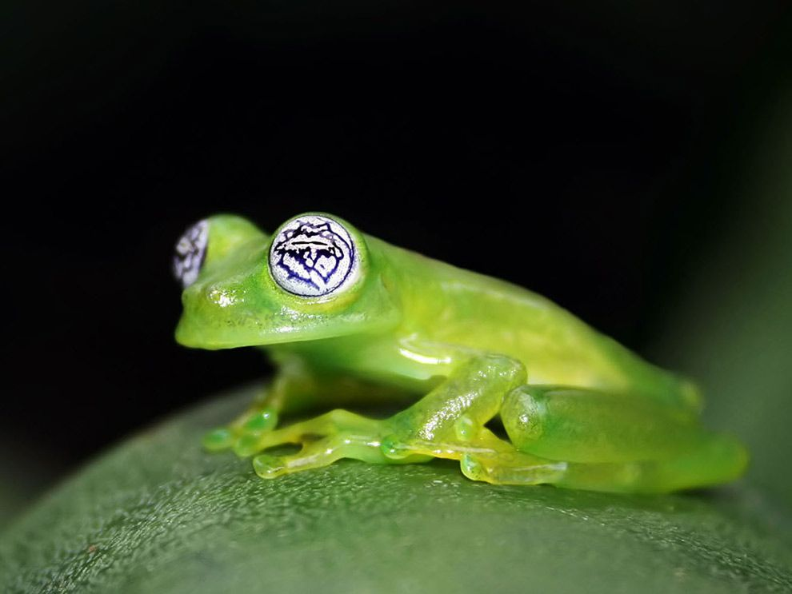
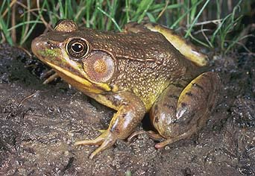
Order Anura: Frogs and Toads
Tailless bodies
Long, muscular hind limbs
Webbed feet
Exposed eardrums
Bulging eyes
Many species have glands that make toxins that protect them from predators

Slide 25
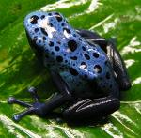
Frogs
Characteristics:
bulging eyes
strong, long, webbed hind feet that are adapted for leaping and swimming
smooth or slimy skin
Teeth in top jaw
Tympanum: external ear drum
Over 3000 species
Largest group of living amphibians
Generally live in moist environments

Slide 26
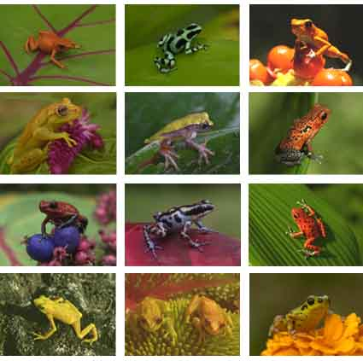
Frogs
Live in every environment on Earth except at the poles and the driest deserts.

Slide 27
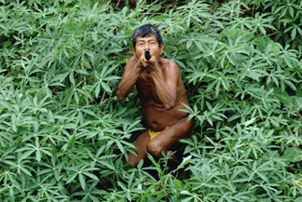
Golden Poison Arrow Frog
Produce a neurotoxin in their skin. Used by humans in weapons

Slide 28
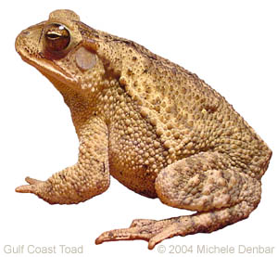
Toads (family Bufonidae)
Rougher, bumpier skin
Shorter legs- not good jumpers
Fat, stubby bodies
Can live in dry environments
Most lack teeth
Boreal toad
Fowler’s toad

Slide 29
Frogs vs. Toads

Slide 30
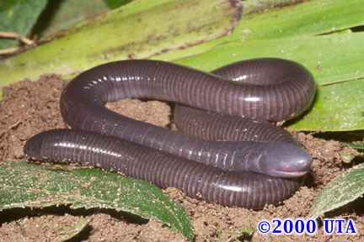
Order Gymnophiona: Caecilians
Legless, burrowing amphibians
Live in the tropics, such as South America
Characteristics:
Elongated body without legs or reduced limbs
Small scales
Blind or reduced eyes
Terminal anus (no tail)
No external ear

Slide 31
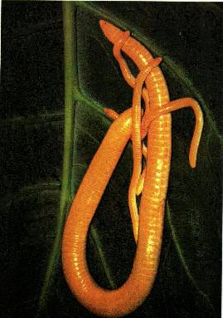
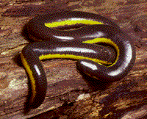
Caecilians
160 species
Range from 4 inches to 5 feet
Banded bodies that make them look like giant earthworms
Are predators
Search for earthworms and grubs
Have no arms or legs for burrowing, so have to move like an earthworm.
Video

