Slide 1
Cartilaginous Fishes
Elasmobranchs and Chimaera

Slide 2
Cartilaginous Fishes (Chondrichthyes)
Sharks, rays, skates, and ratfishes
Basic Characteristics:
Skeleton of cartilage
Heterocercal tail: one lobe generally larger
Mouth is always ventral
Placoid scales and fleshy fins
5-7 gill slits open directly into the water in most species
Spiracles in many species (openings on head used to bring water for respiration without having to open the mouth)
Males in most species have claspers, projections of the anal fin used in copulation
Buoyancy aided by oils in tissues and liver

Slide 3
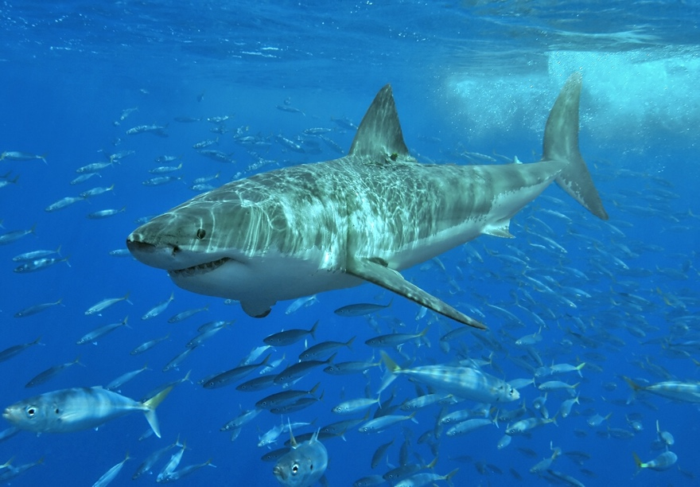
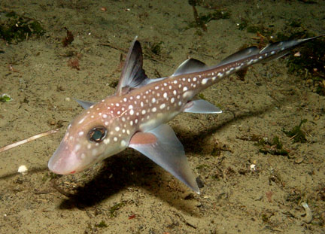
Chondrichthyes
White shark
Stingray
Ratfish (chimaera)

Slide 4
The Elasmobranchs (Subclass Elasmobrachii)
Sharks, rays, sawfish
Characteristics:
five to seven pairs of gill clefts opening to the water (no opercula)
rigid fleshy fins
The teeth are in several series and are not fused to the jaw
Teeth are actually modified scales
the upper jaw is not fused to the skull

Slide 5
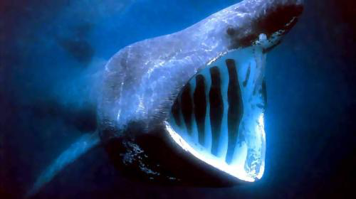
Species
There are over 360 species of sharks!
They can range in size from small enough to fit in your hand to up to 46 feet!!
Smallest Shark is the Pygmy Shark (Euprotomicrus bispinatus)
Feed on small fish, squid, etc. Can dive to 2000 m.
Largest Shark is the Whale Shark (Rhincodon typus)
Filter feeder, feeds on plankton
And of course, this guy
And here he is again with whale sharks
Megamouth shark

Slide 6
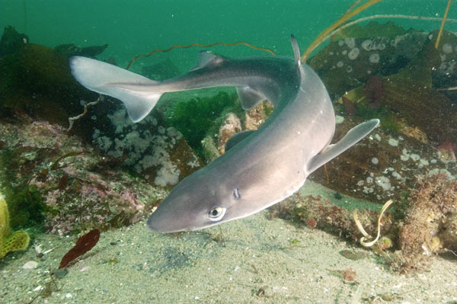
Life Span
Lifespan varies by species
Most live about 20 – 30 years
The spiny dogfish can live up to 100 years
It is thought that the whale shark can live over 100 years as well
The oldest known vertebrate is a Greenland Shark, thought to be over 400 years old.

Slide 7
Shark Reproduction
May be oviparous (lay eggs) or ovoviviparous (give birth to live young)
Mermaid purses:
Live birth (lemon shark)

Slide 8
Rays (Batoidea)
Myliobatis californica
this group includes skates, electric rays, butterfly rays, round rays, manta rays, guitarfish, stingrays, and sawfish.
not all rays are stingrays
Pectoral fins modified into large wing-like appendages
Can be filter feeders or predators
Pristis pristis
My favorite video

Slide 9
Chimaera
Ghost shark Hydrolagus bemisi
Ghost sharks, ratfish, spookfish, rabbitfish
elongated, soft bodies with a bulky head
single gill-opening
grow up to 150 cm (4.9 ft) in length, although this includes the lengthy tail found in some species.
In many species, the snout is modified into an elongated sensory organ
Some have a venomous spine on the dorsal fin
http://viewpure.com/s4uwDrdLfS4?ref=bkmk
Spotted ratfish Hydrolagus colliei

Slide 10
Assignment
Page 72 in the coloring book: Sharks and Bony Fish, a Comparison
Read, highlight, color!
Due Monday
Prezi for Fishes (all of them) is due Monday March 4. Same day as the test.

