Slide 1
Starter Questions are in the Discussions.

Slide 2
Class Amphibia Day 2: Orders

Slide 3
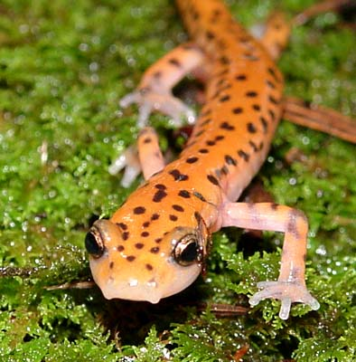
Order Caudata or Urodela: Salamanders
More than 300 species
Characteristics:
Long body
Four walking limbs of equal size
Tail
True teeth on both jaws

Slide 4
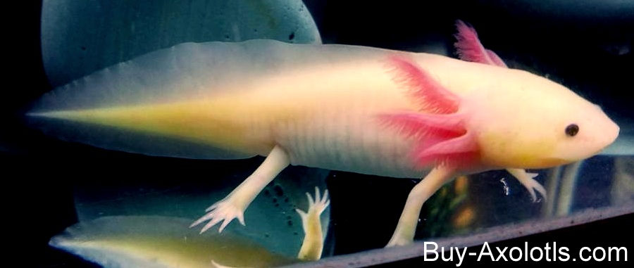
Salamanders
Walk with a side-to-side movement that may be similar to ancient tetrapods
Video: https://www.youtube.com/watch?v=MjAiWnzU2aE
Axolotle: adult retains external gills, lives underwater
Video: https://www.youtube.com/watch?v=lL87xhk63FM

Slide 5
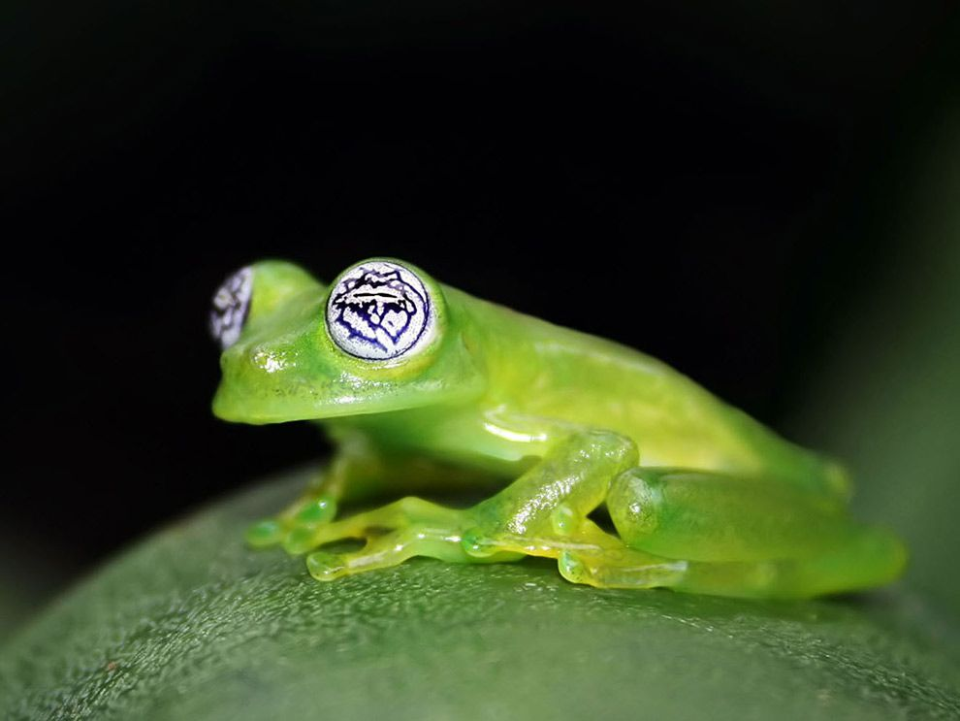
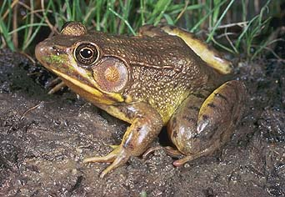
Order Anura: Frogs and Toads
Tailless bodies
Long, muscular hind limbs
Webbed feet
Exposed eardrums
Bulging eyes
Many species have glands that make toxins that protect them from predators

Slide 6
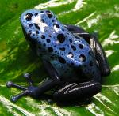
Frogs (6,400 species in 54 taxonomic families)
Characteristics:
bulging eyes
strong, long, webbed hind feet that are adapted for leaping and swimming
Teeth in top jaw only
Tympanum: external ear drum
Over 3000 species
Largest group of living amphibians
Generally live in moist environments

Slide 7
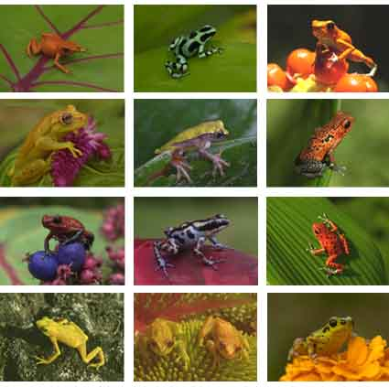
Frogs
Live in every environment on Earth except at the poles and the driest deserts.
Smallest frog is Paedophryne amanuensis. It is the size of your pinkie fingernail.
Largest frog is Conraua goliath, the giant slippery frog, which can get over 7 lbs.

Slide 8
Golden Poison Arrow Frog
Other cool frogs to look up for your Prezi:
Pac-man frog
Wallace’s flying frog
Purple frog
Amazon horned frog
Turtle frog
And, this little fella: http://www.viewpure.com/HBxn56l9WcU?ref=bkmk
Produce a neurotoxin in their skin. Used by humans in weapons

Slide 9
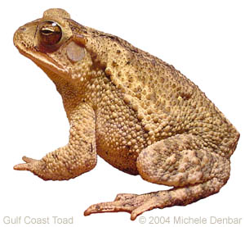
Toads (family Bufonidae, about 570 species)
Rougher, bumpier skin than frogs
Shorter legs- not good jumpers (mostly walk)
Fat, stubby bodies
Can live in dry environments
Most lack teeth
Fowler’s toad
Boreal toad-local to Utah

Slide 10
Frogs vs. Toads: Please copy this in your notes

Slide 11
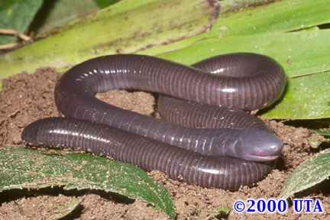
Order Gymnophiona: Caecilians (200 species)
Legless, burrowing amphibians
Live in the tropics, such as South America
Characteristics:
Elongated body without legs or reduced limbs
Small scales
Blind or reduced eyes
Terminal anus (no tail)
No external ear

Slide 12
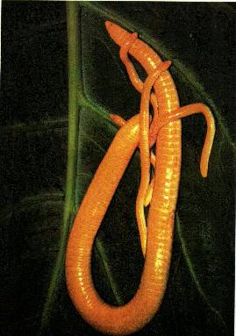
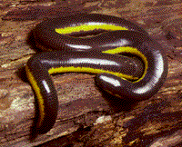
Caecilians
Range from 4 inches to 5 feet
Banded bodies that make them look like giant earthworms
Are predators; earthworms and grubs
Have no arms or legs for burrowing, so have to move like an earthworm.
Video

