Slide 1
Herpetology: Class Reptilia
Phylum Chordata, Subphylum Vertebrata

Slide 2
Class Reptilia
The origin of the reptiles lies about 320–310 million years ago
first reptiles evolved from advanced amphibians
Some modern reptiles are more closely related to birds than to other reptiles (crocodiles, specifically)
First animals to evolve that weren’t dependent on aquatic habitats
Approximately 10,500 living species of reptiles.
range in size from a tiny gecko, Sphaerodactylus ariasae, which can grow up to 17 mm (0.7 in) to the saltwater crocodile, Crocodylus porosus, which can reach 6 m (19.7 ft) in length and weigh over 1,000 kg (2,200 lb).

Slide 3
TIME
Common ancestors/evolutionary splits are where a new color starts.

Slide 4
Basic Characteristics
Ectothermic
Dry skin covered in scales
tetrapods
Oviparous reproduction (Internal fertilization – to avoid desiccation of gametes)
Amniotic eggs with leathery shell
Lungs
3 or 4 chambered heart
No metamorphosis (young look like miniature parent)

Slide 5
Adapting to Terrestrial Habitats
Dry skin with scales: The body of reptiles is covered with horny epidermal scales to reduce water loss and provide protection
Kidneys: Living on land means limited access to drinking water, so reptiles’ kidneys have adapted. They conserve water by producing less urine in more concentrated forms.
Lungs
Basking: Must be exposed to radiant heat in order to move/hunt
Positioning of the legs more directly under the animal. This position provided more support than the splayed arrangement of the Amphibian legs.

Slide 6
But mostly, the Amniotic Egg
First reproductive strategy to evolve that doesn’t require eggs to be laid in water (in fact, aquatic reptiles must lay eggs on land so they don’t drown)
Amnion and chorion membranes prevent deydration
You betcha, there’s a video!!

Slide 7
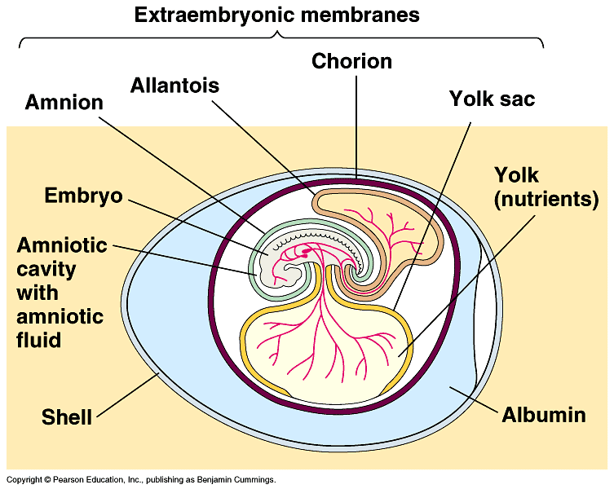
Amniotic Egg Structures & Functions
Chorion provides a special hard covering that is permeable to respiratory gases (O₂ and CO₂) while being impermeable to water vapor.
Albumin is watery protein reservoir between chorion and shell. Provides cushioning and hydration.
Allantois is a storage reservoir for metabolic waste products such as nitrogenous compounds.
Amnion is a fluid filled sac that acts as a cushion for the embryo and also prevents desiccation.
Yolk sac contains food for the embryo, thus eliminating the need for a larval stage.

Slide 8
Modern Reptile Groups Representatives

Slide 9
Types of Reptiles
Lizards: Order Squamata
Snakes: Order Squamata
Turtles: Order Testudines
Crocodiles/Alligators: Order Crocodilia
Tuataras: Order Sphenodontia
Only 2 species

Slide 10
Assignment
Reptiles R&Q on Canvas
Due next time

