Slide 1
Marine Mammals
Please fill in the note guide as you read this presentation.

Slide 2
Mammals: Basic Characteristics
Homeotherms, endotherms: hair (reduced in some species) and layer of blubber for insulation
Viviparous with placenta to provide nutrients to embryo (live birth)
Mammary glands
Large brain in relation to body size
Complex behaviors

Slide 3
Groups of Marine Mammals
Pinnipeds (Order Pinnipedia or Carnivora) – seals, sea lions, and walrus
Carnivores (Order Carnivora) – sea otter, marine otter, and polar bear
Sirenians (Order Sirenia) – dugong and manatees
Cetaceans (Order Cetacea) – whales, dolphins, and porpoises

Slide 4
Pinnipeds Order Pinnipedia or Order Carnivora; there is an argument among biologists and taxonomists about where these animals belong)
As Carnivores, these are predators, feeding mostly on fish, squid, shellfish
Breed on land and return to sea after giving birth
Prefer breeding near shallow water near abundant food
Thick blubber (fat tissue) layer for insulation in cold water habitats
Fore and hind limbs adapted as flippers for swimming
35 species
What are they?
Seals, sea lions, and walruses

Slide 5
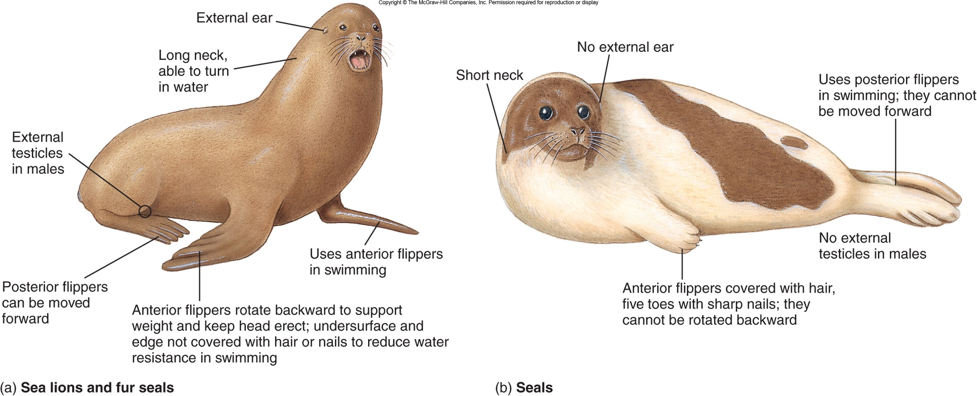
Sea lions vs. seals
How to tell the difference: VIDEO
Sea lions have ear flaps, longer necks, can support themselves on land (walk)
Anterior flippers rotate backward on land to support upper body. Can walk on land with all 4 limbs.
Anterior flippers cannot rotate backward. Used only for swimming.

Slide 6
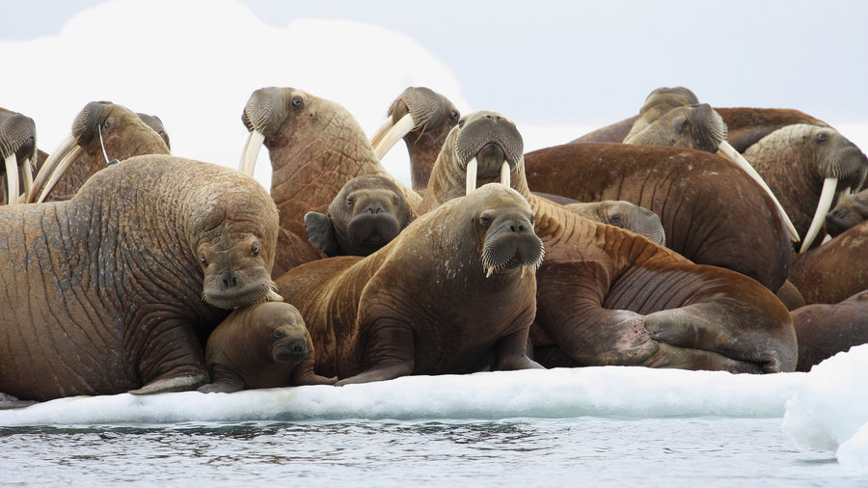
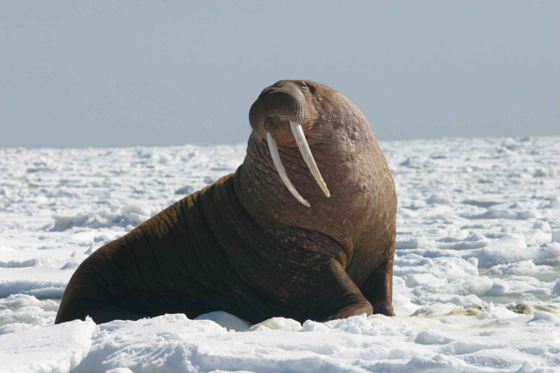
Walrus (Order Pinnipedia)
Live in Arctic ocean, rest on ice floes
Absence of external ears
Tusks
On land, walruses are capable of rotating their hind flippers to walk on all fours as in sea lions.
Food: mainly bivalve mollusks (clams); also other benthic invertebrates like worms, snails, sea cucumbers, squids, and crabs. May occasionally prey on fishes such as polar cod and scavenge on seal carcasses.
VIDEO

Slide 7
Sea Otters
Fine, dense fur coats for insulation, no blubber
Smallest true marine mammal
Front feet small with retractile claws; hind feet broad and webbed
Metabolic rate higher than most mammals of similar size so must consume large quantities of food. Adult sea otters may eat as much as 9 kg (20 lb.) of food each day: sea urchins, crabs, abalone, clams, mussels, octopuses, and fishes.
Three subspecies, or races, of Enhydra lutris (small differences in size, amount of time spent on land):
Asian (northern Japan and Siberia)
Alaskan
California
Video Another Video
Typically found in waters close to shore. The Alaskan sea otter has a greater tendency to come to shore than the California sea otter

Slide 8
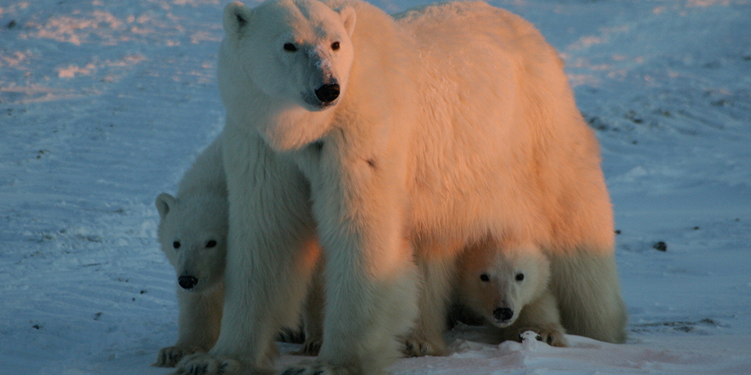
Polar Bear (Order Carnivora)
Ursus maritimus
Largest land carnivore
Spend part of their life on drifting ice in the Arctic Ocean: threatened by decreasing ice
Thick fur coat that appears white in coloration, but is really translucent
Smaller ears and longer necks than other bears (adaptations to low Arctic temperatures)
Adult polar bears need an average of 2 kg (4.4 lb.) of fat per day to maintain their weight. Diet includes mostly ringed and bearded seals but also other seal species, walrus, narwhal, beluga whale, whale carcasses, fishes, birds, eggs, berries, and kelp.

Slide 9
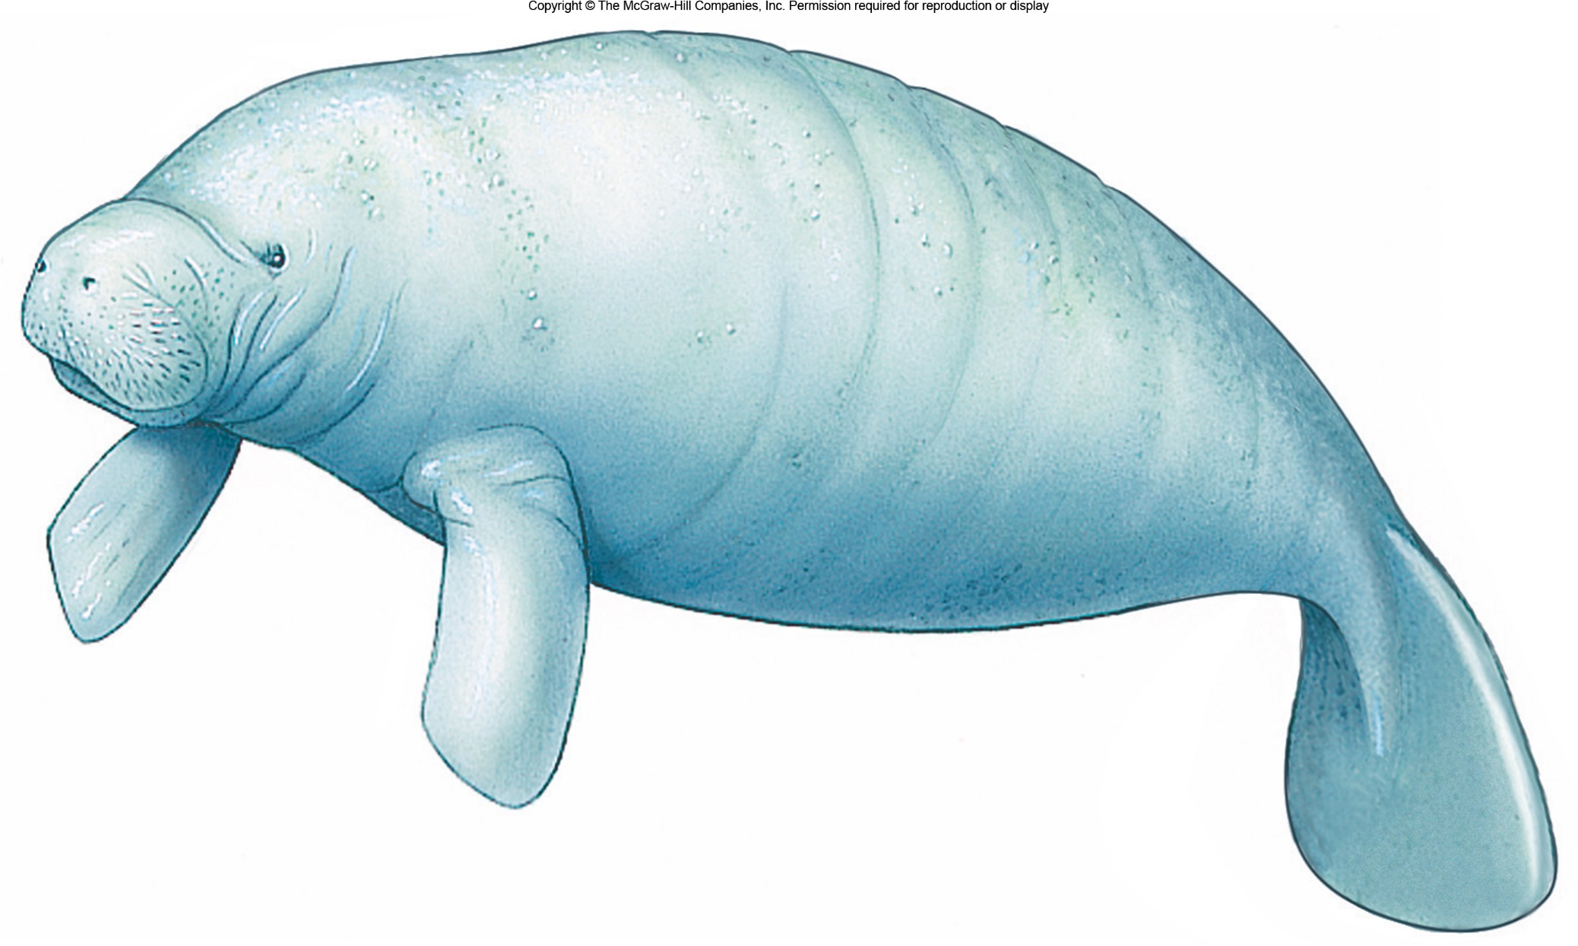
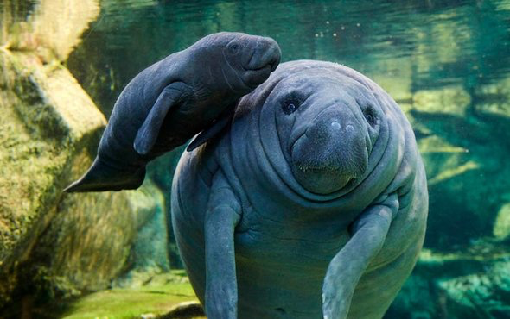
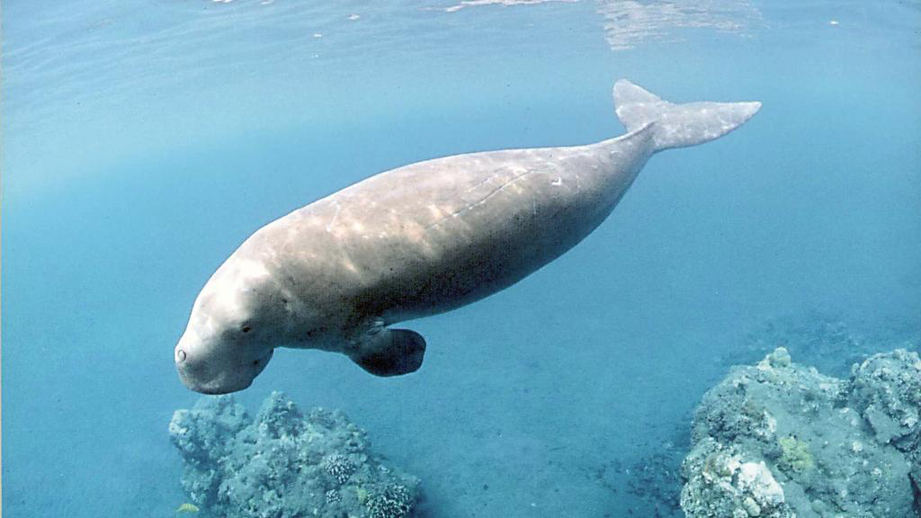
Order Sirenia: Manatees and Dugongs

Slide 10
Manatees and Dugong (Order Sirenia)
Front flippers but no rear limbs; paddle-like horizontal tail
Primarily herbivores
may reach 4.5 m (15 ft), 600 kg (1,320 lbs)
All four species endangered or threatened, particularly dugong
Slow reproduction, mature after about five years and giving birth to a single calf every two to five years after a gestation period of about a year.
Dugong Video
Manatee video

Slide 11
Order Cetacea
Whales, dolphins, and porpoises.
Forelimbs are modified into flippers, hindlimbs reduced to internal vestigial structures.
Fin-like tail (fluke)
Nostrils are located on the top of the head as a single or double opening (blowhole).
We will talk more about cetaceans next time!

Slide 13
Assignments
1. Marine mammals worksheet
2. Marine Mammals Report.
Similar to the Marine Reptiles and Seabirds Reports. Details are on Canvas!

