Slide 1
Order Cetacea
Whales, dolphins, and porpoises

Slide 2
Order Cetacea Characteristics
Forelimbs are modified into flippers, hindlimbs reduced to internal vestigial structures.
Fin-like tail (fluke)
Nostrils are located on the top of the head as a single or double opening (blowhole).

Slide 3
Order Cetacea
Baleen whales (Suborder Mysticeti) – baleen for filter feeding, two blowholes, larger size
Toothed whales (Suborder Odontoceti) – teeth, single blowhole, smaller size

Slide 4
Suborder Mysticetae: Baleen Whales
Filter feeders: Take in huge mouthfuls of water containing krill or small fishes. The baleen traps the prey, and water is forced back out of the mouth
Baleen is plates of keratin (like your fingernails) that hang from the upper jaw like a stiff curtain
13 species, including the right, gray, blue, and humpback whales
Includes some of the largest animals to ever exists

Slide 5
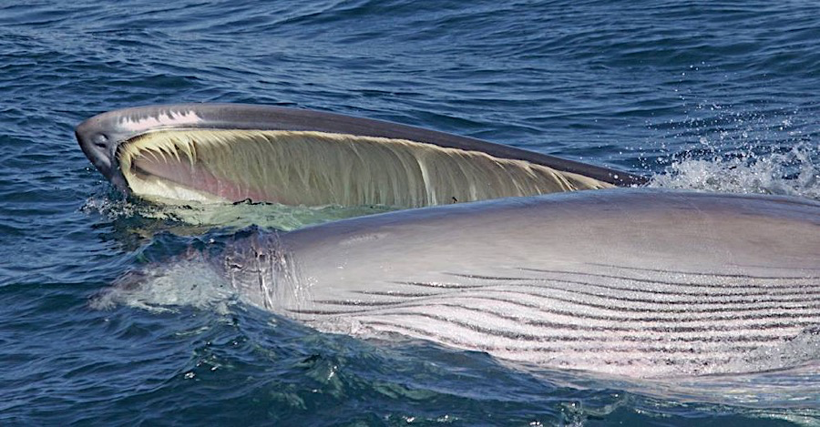
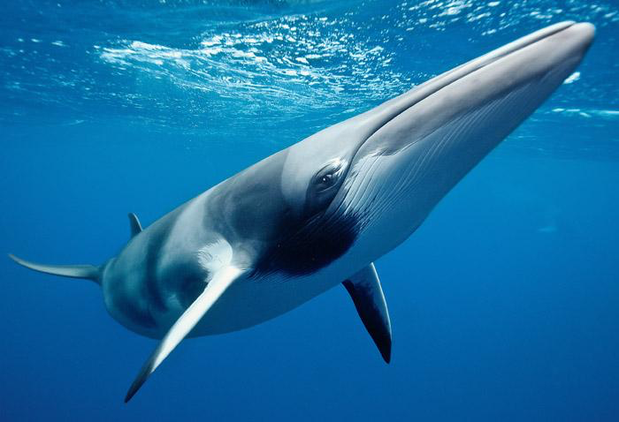
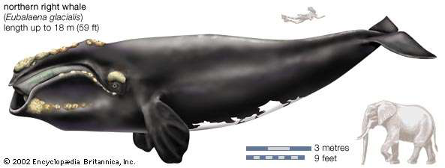
Examples of Baleen Whales
Video
Minke whale

Slide 7
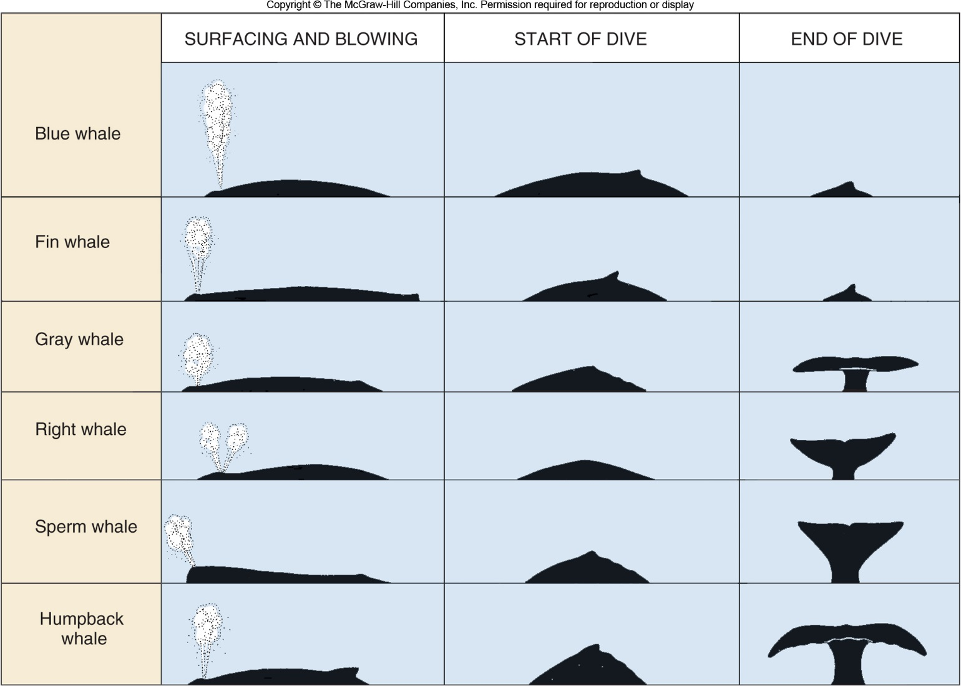
Whales may be identified from their fluke shape, blow pattern, or view of back when starting a dive.

Slide 8
Suborder Odontoceti: Toothed Whales
Characteristics:
Simple, peg-like teeth, which vary considerably in number and size among species.
Single blow-hole
Dolphin teeth are conical and interlocking, those of porpoises are spade-shaped. Teeth are adapted for grasping and tearing, not chewing.
Diet: fishes, squids, bottom invertebrates
Include dolphins, porpoises, belugas, narwhals, sperm, orcas (killer whales), river dolphins, and beaked whales
Video
Another video!

Slide 9
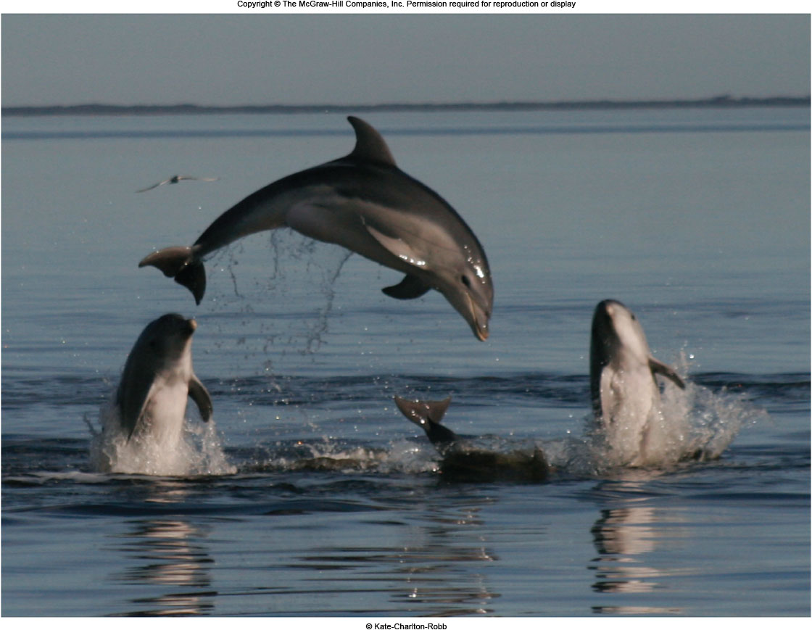
Spinner dolphin
Baltic Sea Harbor porpoise
Bottlenose dolphin
Dall’s porpoise
Vaquita: the most endangered toothed whale. There are 10 left.
Narwhal

Slide 10
Orca: the largest dolphin, and one of the smartest.
Sperm whale: the largest Odontocetan

Slide 11
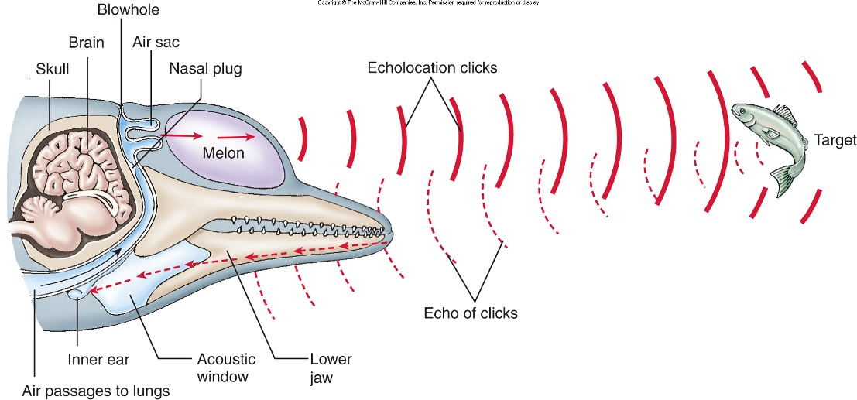
Echolocation: “seeing” with sound
Sound waves are emitted as a series of clicks of varying frequencies
Melon directs the outgoing sound waves
After the echo strikes an object, it is reflected back
These reflected echoes are received back by the melon and lower jaw, and a picture is translated in the brain
The longer it takes a echo to return, the farther away the object is located
Characteristic of toothed whales

Slide 12
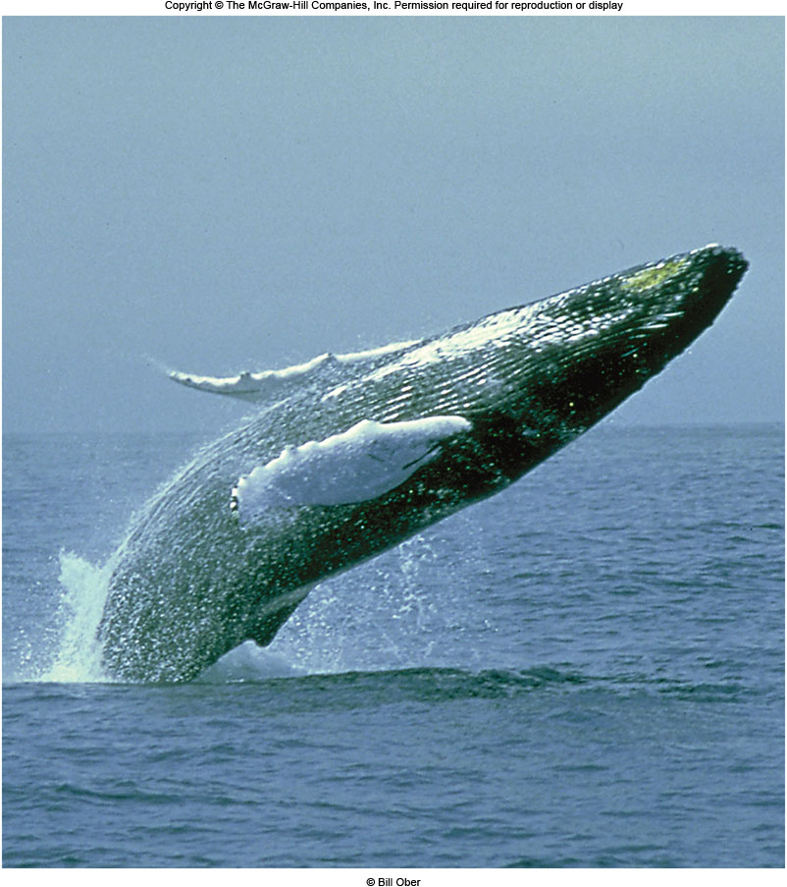
Behavior of Marine Mammals
Breaching: many species jump out of the water and crash back into the water on their backs
The reasons for this behavior: removing parasites, a warning signal, to avoid suitors, or just to play
Some whales show “spying” behavior: peeking out above water.

Slide 13
Behavior of Marine Mammals
Many whales are known for their long migrations
Among the longest migrations are those of the gray and humpback whales, where migrations are timed with feeding in cold water and breeding in warm water
Females give birth in the pelagic tropical oceans, then migrate to the poles to feed in nutrient-rich cold waters

Slide 14
Behavior of Marine Mammals
When one member of a group (pod) is sick or injured, other members will care for it
Mass strandings are often the result of caregivers following a sick/injured animal to shore
Maternal care of young for years, and mothers go through a visible period of grief if calf dies.

Slide 15
Assignments
Cetacean families worksheet. The pictures to use for identifying which family a species belongs in is on Canvas or in the Marine Bio books on the shelves by the lab tables (tables 7 & 8 are by lab table 1)
Marine mammals report:
Similar to the marine reptiles and birds reports
Details are on Canvas
Research a species of each of the following:
Seal
Sea lion
Otter
Polar bear (Ursus maritimus is the only one)
Manatee
dugong

