Slide 1
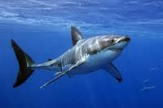
Starter Questions Google classroom
1
3
5
1-6: name that fin!
Pectoral
Pelvic
Dorsal
Anal
Caudal
7. What kind of coloration does this fish have?
Counter shading
8. What body style does this fish have?
fusiform
4
2

Slide 2
Fish Physiology
Assignments due: Design a fish (both from the website and the fish you needed to design yourself.

Slide 3
Anatomy and Physiology
Physiology: The physical mechanisms and structures that keep a living body functioning.
How an organism is built (anatomy) correlates with how it functions (physiology), as well as its habitat (where it lives)

Slide 4
Circulatory System
2 chambered heart
Deoxygenated blood enters 1st chamber of heart from body (atrium)
2nd chamber pumps this blood into gills (ventricle)
Gas exchange takes place in gills
Oxygenated blood carried to rest of body

Slide 5
Respiration
Must keep gills irrigated
Swimming, opening & closing of mouth
Each gill has rows of filaments with lamellae (increases surface area)
Oxygen diffuses from sea water to blood
Water and blood flow in opposite directions → boosting diffusion rate
Counter-current diffusion

Slide 6
Neutral Buoyancy (maintaining vertical position in the water column)
Fish are slightly heavier than water.
To keep from sinking, sharks must continually move forward
The shark liver has squaline, a fatty hydrocarbon, that acts to keep sharks a little buoyant.
The swim bladder, is the most efficient flotation device.
Found in bony fish only
A fish can control depth by adjusting the volume of gas in the swim bladder.
Due to pressure, as a fish descends, the bladder is compressed making the total density of the fish greater.
As a fish ascends, the bladder expands making the fish lighter and it will rise ever faster.
Notes:
Fig. 24.27

Slide 7
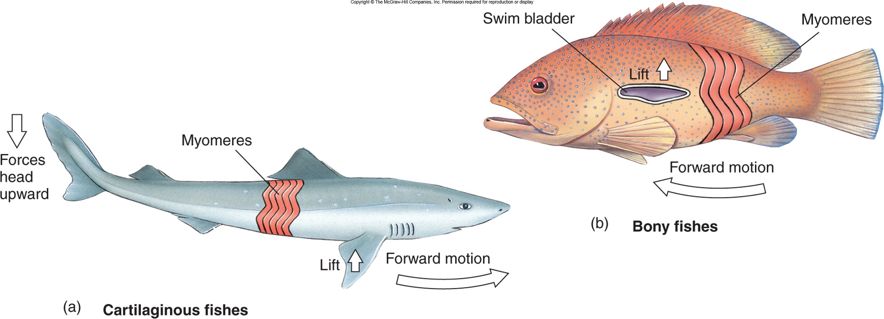
Teleosts vs. Chondrichthians
Teleosts: Swim bladder provide buoyancy
Chondricthians: Stiff pectoral fins and squaline oil provide buoancy

Slide 8
Osmotic Regulation
Freshwater has far less salt than is in fish blood; water tends to enter the body of the fish and salt is lost by diffusion.
The scaled and mucous-covered body is mostly impermeable, but gills allow water and salt fluxes.

Slide 9
Freshwater fishes are hyperosmotic regulators.
There is more water surrounding the fish than there is inside its cells
The opisthonephric kidney pumps excess water out.
Special salt-absorbing cells located in epithelium actively move salt ions from the water to the fishes’ blood.
These systems are efficient; a freshwater fish devotes little energy to keeping osmotic balance.
About 90% of bony fishes are restricted to either freshwater or seawater habitats.
Euryhaline fishes live in estuaries where salinity fluctuates throughout the day.

Slide 10
Marine bony fishes are hypoosmotic regulators.
Marine fishes have a much lower blood salt concentration than in the seawater around them.
Therefore they tend to lose water and gain salt; the marine fish risks “drying out.”
To compensate for water loss, a marine teleost drinks seawater; this brings in more unneeded salt.
Unneeded salt is carried by the blood to the gills and secreted by special salt-secretory cells.

Slide 11
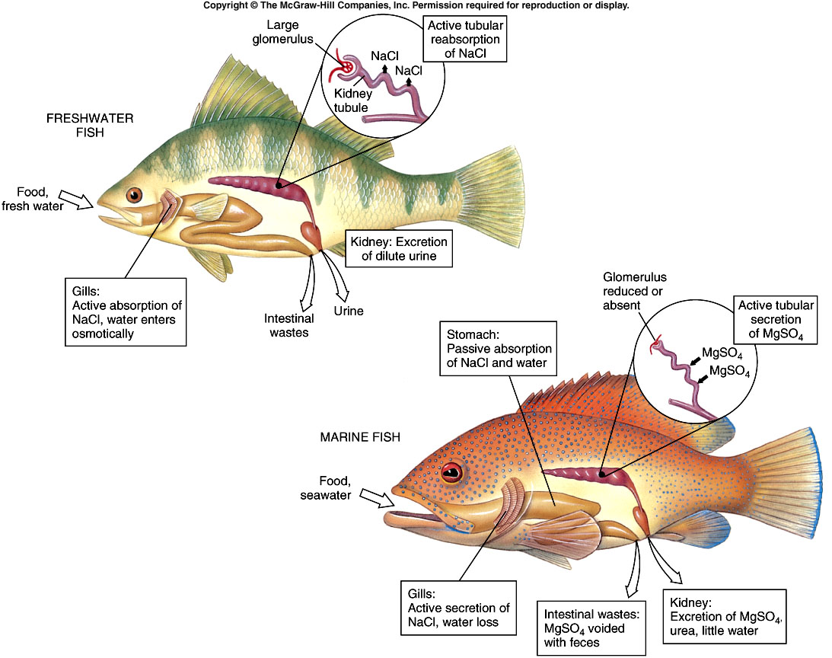
Fig. 24.29
Notes:
Fig. 24.29

Slide 12
Reproduction
Most sexually reproduce and have separate sexes (dioecious)
Fertilization:
External: most common; involves broadcast spawning
Internal: mostly in cartilaginous fishes: claspers in males for copulation
Oviparous-eggs develop outside the female.
Ovoviviparous- eggs are fertilized internally and hatch and develop inside the mother. Don’t receive nutrients from her body. (Sharks)
Spawning-Most fish externally fertilize eggs in a large group. No parental care.
Mouth Brooding- a few species care for eggs and/or larvae by protecting them in their mouths.

Slide 13
Deep-sea anglerfish. The male attaches to the female and becomes a symbiont, only there to provide sperm.
Mouth-brooding jawfish male
Video: Fish reproduction strategies
Seahorse giving birth

Slide 14
Life Cycle of Fish
Egg: –embryo is formed inside the egg, once the egg is fertilized.
Larvae: – After hatching from egg, new larvae have a yolk sac.
Can survive for 2-4 days on their yolk sac food supply.
Fry: – The young fish once the yolk sac is fully absorbed.
ready to start eating on their own.
Video: http://viewpure.com/iCM6CawGBRk?ref=bkmk

Slide 15
Life Cycle of Fish
Juvenile: – Metamorphosis is the process that marks an end point of the larval stage.
acquire characteristics of an adult fish
Smolt: – rapid growth and maturation.
Adult: –able to reproduce
Spawning: – Females release the eggs in water and males release milt that helps to fertilize the eggs.

Slide 17
Movement
Locomotion
- Typically an “s-shaped” swimming pattern
- Bands of muscles along the body (myomeres) drive swimming motion
- Different fins are used for different forward movements
Notes:
STOP HERE ON FIRST DAY!

Slide 18
Schooling and Shoaling
Not physiology, but important fishy behavior
A shoal is any group of fish (can be mixed species) that stay together in a concentrated area
Protection from predators
Social
A school is a concentrated, polarized shoal with purposeful movement. Usually consists of a single species.
Physiologically, a school’s behavior is controlled via the lateral lines on each fish’s body. It senses the movement of the fishes next to it, and this fish responds by moving the same direction. There is no “leader”.
Video: https://www.youtube.com/watch?v=dkP8NUwB2io

