Slide 1
The U.K. has banned microbeads. Why? by Des shoe the Ny Times
Current Event presentation by
Mrs. Fravel
Marine Biology

Slide 2
The new law (Summary)
The government of the United Kingdom pledged in September 2016 to ban the manufacturing of cosmetic products with microbeads, and that ban took full effect Jan 2018. A ban on the sale of such products will come later this year.
Congress and President Obama have passed and signed the Microbead-Free Waters Act of 2015 in the U.S.
“To amend the Federal Food, Drug, and Cosmetic Act to prohibit the manufacture and introduction or delivery for introduction into interstate commerce of rinse-off cosmetics containing intentionally-added plastic microbeads.”
(Huston, para 2; www.govtrack.us)

Slide 3
What are Microbeads? (summary and explanation of significance of article/study)
Microbeads are tiny plastic spheres (usually less than 5 microns in size) used in many cosmetic and personal-care products.
Used and touted as “exfoliants”
Remove dead skin (face and body wash)
Polish teeth and remove stains and bacteria

Slide 4
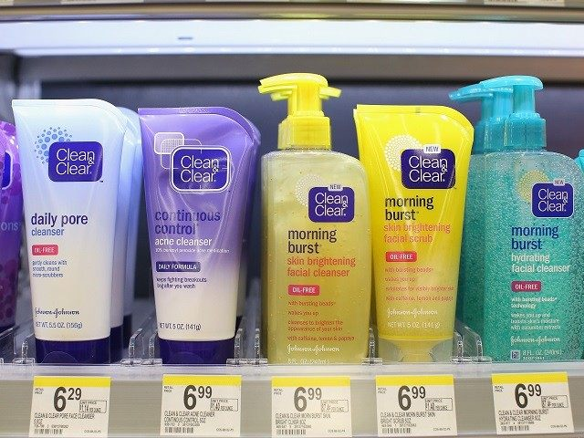
CNN.com
Scott Olson/Getty Images

Slide 5
Why are microbeads a problem?
When used in “rinse-off” products, they are washed down drains, eventually ending up in sewage treatment plants.
Sewage plants aren’t equipped to strain or filter out particles this small, and the microbeads end up in treated water that is returned to waterways via outflow from treatment plants. (Huston, para 4)
Plastic never dissolves or biodegrades. That means once a microbead is in the environment, it is there forever
Currently, it is reported that more than 8 trillion microbeads were entering the country's aquatic habitats daily. The volume was enough to coat the surface of 300 tennis courts every day. (Rothman et.al. 2)

Slide 6
Microbead beach

Slide 7
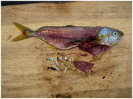
Biggest problems?
Animals ingest or inhale microbeads.
Cannot be digested and are often not passed through the gut, and therefore accumulate in the animal’s stomach or other organs.
Threat to humans:
Animals that have ingested plastics may absorb toxic chemicals. If the animal is then eaten by people, those toxins may accumulate in a person’s tissues. (Imam, para 9)
Treated sewage sludge is often used as fertilizer, which means microbeads are being sprayed on food crops.
Human skin and mouth may absorb toxic chemicals.

Slide 8
Future implications
“Microplastics are likely the most numerically abundant items of plastic debris in the ocean today, and quantities will inevitably increase.” (Law, Thompson)
Plastic is made from oil. The environmental impact of oil extraction is huge.
As microbeads are non-biodegradable and nearly impossible to clean up, doing the math projects that the problem of their presence will only get worse:
(78ft X 27ft)300= 631,800 square feet per day (CCHS is about half that)
631,800 X 7 = 4,422,600 square feet per week
4,422,600 X 52 = 229,975,200 square feet per year (That is about half the size of the state of Utah)

Slide 9
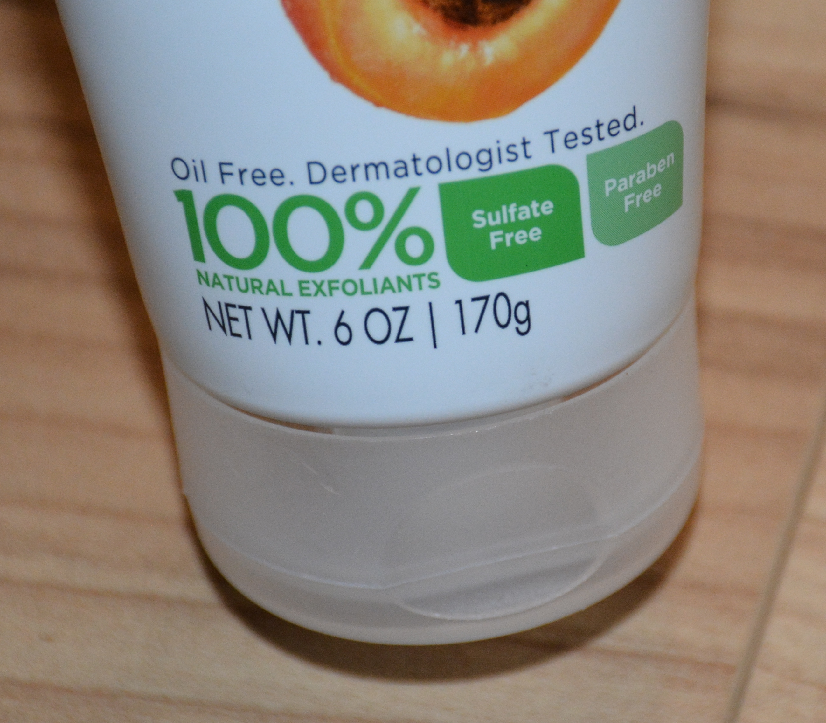
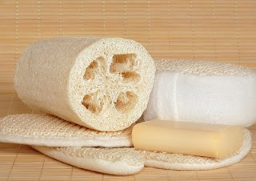
Ban them! (point of persuasion)
Preventable threats to wildlife is an ethical choice to stop.
The health of our rivers, lakes, and oceans is in peril
A recent study claims that there is 1.7 million microbeads per square kilometer in Lake Erie, U.S. (Huston, para 8)
There is no scientific or health need to be exfoliated.
Exfoliation can be achieved using natural/non-microbead methods
Products with salt, apricot or peach pit exfoliants
Use a washcloth or loofah sponge
Sdedible.org
Livingporposefully.com

Slide 10
Cited sources
Shoe, Des, “The UK has Banned Microbeads. Why?” New York Times, Jan 9, 2018. https://www.nytimes.com/2018/01/09/world/europe/microbeads-ban-uk.html
Imam, Jareen. “Microbead Ban Signed by President Obama” CNN.com Dec 21, 2015 http://www.cnn.com/2015/12/30/health/obama-bans-microbeads/
Imam, Jareen “8 Trillion Microbeads Pollute Aquatic Habitats Daily” CNN.com Oct 6, 2015 http://www.cnn.com/2015/09/19/us/8-trillion-microbeads-pollute-water-daily-irpt/
Law, Kara Lavender and Thompson, Richard C. “Microplastics in the Sea” Science 11 Jul 2014: Vol. 345, Issue 6193, pp. 144-145
Rochman, Chelsea et. al. “Scientific Evidence Supports a Ban on Microbeads” Environmental Science & Technology Sept. 2013

