Slide 1
Starter Questions
1. What are the classes of echinoderms?
Asteroidea
Echinoidea
Holothuroidea
Ophiuroidea
2. What is a keystone species?
If removed from an ecosystem, the food web collapses.

Slide 2
Molluscs (Phylum Mollusca)
Basic characteristics:
Basic body plan: head, muscular foot, and visceral mass of internal organs
Body covered by skin-like mantle that often secretes shell of calcium carbonate
Radula: tooth structure for grazing and other types of feeding
Well developed nervous system with brain
Open circulatory system, complete digestive system
Large, successful group with nearly 100,000 known species but many remaining to be discovered

Slide 3
Mollusc Anatomy (external)

Slide 4
Types of Molluscs
Gastropods (Class Gastropoda)
Largest group of molluscs (snails, limpets, abalones, sea slugs)
Gastropoda = “belly-footed” (internal organs over foot)
Coiled shell on most species
Radula for grazing on seaweeds; some are deposit feeders or even suspension feeders
Some are carnivores and use radula to capture prey

Slide 5
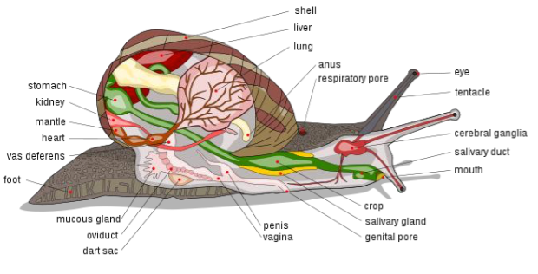
Video
Another video!
One more!!

Slide 6
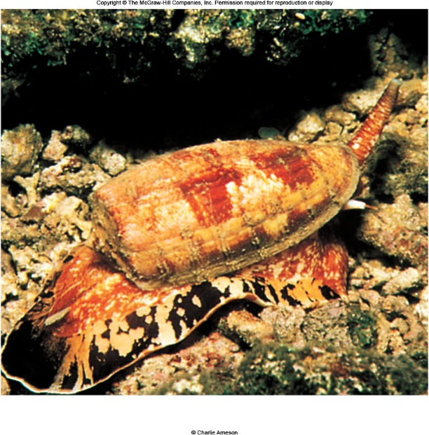
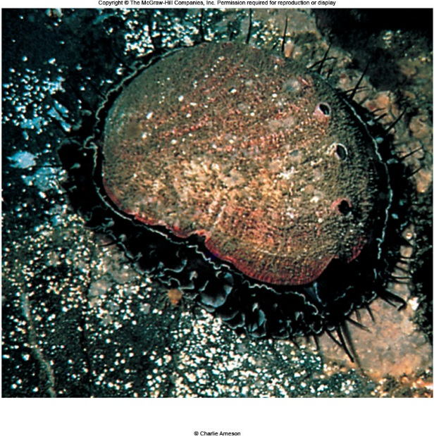
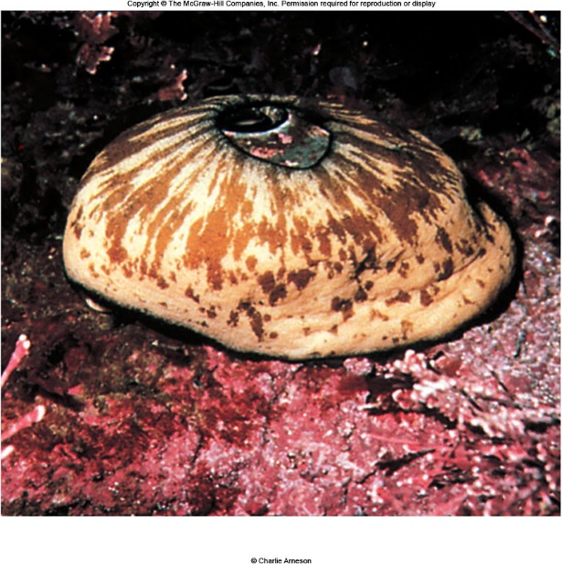
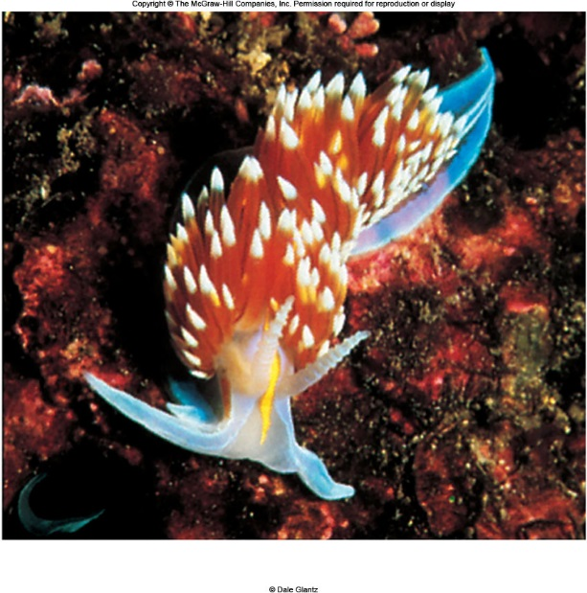
Gastropods

Slide 7
Types of Molluscs
Bivalves (Class Bivalvia)
Specialized filter feeders: clams, oysters, scallops, mussels, shipworms
Compressed body in mantle cavity between two shells or valves (= Bivalvia)
Expanded, folded gills for respiration and filter feeding
Water enters and exits mantle cavity through siphons
Head, radula absent
Clams burrow (using muscular foot for burrowing), oysters and mussels attach to hard substrates or grow attached to each other, scallops are free-living

Slide 8
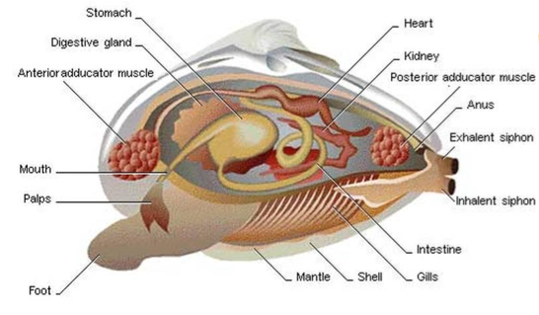
Video
Scallops link: https://www.encyclopedia.com/plants-and-animals/animals/zoology-invertebrates/scallop)

Slide 9
Types of Molluscs
Cephalopods (Class Cephalopoda)
Squids, octopuses, cuttlefishes, chambered nautilus
“Head-footed” (= Cephalopoda)
Fast swimming predators using water jet propulsion, water entering and exiting mantle cavity by way of siphon (funnel)
Well developed nervous system, with large, complex eyes, brain, nerves
Thick mantle covering body
Radula beak-like jaws to crush or rip prey
Shell internal (the pen of squids) or absent
Nautilus is the only cephalopod with external shell.
Chromatophores: cells in skin can change the color and texture of their skin

Slide 10
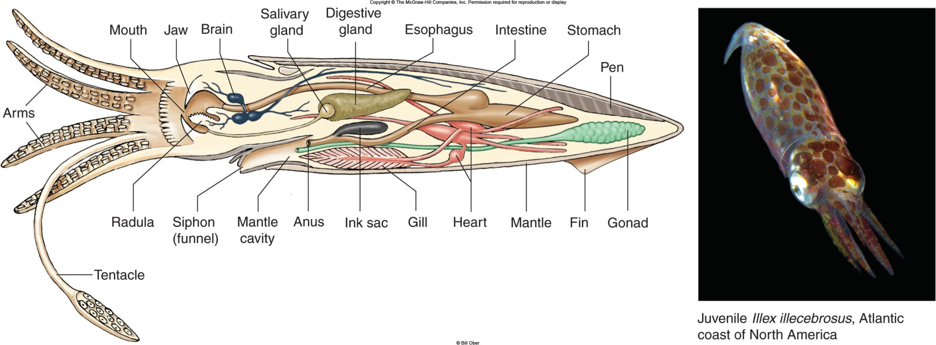

Slide 11
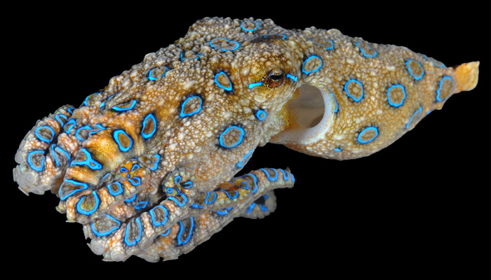
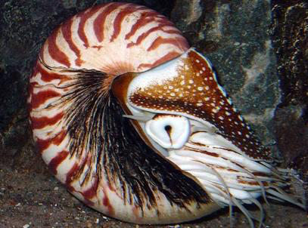
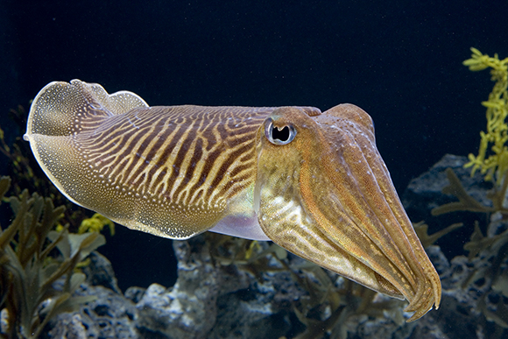
Cephalopods!
Cuttlefish hunting video

Slide 12
Assignment
Phylum Mollusca worksheet
VIDEO: Shape of Life
VIDEO: Octopus Camouflage
VIDEO: Octopus through small opening
DUE Thursday 10/25 (Will go on 2nd quarter grades)

