Slide 1
Starter
1. What are the three classes of fishes?
Osteichthyes, Chondrichthyes, Agnatha
2. List two characteristics of bony fishes
Opercula, swim bladder, lateral line, ctenoid or cycloid scales, bony skeleton
3. List two characteristics of cartilagenous fishes
Open gills, placoid scales, skeleton of cartilage, ventral mouth, males have claspers, spiracles

Slide 2
Fish: External Anatomy and Adaptations

Slide 3
Fins and Swimming
Pectoral fins (paired; analogous to arms in humans): provide stabilization, steering, and some propulsion.
Pelvic fins (paired; analogous to hind legs): stabilization, steering, stopping.
Dorsal fin (not paired, but some fish have more than one): Stabilization
Caudal fin: tail fin. Propulsion and stabilization.
Anal fin: on ventral surface, for stabilization.
Finlets and caudal keel: found in some fast-swimming fish. Stabilization and hydrodynamics.
Adipose: on ventral surface in front of tail, possibly sensory.

Slide 4
1. Pectoral 2. Pelvic 3. Dorsal 4. Finlet/keel 5. Anal 6. caudal

Slide 5
Mouth and Feeding Habits
Inferior or ventrally positioned mouths: eat prey in substrate or by attacking from above.
Superior: mouth toward top of face. Eat from surface of water.
Terminal: mouth at middle of head at the end. Feed on what’s ahead of them (filter feed) or chase prey.

Slide 6
Mouth and Feeding Habits
Mouth structure and position tell the diet of fishes
The “beak” (fused teeth) of parrotfishes is used for scraping algae and other organisms off hard surfaces
The long tube-like mouth of butterfly fishes to feed on corals or plankton. They pick at small prey.
The rows of sharp teeth and a wide mouth of the barracuda to capture its prey – other fishes
Slipmouths or ponyfish have an extendable jaw. Eat mollusks and sometimes algae.

Slide 8
Body Shapes
Determined by habitat (where they live)
Fusiform- streamlined. Fast or long-distance swimmers. Mainly in the open ocean.
Tuna: live in the vast open ocean. Swim continuously.

Slide 9
Body shapes cont.
Laterally compressed: flattened side to side. Maneuvering through tight habitats like coral reefs or kelp forests.
Lookdowns: live in shallow coastal waters that are rocky or have coral reefs

Slide 10
Body shapes cont.
Dorsoventrally depressed: flattened top to bottom. Demersal (bottom-dwelling). May be ambush hunters or hide from predators, or feed on organisms in the substrate.
Rays are dorsoventrally depressed

Slide 11
Laterally or Dorsoventrally compressed?
Flounders, halibut
Demersal fish, ambush predators
These fish LOOK like they are dorsoventrally flattened, but are actually laterally flattened.
Both eyes are on one side of the face, they lie on their other side on the benthic surface.
Metamorphosis video: http://viewpure.com/qePwW44HhNg?ref=bkmk

Slide 12
Body shapes cont.
Snake- or ribbon-like: burrowing fish or live in holes in rocks
Moray eel
Grass eel

Slide 13
Color Patterns
Countershading, the dorsal surface is darker than the ventral (belly) surface
When seen from above, the darker coloration of the dorsal surface blends in with the darker color of the ocean bottom
When seen from below, the lighter ventral surface blends in with the lighter color of the ocean surface
Disruptive coloration - bars or stripes that help break up the silhouette for predator avoidance
Cryptic coloration - coloration that helps blend in with the background
Warning coloration - color to advertise bad taste or poisonous nature

Slide 14
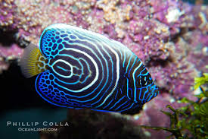
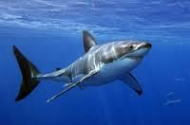
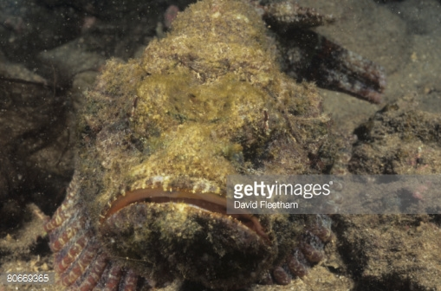
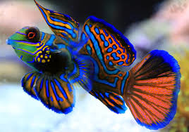
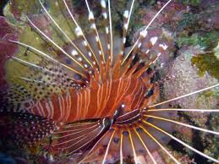
disruptive
disruptive
cryptic
Countershading
warning
warning

Slide 15
Design a Fish
1. Go to: https://static.lawrencehallofscience.org/scienceview/scienceview.berkeley.edu/html/showcase/flash/fish.html
Read the instructions, create a SUCCESSFUL body design for each habitat. Fill out the worksheet; be sure to draw all of your creations!
2. Design your own fish! Follow the instructions and rubric.
Due Monday 11/19.

Slide 16
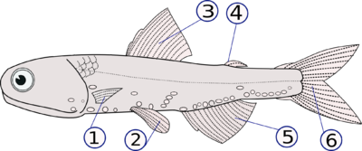
STARTER
1-6 Write the fin names that correspond with the numbers.
7.What are the two classes of fish?
8. List 3 types of color patterns in fish.

Slide 17
Assignment
Anatomy Lab: rotate through each fish specimen. Fill in your lab sheet. Make sure you can identify all the fins, gills, lateral lines, and spiracles (if present). Decide if the fish is a bony fish or cartilagenous based on its external appearance (i.e., you can’t see bones or swim bladders)
When done, get your computer. Complete the Fish physiology worksheet from the website link.

