Slide 2
Starter Questions – Day 2 Please get a green Starter Sheet from the front counter.
How much is the class fee?
Where do you pay it?
How many research projects are we doing in this class?
Where is our final exam held?
What happens if you don’t pay your fee?
What is one thing you are really curious about regarding the field of Marine Biology?

Slide 3
Oceanography vs. Marine Biology
Oceanography is the study of the non-living (abiotic) parts of the ocean
Salinity and water temperature
Currents
Tides
Zones of the ocean and the sea floor

Slide 4
What is Marine Biology?
Marine biology - the study of organisms that live in the sea, including all water that has some degree of salinity, like the estuaries at river mouths
Plants and microbes (algae and plankton)
Invertebrates
Cnidarians (jellyfish, corals, anemones)
Molluscs (octopus, squid, snails, clams, etc)
Echinoderms (sea stars, urchins, etc.)
Arthropods (crabs, shrimp, lobsters, sea spiders)
Vertebrates
Reptiles, Birds, Mammals

Slide 5
A Marine Biologist is not exactly the same as an Oceanographer
Marine Biologists study the organisms that inhabit the sea
Oceanographers mainly study the physical (non-living) aspects of the ocean including tides, currents, waves, and the chemical make-up of seawater
But they do overlap

Slide 6
Why Study Marine Biology and Oceanography?
1. Since life is believed to have arisen in the sea, studying marine life can provide clues about early life on earth.
2. Many products come from the sea including food, medicines derived from marine species, food resources, and other items used for human use.

Slide 7
Why Study Marine Biology?
3. Marine organisms produce oxygen used by all kinds of organisms, including humans.
4. The marine environment provides recreation and support tourism worldwide.

Slide 8
Why Study Marine Biology?
5. The oceans help regulate climate.
Water is slow to change in temperature, keeping coastal land masses more stable year-round.
Any long-term or short-term change in the ocean’s temperature will affect the entire planet.

Slide 9
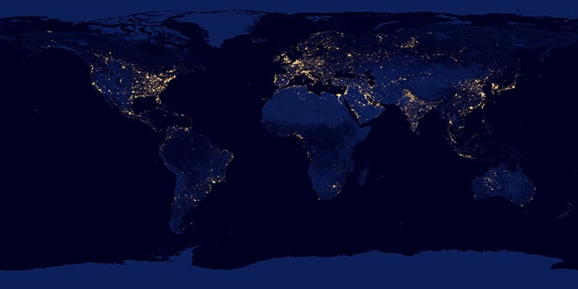
Humans are tied to the oceans.
Humans’ first settlements were almost always near water (rivers and lakes)
Once we mastered traveling the open ocean, major cities were established on coasts.

Slide 10
Human History with the ocean world
Clam shells, which are approximately 165,000 years old, have been discovered in a cave previously inhabited by humans in South Africa
110,000-year-old shell harpoons and fishhooks have also been found
This shows that humans have been using the sea since early times

Slide 11
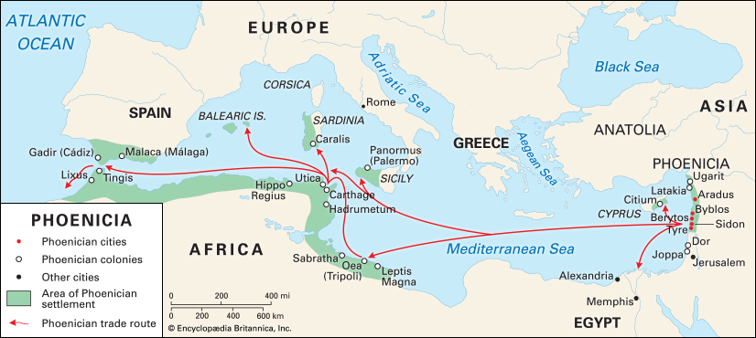
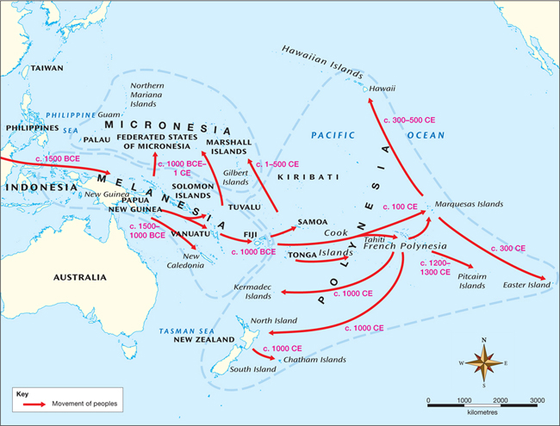
History
Early explorations were made by Pacific Islanders as well as the Phoenicians, who extensively sailed the Mediterranean and adjacent seas
Ancient Greeks (~2-3 thousand years ago) also had extensive knowledge of the Mediterranean Sea.

Slide 12
History
Captain James Cook and his crew, which included naturalists, sailed around the world beginning in 1768, and were the first Europeans to view the Antarctic ice fields and land on Hawaii, Tahiti and many other Pacific islands.
His crew did extensive mapping and brought back many specimens.
1831-1836 HMS Beagle (Darwin)
1872-76 HMS Challenger
Art by Geoff Hunt

Slide 13
Modern Marine Biology & Oceanography
Many marine biology research stations exist in locations around the world.
Several facilities in the United States are considered among the most famous:
Woods Hole Oceanographic Institution and Marine Biological Laboratory, Massachusetts
Scripps Institution - La Jolla, California
Friday Harbor Laboratories, Washington state
National Oceanic and Atmospheric Administration (NOAA)

Slide 14
Important Tools in Modern Marine Biology
Remote sensing – Satellites are used to study large expanses of the ocean surface and sea floor.
Sonar – Used to map seafloor depths and formations
SCUBA – Used for the study of the marine environment for longer periods and at depths otherwise unavailable to humans
Remotely operated vehicles (ROVs) – Allows for direct exploration of the marine environment when scuba is not an option.

Slide 15
Critter Cams
An important modern tool is the amazing technological ability to attach cameras to animals themselves and see what they see.
http://viewpure.com/b5Lfg-3bBlQ?ref=search
http://viewpure.com/0LpYOUKSt7o?ref=search

Slide 16
Important Tools in Modern Marine Biology
Research vessels – These floating laboratories allow oceanographers and marine biologists to explore the marine environments for weeks, months, or even years without returning to a land-based facility.
Nautilus Live:

Slide 17
Assignments
Explorer Cards Game
Ocean Explorer Timeline and Worksheets
Due Wed. 8/29

