Slide 1
Starter: Please get your computer and answer on google classroom
What animals are in the phylum Porifera?
sponges
List two classes of cnidarians
Scyphozoa -Cubozoa -Hydrozoa
What are the two body forms for cnidarians?
Polyp and medusa

Slide 2
Anthozoans: The polyps that rule the world
Class Anthozoa includes:
Anemones (individual polyp)
Corals (colonial or individual polyps)
No or limited medusal stage
Sessile and benthic: attached to substrate (but some can ”walk”
Have symbiotic algae that live in their mesoderm tissue
What are corals?
Animal, vegetable, mineral
Time-lapse coral movement video

Slide 3
Zooxanthellae (zoh-ah-zan-thellay)
Symbiotic algae.
The algae and coral have a mutualistic relationship
The coral provide algae with a protected environment and some of the compounds needed for photosynthesis. In return, zooxanthellae produce oxygen and supply the coral with important metabolic compounds
This microscopic, photosynthetic alga is one of the most important primary producers within the coral reef system.

Slide 4
Coral Nutrition
The coral zooxanthellae produce organic matter (sugars) through photosynthesis
Some of this organic matter is passed to the coral
Zooxanthellae help in the deposition of the calcium carbonate skeleton
Coral polyps also ingest plankton and other small prey aided by the nematocysts in their tentacles

Slide 5
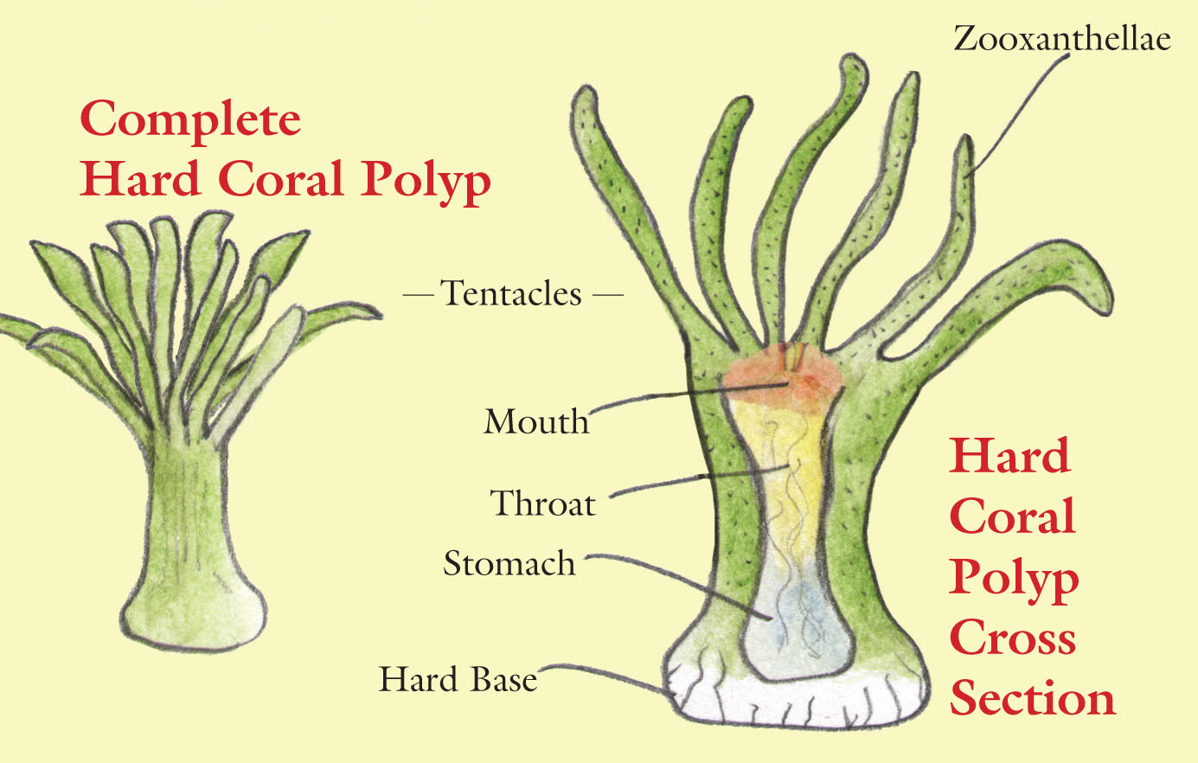
Types of Corals: Stony
Scleractinians
Build skeleton of calcium carbonate (CaCo3)
Calyx-surrounds soft body
As each individual dies, new generations grow on top of old skeletons, building a reef
Slow growth
Large-polyp or small-polyp

Slide 6
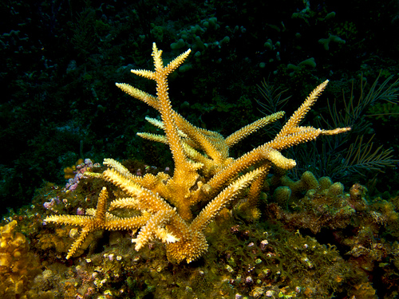
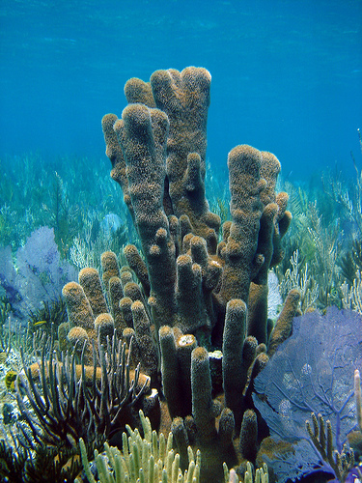
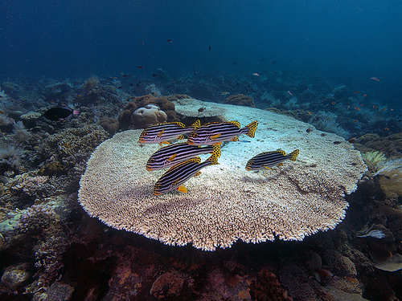
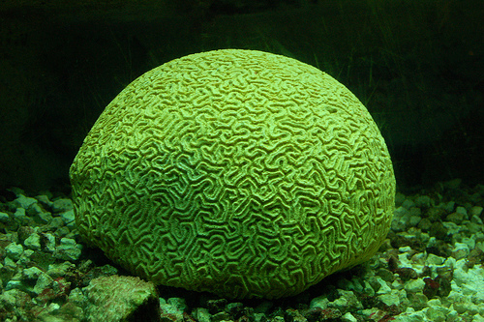
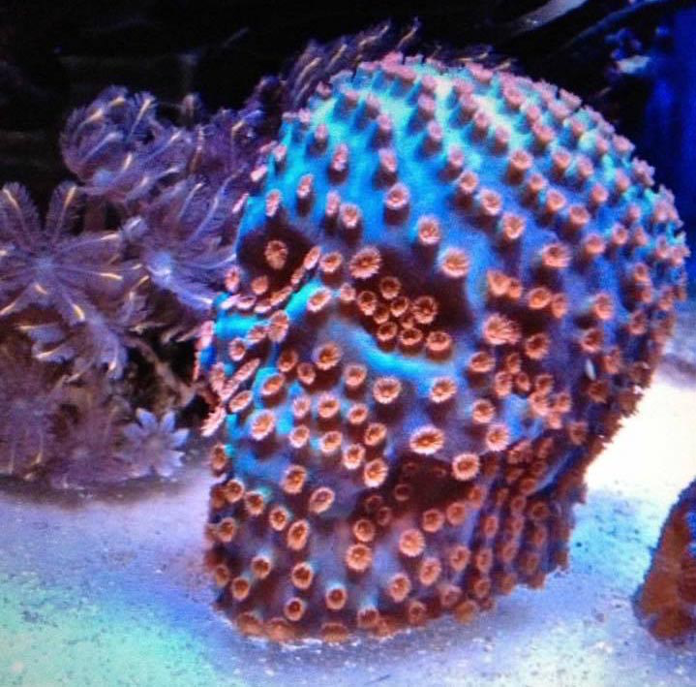
Stony coral groups
Branching
Plate
Encrusting
Free-living
columnar

Slide 8
Types of Coral: Soft
Alcyonaceans
Don’t build stony skeletons
Bodies contain sclerites (minute spiny skeletal elements) for support
Hold on to substrate with pedicel (foot)

Slide 9
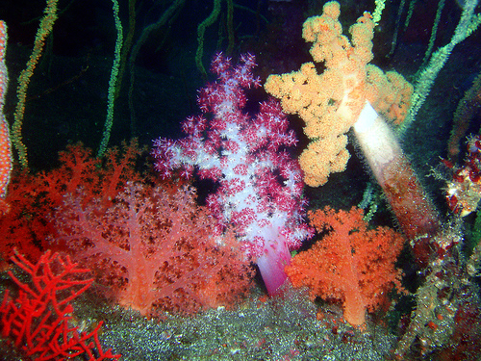
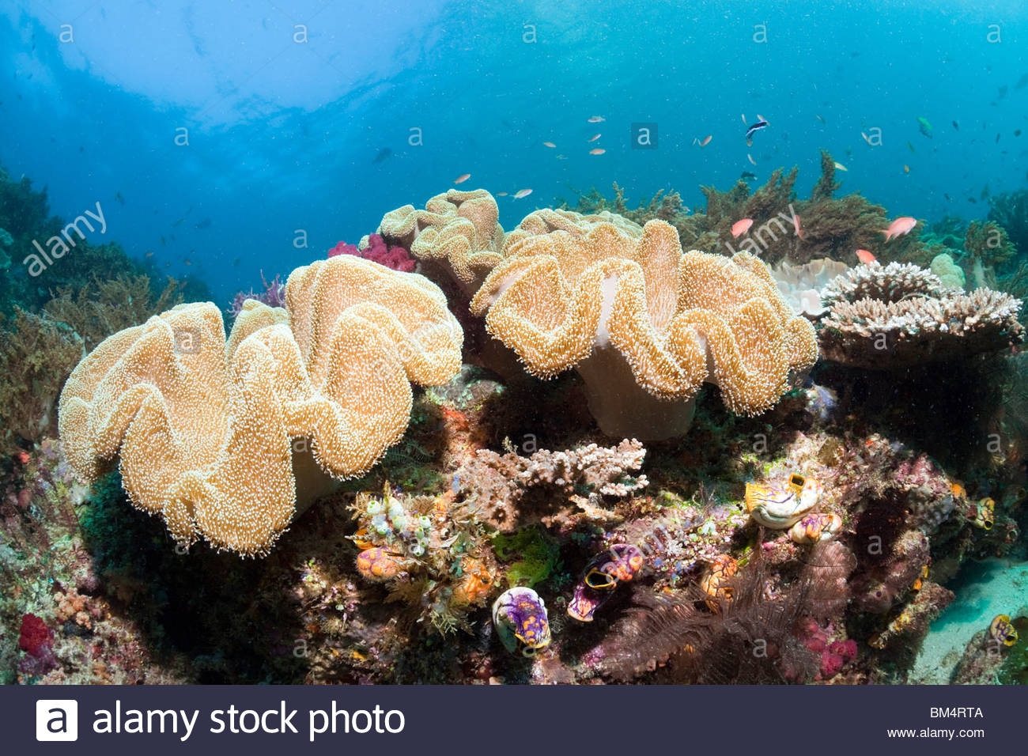
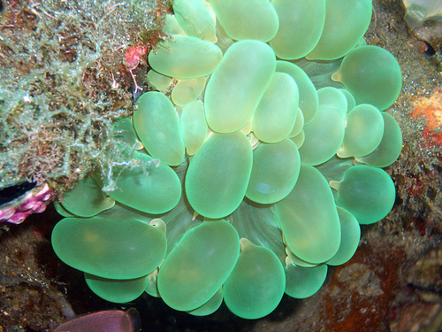
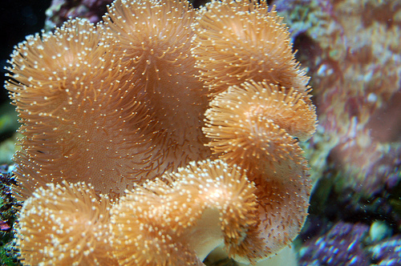
Soft coral types
Bubble
Sea fan (Gorgonian)
Mushroom
Tree-like
Pulsing
Zoanthid

Slide 10
The Great Barrier Reef
World's largest coral reef system composed of over 2,900 individual reefs and 900 islands stretching for over 2,300 kilometres (1,400 mi) over an area of approximately 344,400 square kilometres (133,000 sq mi). The reef is located in the Coral Sea, off the coast of Queensland, Australia.
Corals include the organ pipe coral, flowerpot coral, cauliflower coral, many table and brain corals.
Animals found there include anemone fish, blue tang, coral trout, grouper (and thousands more), octopus, cuttlefish, sea turtles, echinoderms, sea snakes.

Slide 11
Assignment– upload on Canvas
For each species, include:
Common name and scientific name (genus and species)
Picture and written description
Where are they found in the wild
Make a slideshow on google slides
Each slide should showcase a different species of coral
You must have:
One large polyp stony
One small polyp stony
One gorgonian
Two other soft corals
6th slide: look up a coral reef somewhere in the world that is not the Great Barrier Reef. Include a picture and a brief description of the ecosystem, corals found there, fish and other organisms, human use/impact.

