Slide 1
Phylum Arthropoda
Subphylum Crustacea

Slide 2
Arthropods (Phylum Arthropoda)
Basic characteristics:
Animal phylum with largest number of species (about 75% of all animals on earth): insects, crustaceans, spiders, etc.
Jointed legs and other appendages
Chitin exoskeleton that must be shed to grow (molting).
Body divided into head, thorax, and abdomen; or cephalothorax and abdomen
Segmentation
Sexual reproduction

Slide 3
Arthropods: Crustaceans (Subphylum Crustacea)
includes crabs, lobsters, crayfish, shrimp, krill, and barnacles.
Basic characteristics:
Gills used for gas exchange
Segmented body. Head and thorax fused as a cephalothorax, typically covered by a carapace
Some are filter feeders, others scavengers, parasites, carnivores
Appendages specialized for different functions: feeding, swimming, carrying eggs, antennae, etc.
Sexual reproduction
Exoskeleton reinforced with calcium carbonate

Slide 4
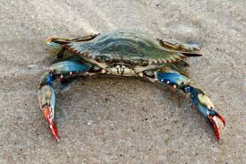
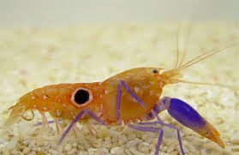
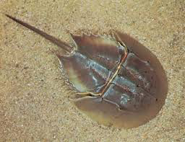
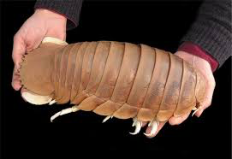
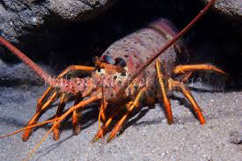
Blue crab
shrimp
Horseshoe
crab
Giant isopod
lobster

Slide 5
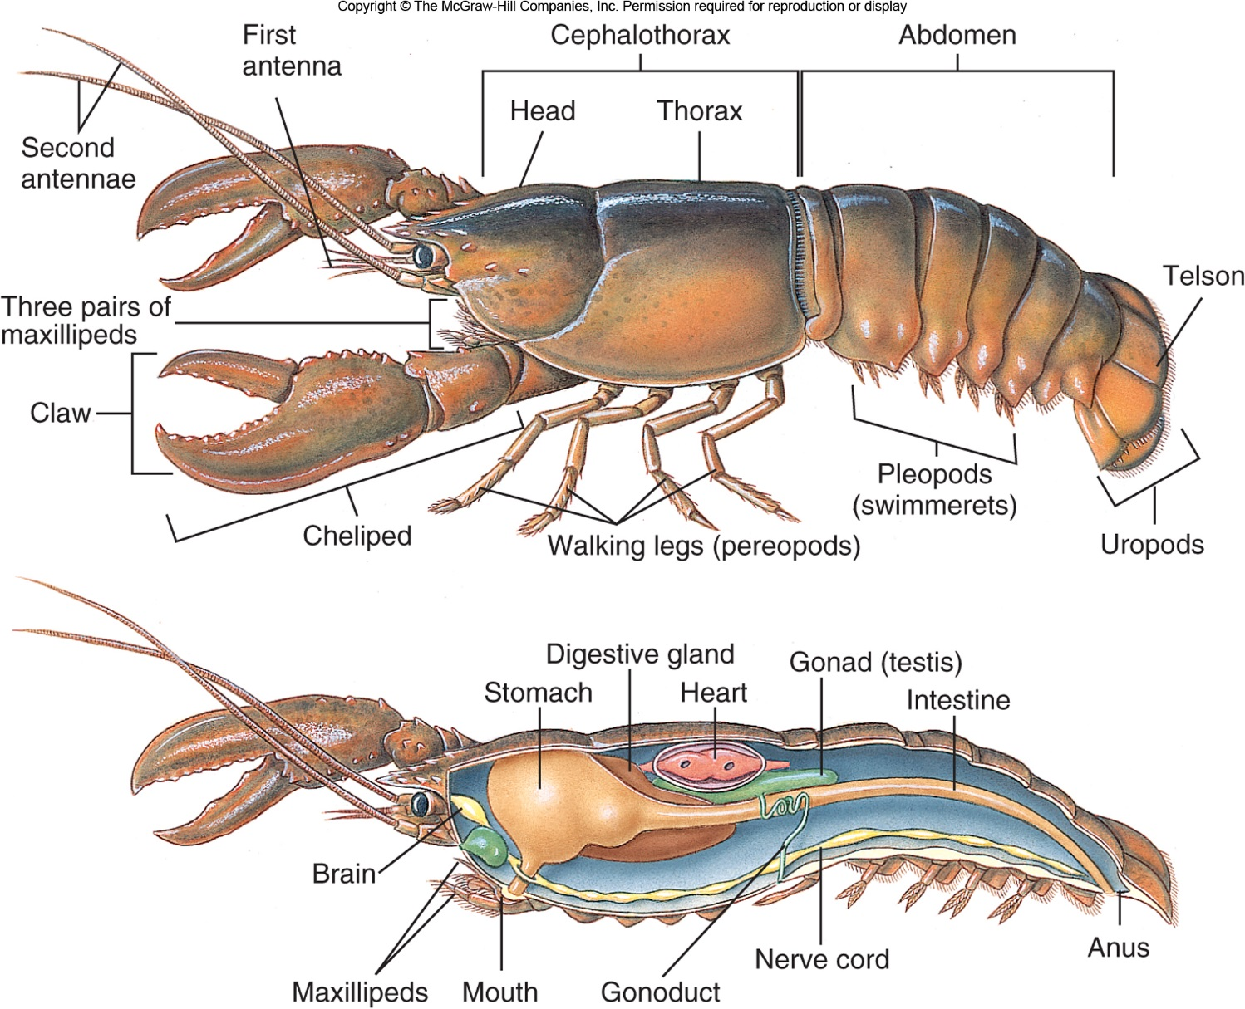
Crustaceans: Shrimp, Lobster and Crabs
Free-ranging benthic organisms
Feed on detritus or are predatory
two pairs of antennae
mouths made up of one pair of mandibles (which are eating appendages behind the crustacean's antennae) and two pairs of maxillae (mouth parts located after the mandibles).

Slide 6
Shrimp external anatomy
Crab external anatomy

Slide 7
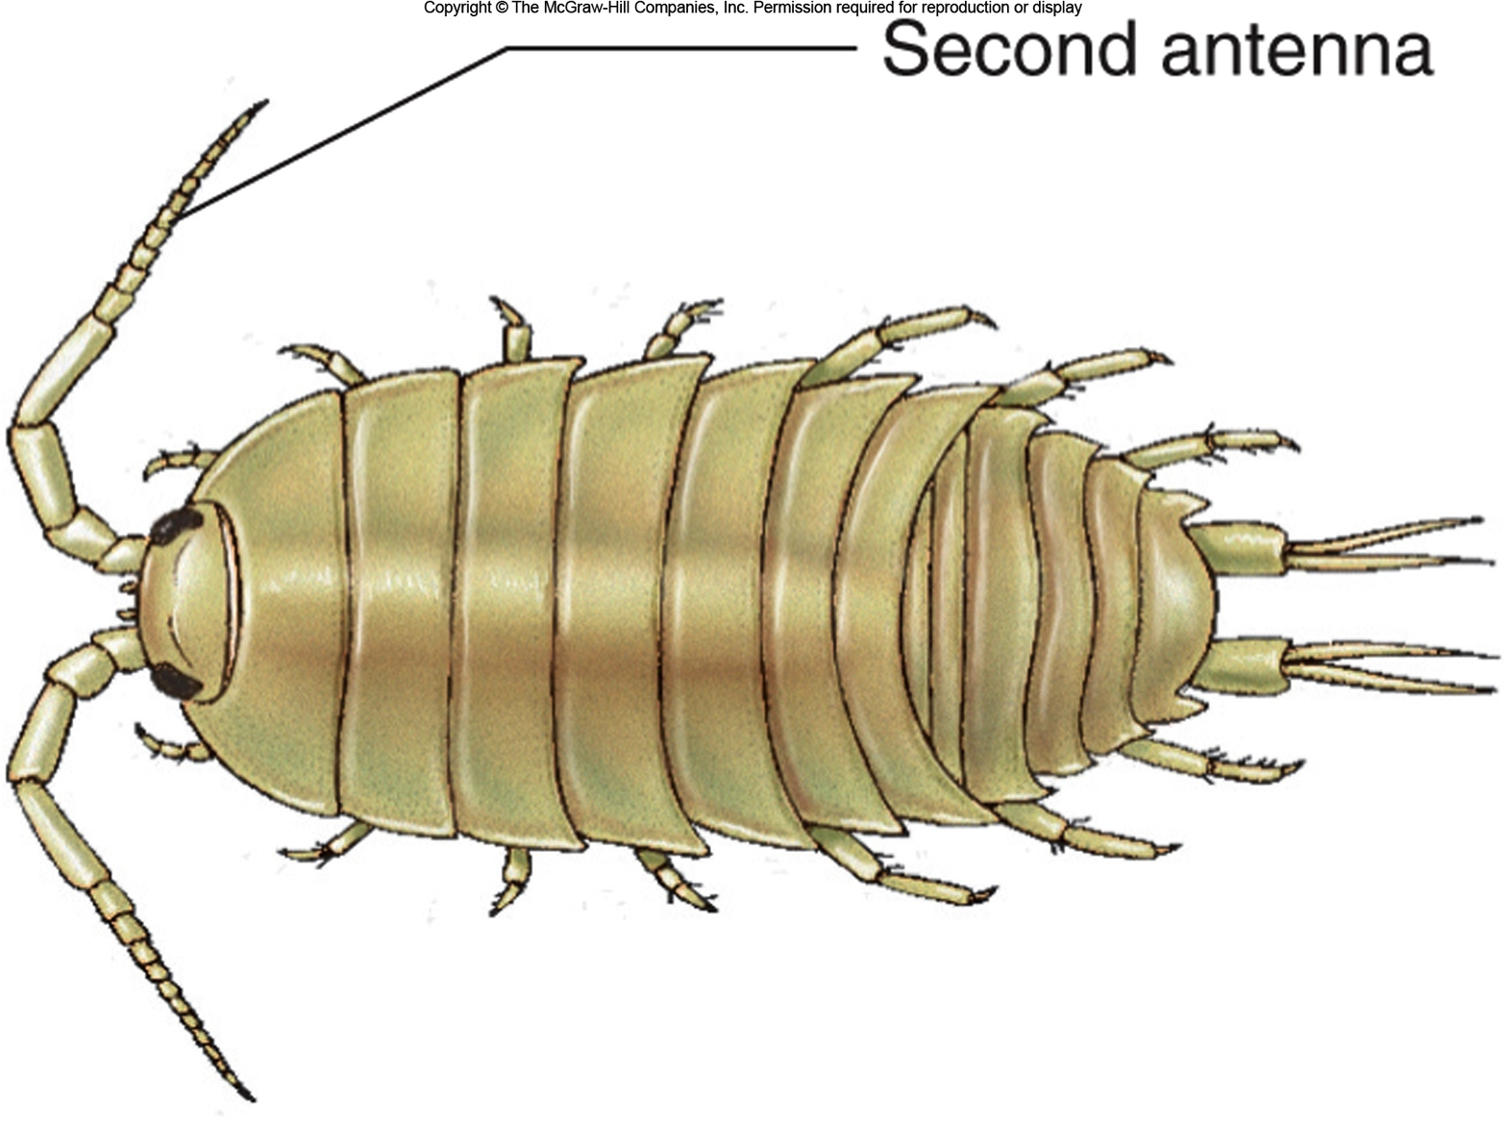
Isopod: cousin of the terrestrial sow bug/pill bug

Slide 8
Barnacles: Sessile Crustaceans
As larva, the barnacle attaches to any surface, glues its head down and builds its shell around itself.
body is folded up within its shell, so that its appendages (legs) can protrude from the opening. When the tide comes in and covers it, the barnacle opens its shell plates and extends its six pairs of feathery appendages, called cirri.

Slide 9
Other Marine Arthropods
Horseshoe Crabs (Class Merostomata)
5 pairs of legs, first pair modified in males for reproduction
Mating pairs come onto beaches each spring to breed and lay their eggs in wet sand
Among the oldest creatures on earth, having remained virtually unchanged for millions of years
They live and burrow in soft sediments, normally near shore, where they scavenge and feed on other invertebrates

Slide 10
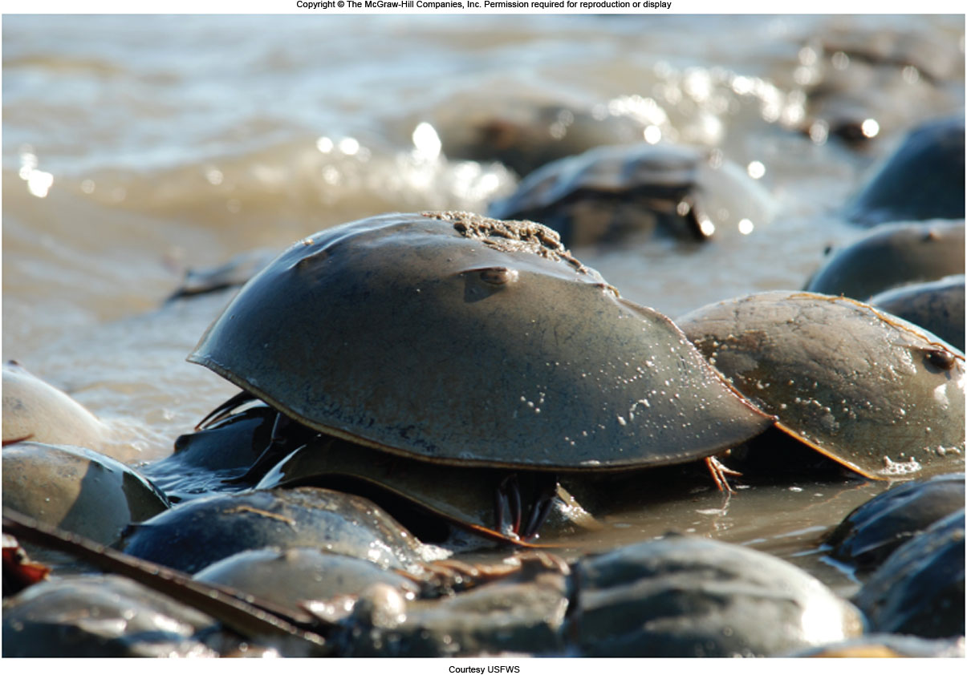
Insert new Fig. 7.40

Slide 11
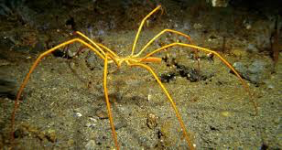
Other Marine Arthropods
Sea Spiders (Class Pycnogonida)
Four of more pairs of jointed legs
Proboscis for feeding on soft invertebrates like
sea anemones and hydrozoans
- More common in cold water, but found worldwide

Slide 12
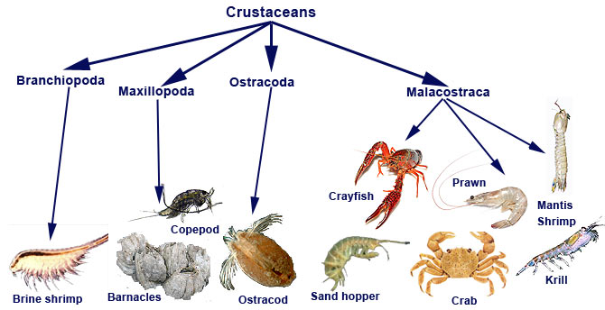
Worksheet: Arthropods Video
Mantis Shrimp Video
Assignment: Read the arthropods and crustaceans article and answer the questions

