Slide 1
Interactions Between Marine Organisms
Symbioses and Predation

Slide 2
Ecology Day 2: Interactions
Organisms and populations in any ecosystem interact with each other
Interactions keep the ecosystems in balance

Slide 3
What do these mean? (Brainstorm together)
competition
when two or more organisms rely on the same environmental resource
predation
behavior of one animal feeding on another
symbiosis
the close relationship of two dissimilar organisms
mutualism
a symbiotic relationship where both organisms benefit
commensalism
a symbiotic relationship where one organism benefits and one does not benefit but is unharmed
Parasitism
a symbiotic relationship where one organism benefits and one is harmed

Slide 4
Competition
Competition occurs when two different species use the same limiting resource they both require for survival
Organisms can compete with members of their own species – intraspecific competition – or members of other species – interspecific competition

Slide 5
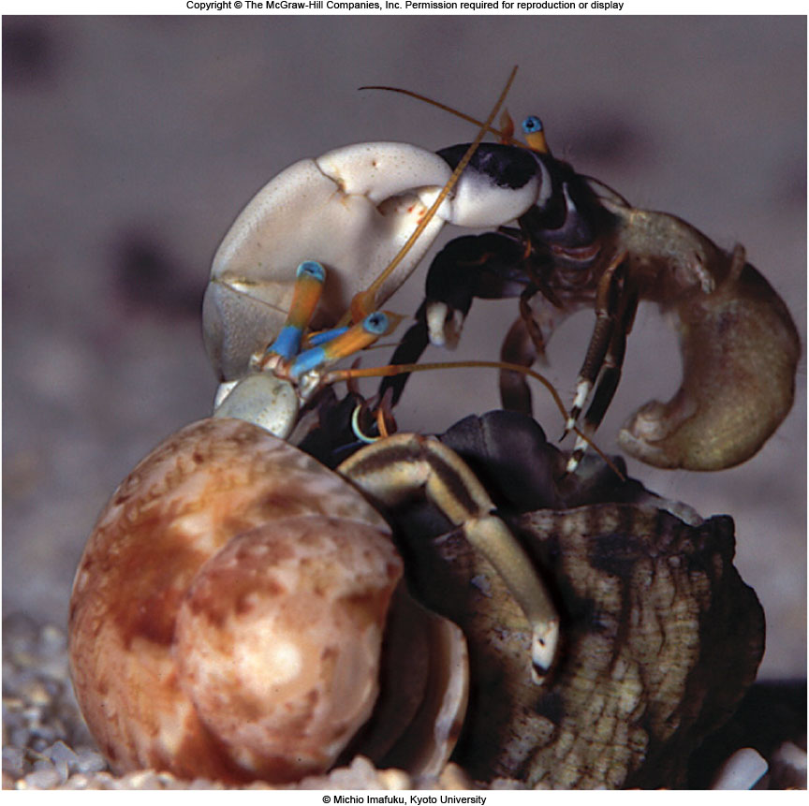
Hermit Crabs competing for shelter
Competition for food: whales, birds, and other animals all feed on krill. If a bigger animal is in the area they will scare off the other animals.
Blue whales eating krill

Slide 6
Acquiring food
Herbivores in the ocean eat algae, grasses
Foraging behaviors (grazing)
Predators eat other animals:
Starfish eat molluscs
Butterfly fish and other reef consumers eat algae and coral bodies
Many open-water fish and cephalopods are filter feeders or opportunistic eaters (tuna and squid eat smaller fish)
Seabirds hunt and eat fish
Baleen whales filter feed small fish and krill
Top marine predators include:
Orca
Sharks
Dolphins
Otters
Polar Bears

Slide 7
Video: Sardine Ball Feeding Frenzy

Slide 8
Symbiosis – species living in close association
Types of Symbiosis:
1. Mutualism - both species benefit (examples: cleaning associations, zooxanthellae and corals, pistol shrimp and goby)
2. Commensalism - one species benefits with no apparent effect on the other (example: barnacles living on whales, sharks and ramoras)
3. Parasitism - one species benefits & the other is harmed (example: tapeworms in the guts of whales).
Notes:
Mutualistic relationship between squid (Euprymna scolopes) and bacteria (Vibrio fischeri) found in squid’s light-emitting organ. Bacteria are sheltered & fed, while the nocturnal squid evades predators or hides from prey as the glow from its bacterial passengers mimics moonlight coming from above.

Slide 9
Assignment
Symbioses worksheet
Open Ocean Predators: on Canvas. Click the link, read the description of the animals of every predatory level. Rewrite a summary, include animals in each category.

