Slide 1
Starter Questions: on the Google Classroom
What does the word “Porifera” mean?
Pore-bearing
What is a choanocyte? What do they do?
Collared cell with flagella. Move water through the sponge
What is the osculum?
Larger hole through which water moves out of the sponge

Slide 2
Phylum Cnidaria: Siphonophores, Jellies, Corals, Anemones
Day 1

Slide 3
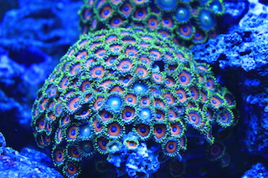
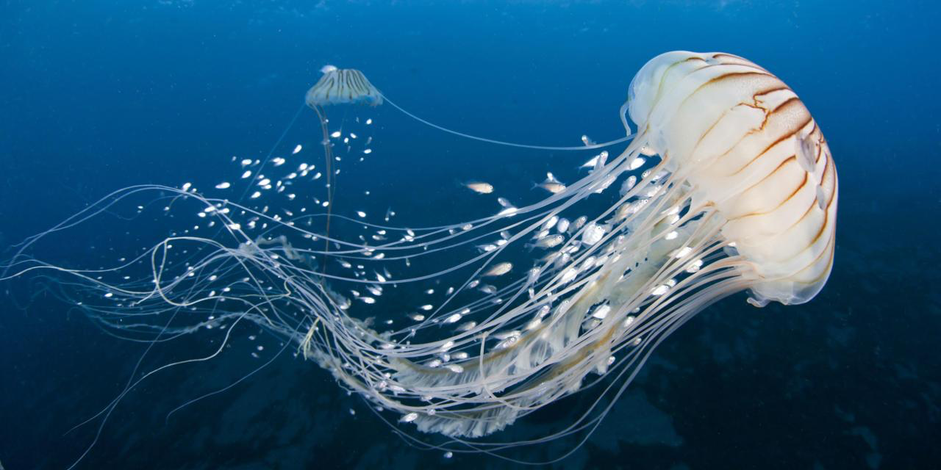
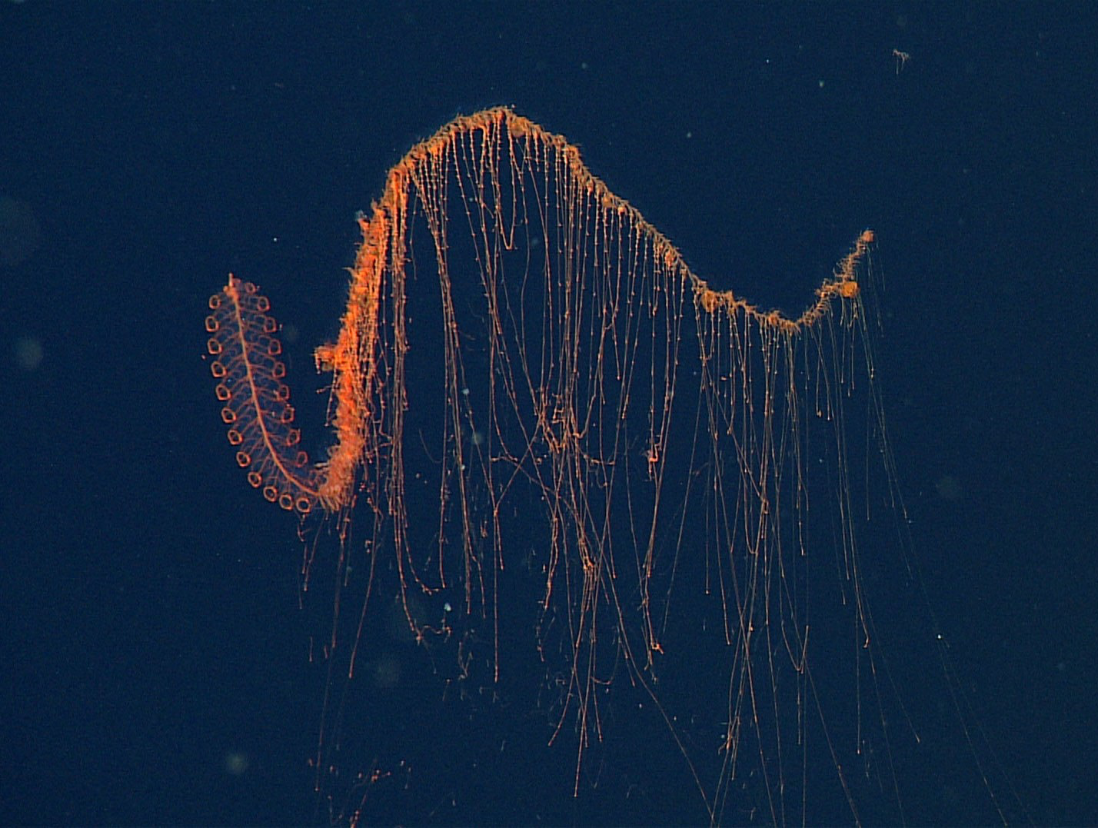
Phylum Cnidaria
Coral
Anemone
Siphonophore
Jelly

Slide 4
Cnidarians (Phylum Cnidaria)
Basic characteristics:
Radial symmetry
Two tissue layers, no organs
Epidermis covers body surface
Gastrodermis lines internal body cavity; specialized for digestion
Nematocysts (stinging cells) within specialized cells (cnidocytes) on tentacles. Used for protection and feeding
Digestive system is incomplete (sac-like with mouth only)
Nerve net throughout body coordinates movements
Have light sensing cells, but no eyes

Slide 5
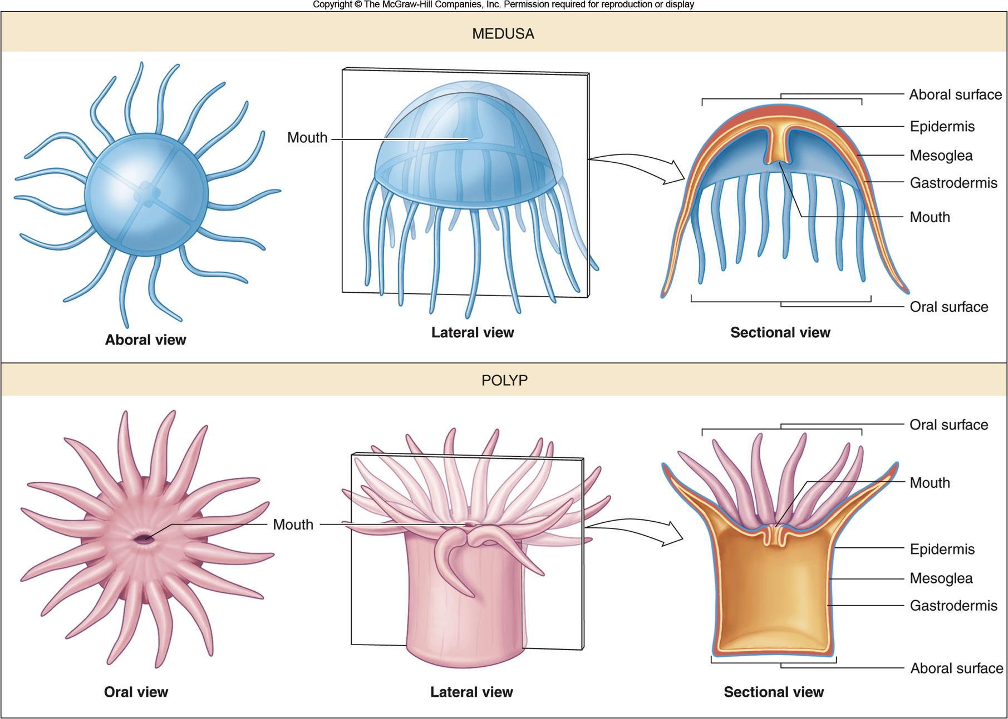
Cnidarian Body Forms:
Medusa – free-swimming form that is transported by water currents, mouth with surrounding tentacles positioned downwards
Polyp – attached form with mouth and tentacles positioned upwards
All cnidarians go through both phases in their life cycle.

Slide 6
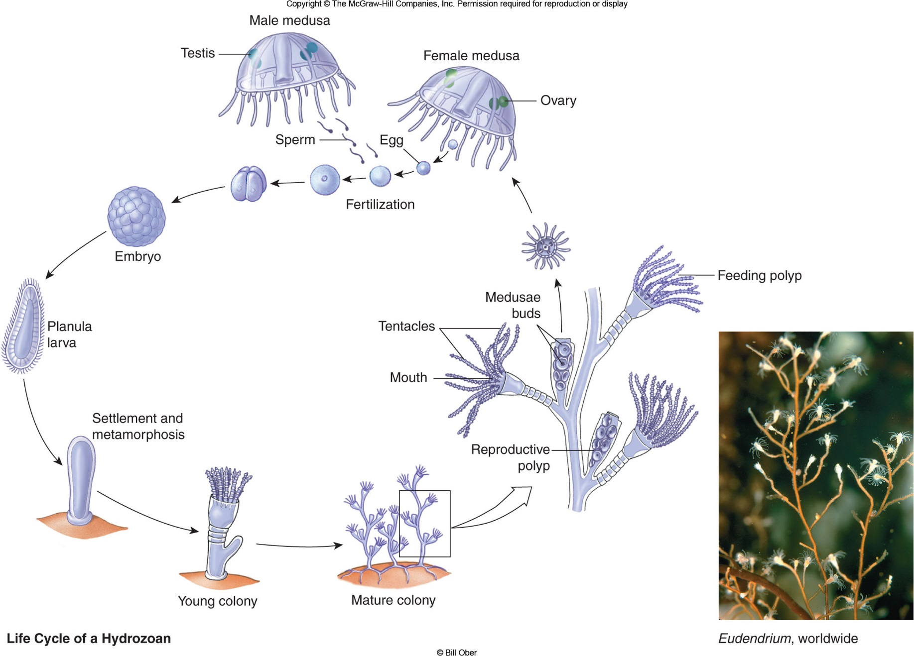
http://www.viewpure.com/d5DpB6ycUDc?ref=bkmk

Slide 7
Nematocysts and Cnidocytes
Weapons that are used for protection, stunning prey, defense.
Nematocyst- organelle constructed as an explosive harpoon tipped with neurotoxin.
Cnidocyte- Cells containing nematocyst. Located on the tentacles
Video

Slide 8
Classes of Cnidarians
Hydrozoans (Class Hydrozoa)
Most consist of colony of polyps, with small reproductive medusae
Siphonophores – hydrozoans that form drifting colonies of polyps
Portuguese man-of-war (Physalia) – siphonophore carried by a gas-filled float; some of the polyps with long tentacles armed with stinging nematocysts

Slide 9
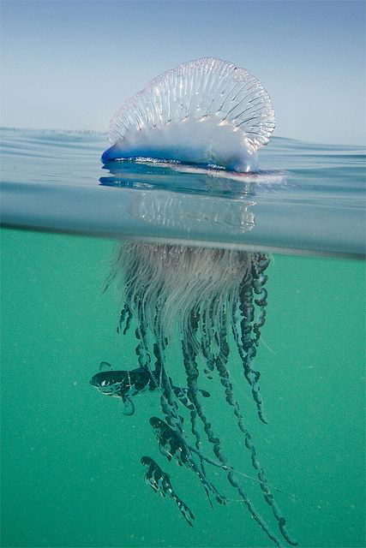
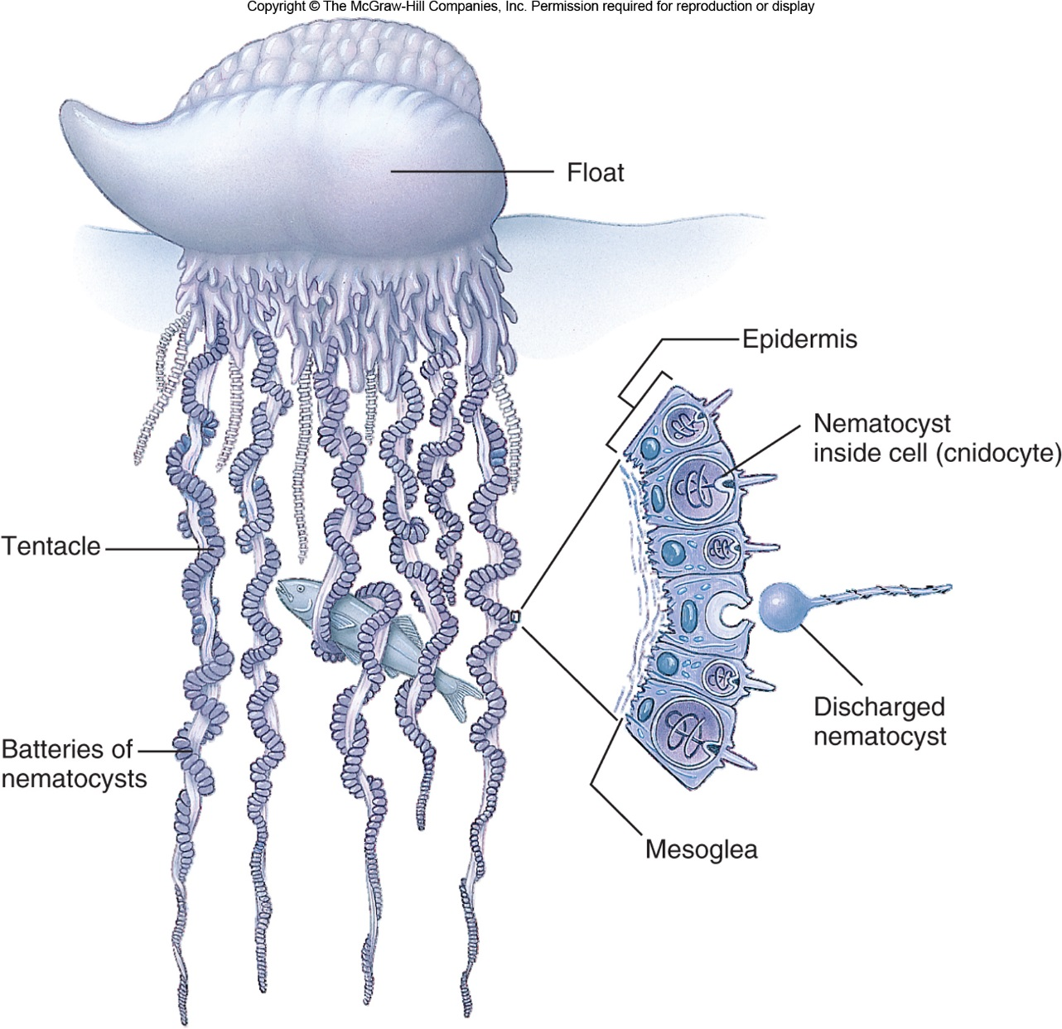
Portugese Man 0’ War
Video! http://www.viewpure.com/RRk3VqE9Zoc?ref=search

Slide 10
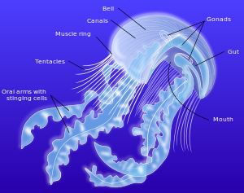
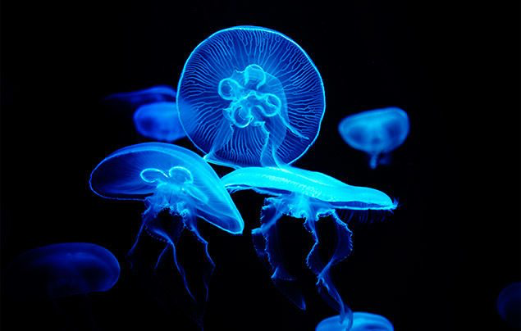
Class Scyphozoa
Jellyfishes (sea jellies)
Large medusae (adults)
minute sessile polyps (larvae)
Move by rhythmic muscular contractions of the bell, but carried by water currents

Slide 11
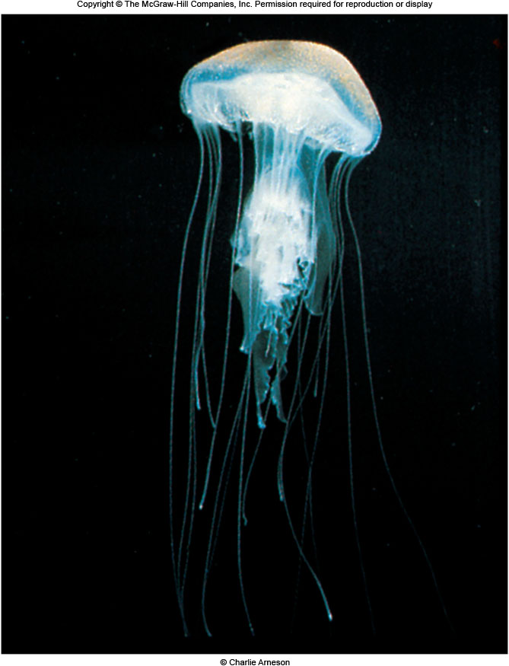
Video

Slide 12
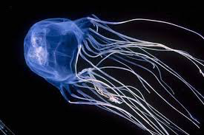
Class Cubozoa
Cubomedusae -Small medusae with tentacles armed with very powerful nematocysts that may cause death in humans
Called the Box jellyfish or sea wasp

Slide 13
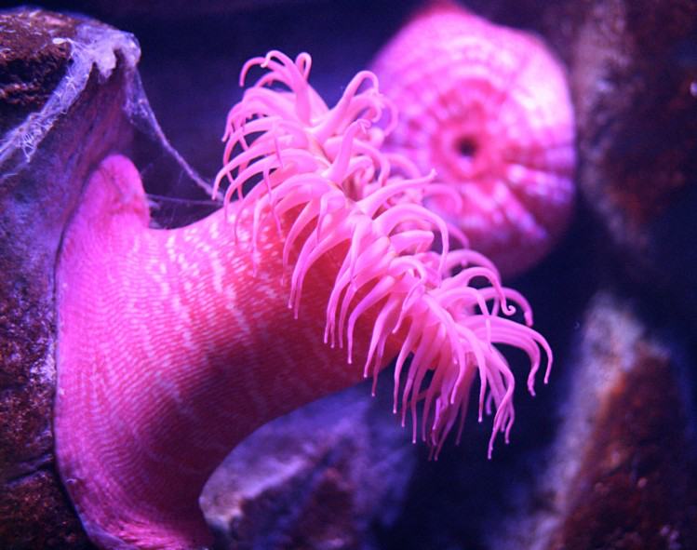
Anthozoans (Class Anthozoa)
- Corals, sea anemones, gorgonians (sea fans)
Single or colonial polyps without a medusa
Most reef-building corals are colonial: interconnected polyps that develop asexually from a single polyp
.
Anemone Video
And they WALK

Slide 14
Assignment: Cnidarian Stings
For each of the listed types of cnidarians on the table, search the internet and find a species, where they are found, and how bad their sting is.

