Slide 1
Starter Questions: Google classroom (get your computer)
What are zooxanthellae?
Symbiotic algae that live in the bodies of corals
What are coral reefs made by and from? (Body form and anatomical structure)
Polyps, skeletons
Which cnidarian body form is sessile?
Polyp
Back to poriferans: what is an osculum?
opening that water flows out of

Slide 2
Reminders!
All work for this unit is due next Wednesday 10/16 end of day. (The quarter ends Friday 10/25)
If you have not paid your fee, please go do so. ($15 on Skyward or to the office, tell them it is for Marine Biology).

Slide 3
Phylum Echinodermata
Spiny-skinned marine invertebrates

Slide 4
Echinoderms (Phylum Echinodermata)
Basic characteristics:
Pentamerous (based on five parts) radial symmetry
Water vascular system with tube feet for locomotion and feeding
Skin gills for respiration
Nervous system is decentralized: brain is absent, no head
Exoskeleton; bony plates embedded in skin.
Many can easily regenerate lost body parts

Slide 5
Types of Echinoderms: Class Asteroidea
Sea stars
Characteristics:
Move with tube feet
Have a central disc in center of body surrounded by five arms (or multiples of 5 with as many as 50 arms)
Internal organs extend through the entire body, including the arms
Calcium carbonate plates are loosely embedded in spiny skin making them slightly flexible
Pedicellariae – pincer-like organs that keep skin clean
Mostly benthic (stay on the sea floor) carnivores

Slide 6
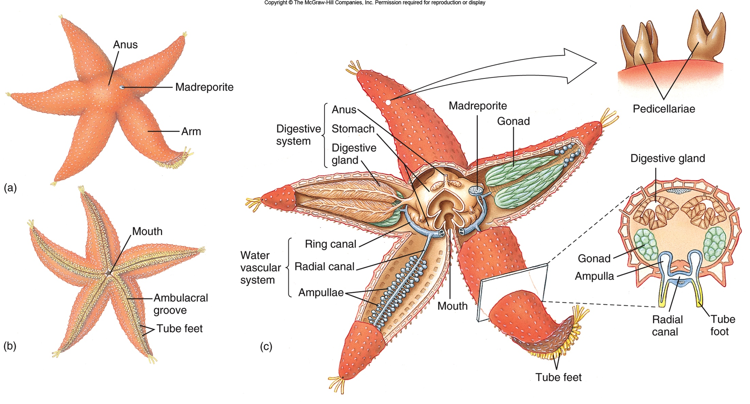
Sea Star (Asterias vulgaris)

Slide 7
Types of Echinoderms: Class Echinoidea
Sea Urchins, Sand Dollars Characteristics:
Conspicuous, movable spines (short in sand dollars)
Rigid plates fused into a solid test
Move with tube feet
Mouth on the bottom, anus on top of body
Biting mouth for grazing with Aristotle’s lantern, a feeding structure of jaws and muscles
Feed on seaweeds, detritus, and encrusting organisms they scrape off benthic surfaces

Slide 8
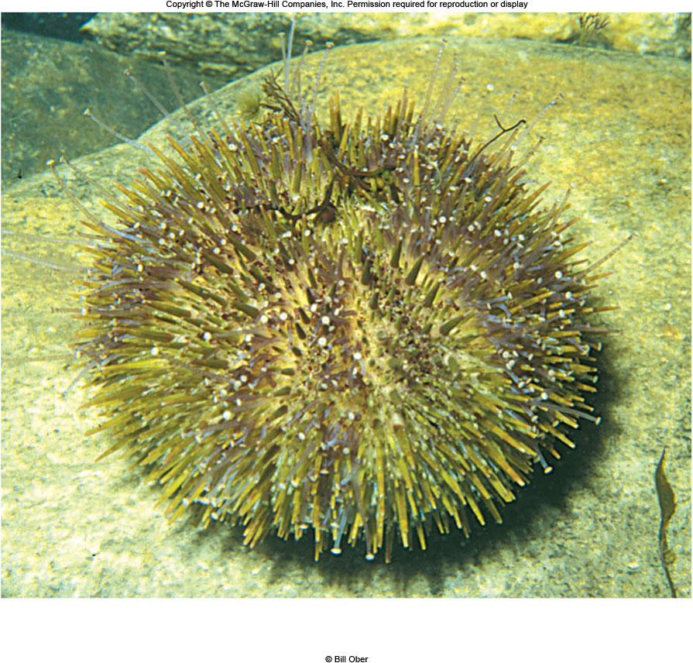
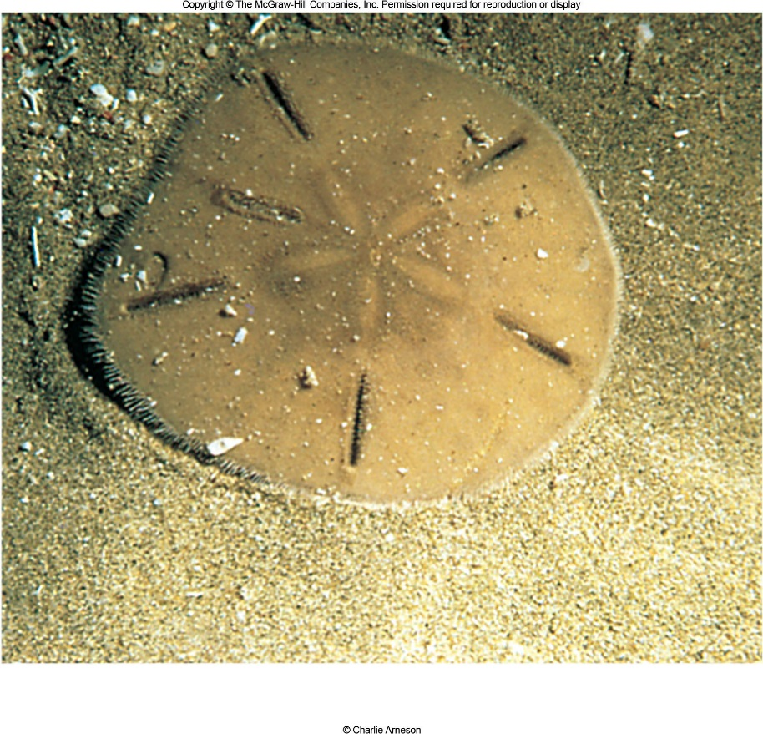

Slide 9
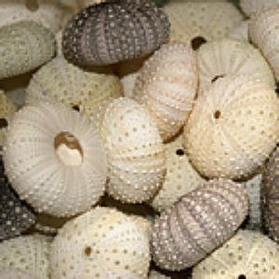
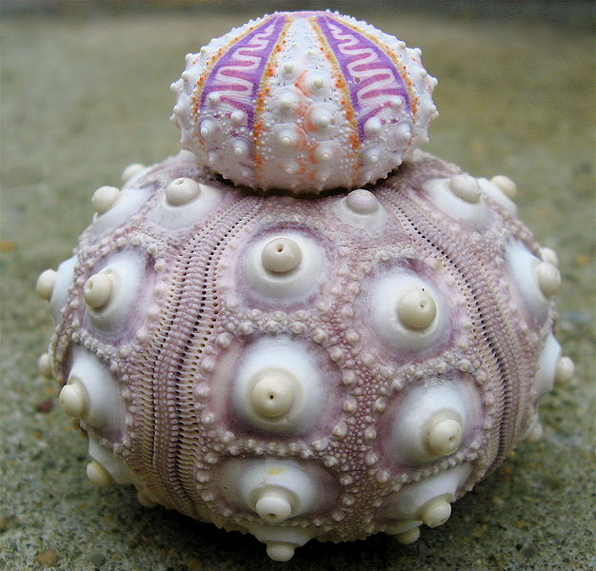
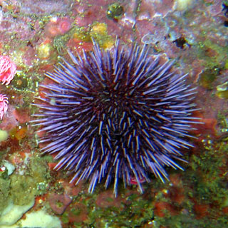
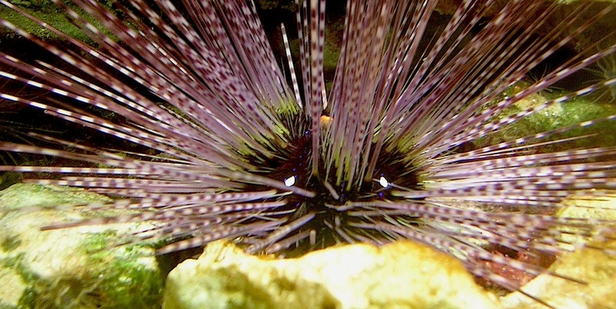
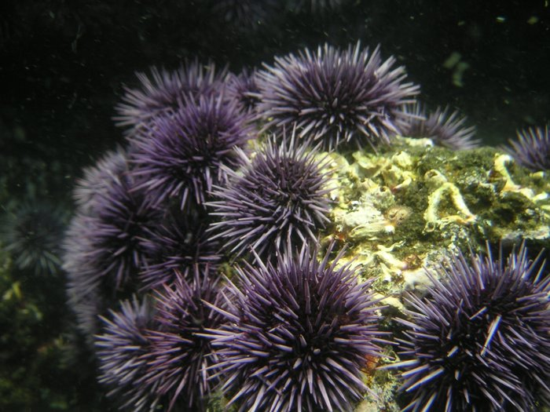

Slide 10
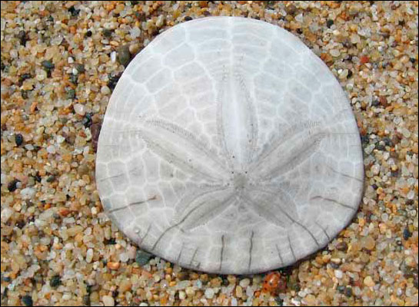
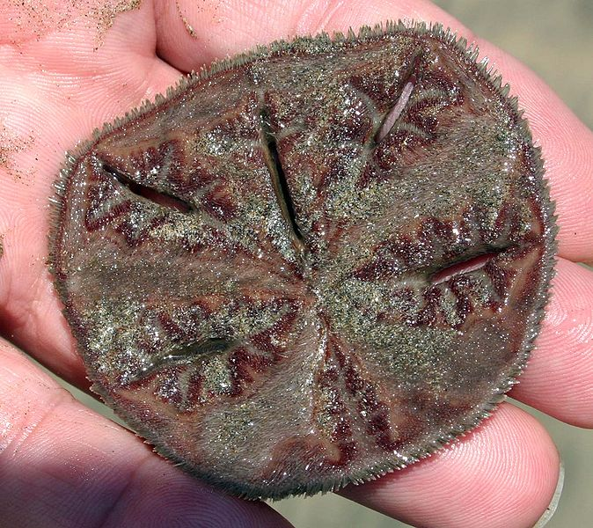
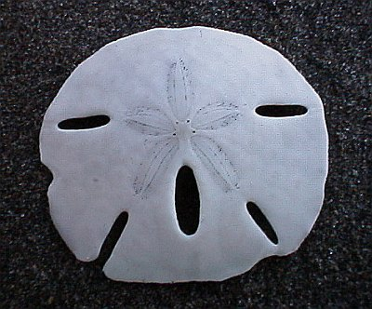
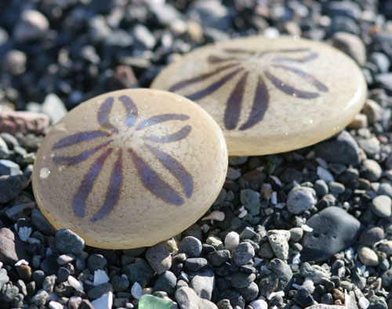
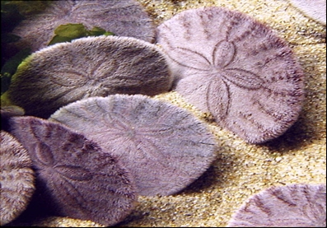

Slide 11
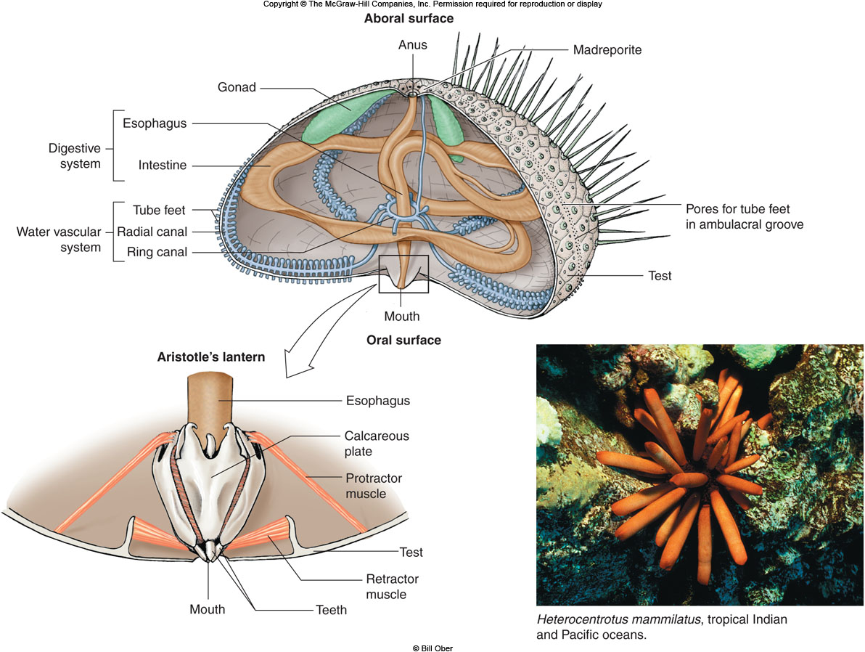

Slide 12
Types of Echinoderms: Class Holothuroidea
Sea cucumbers
Worm-like, with mouth and anus on opposite ends and five rows of tube feet restricted to one side
Still radially symmetrical (even if superficially appearing to have bilateral symmetry)
Skin embedded with calcareous spicules, no spines
Benthic, scavenging detritovores
Evisceration - expulsion of the internal organs when disturbed; internal organs regenerate back.

Slide 13
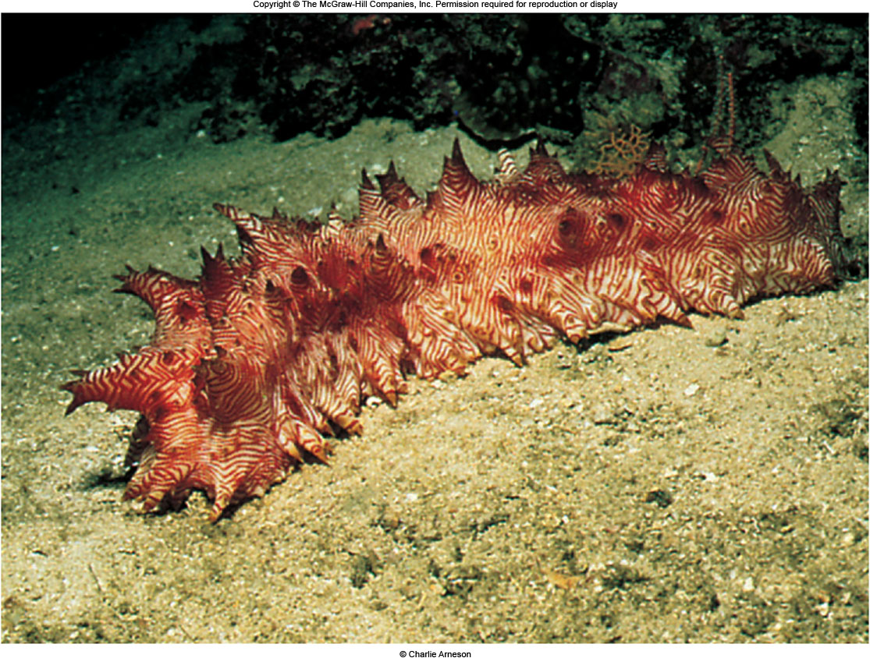
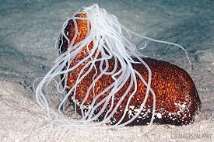
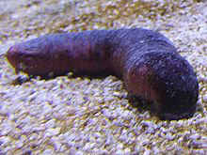
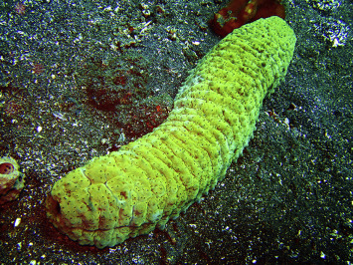
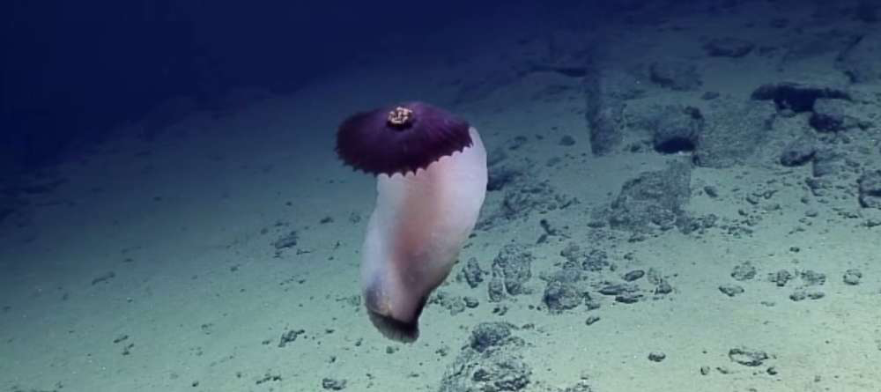
Evisceration
Evisceration video

Slide 14
Types of Echinoderms: Class Crinoidea
Crinoids: Sea lilies live attached in deep water, feather stars crawl on the bottom and live mostly in shallow-water coral reefs
Five or more arms that branch out for suspension feeding
Mostly in deep water but many inhabit coral reefs in the tropics

Slide 15
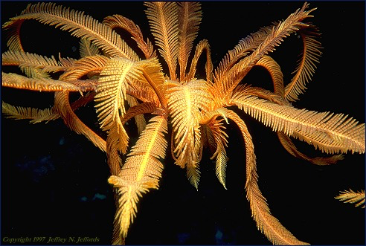
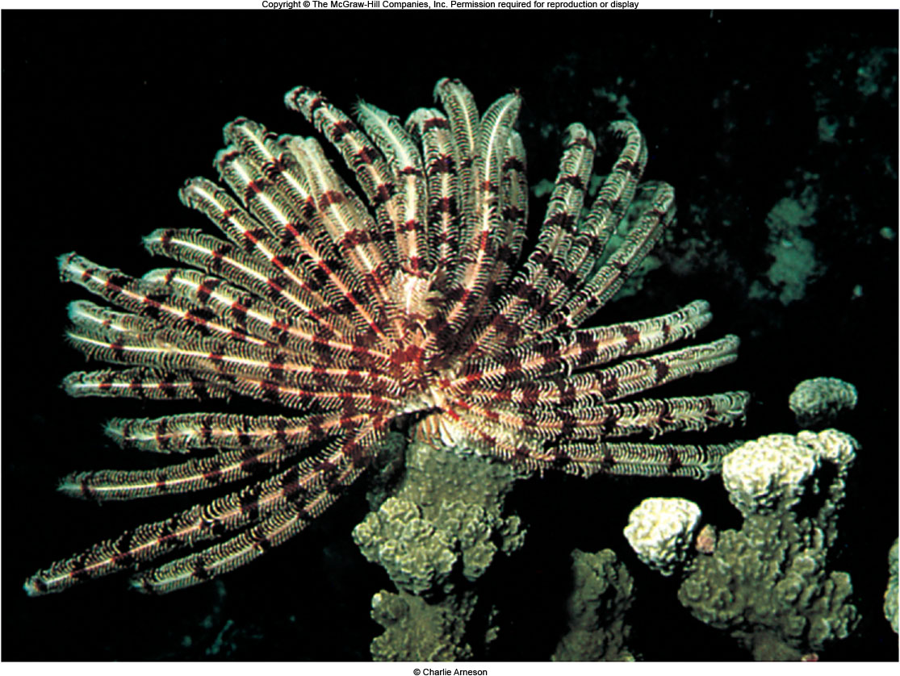
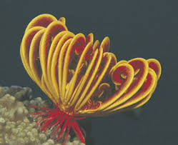
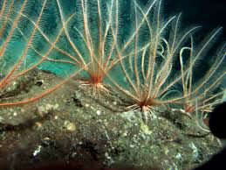
WATCH THIS VIDEO!!!

Slide 16
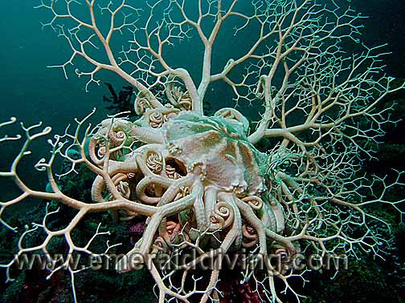
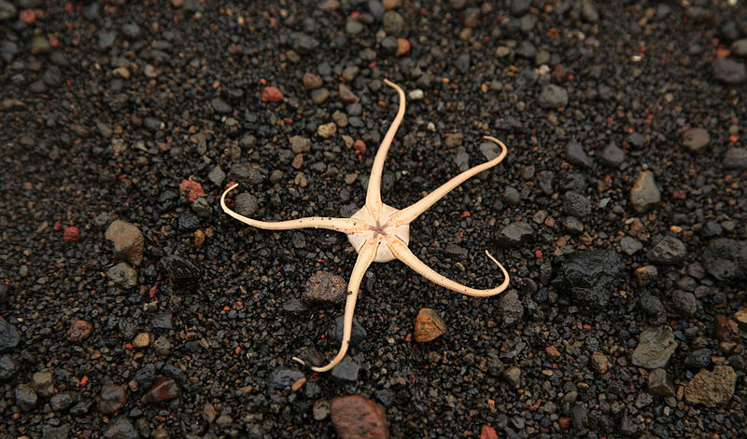
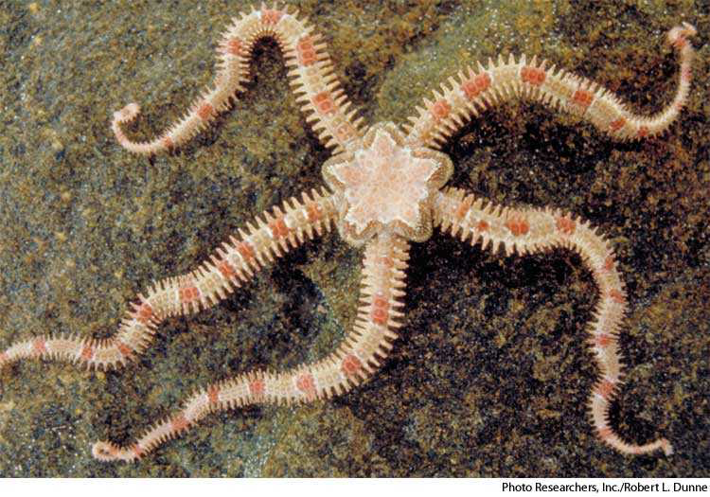
Types of Echinoderms: Class Ophiuroidea
Brittle Stars and Basket stars
Central disc surrounded by thin, flexible arms
Internal organs are restricted to the central disc
Tube feet without suckers used for feeding on detritus and small animals

Slide 17
Echinoderm video
Fill in the answers from the video on your note guide
Assignment: Echinoderm packet on Google doc
Assignment: Echinoblog evaluation
Due Tuesday 10/15

