Slide 1
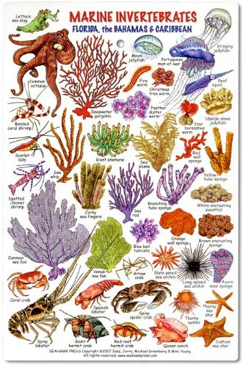
Unit 2
Marine Animals Without a Backbone
Copyright © 2016 McGraw-Hill Education. All rights reserved. No reproduction or distribution without the prior written consent of McGraw-Hill Education.

Slide 2
Sponges (Phylum Porifera)
Basic characteristics:
All are sessile (attached), some encrusting on hard substrates.
Numerous tiny pores (ostia) allow water to pass through the body for filter feeding on plankton and organic matter in the water.
Water flow also carries waste and gametes away
Mostly marine
Asymmetrical body plan with no tissues or organs: colony of different types of cells

Slide 3
Sponges (Phylum Porifera)
Types of sponge cells:
Choanocytes (collar cells)
line interior canals
flagella create a water current that brings in food particles
collar on choanocyte traps food particles.
Pinacocytes - flattened cells that cover exterior of body
Porocytes – cells with a pore to allow water to pass into body
Ameobocytes – motile cells that perform many functions
Spicules: (not cells, just structures in the body wall) small calcium or silica structures used for support

Slide 4
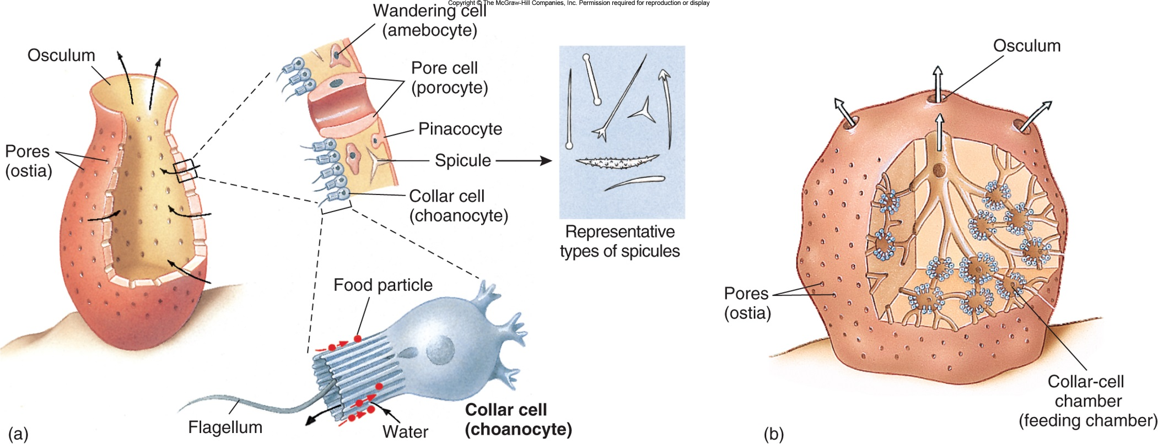

Slide 5
Sponges (Phylum Porifera)
Reproduction:
Asexual budding – buds break off and grow into a new sponge
Sexual - sperm are released into the water (broadcast spawning) to be picked up by a nearby sponge and directed to egg.
Most sponges are hermaphrodites (produce both sperm and eggs).

Slide 6
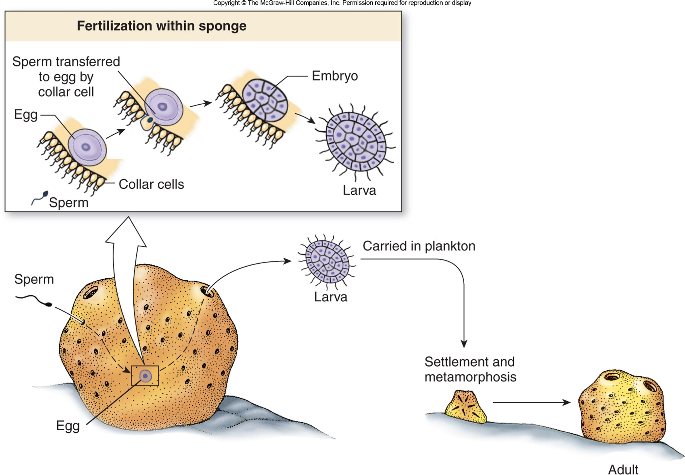

Slide 7
Videos!
Biology of Sponges
Abnormal biology of Sponges
Assignment: Read and highlight the Sponge Morphology article. Color the diagrams, using a different color for each structure.

