Slide 1
Starter Questions 1/27/2016
When you have paid your lab fee, what do you do with the receipt?
  Bring it to Mrs. Fravel
If you are absent, how do you find the assignment?
  Canvas and/or the class folder
What is the difference between Marine Biology and Oceanography?
  MB studies living organisms, Oceanography studies abiotic factors.
What is one abiotic factor in the ocean?
  Tides, currents, salinity, ocean zones
What is one group of living organisms in the ocean?
  Invertebrates, Fish, Reptiles, Birds, Mammals, Plants

Slide 2
Water and Seawater
Properties

Slide 3
Overview
Water has many unique thermal and dissolving properties.
Seawater is mostly water molecules but has dissolved substances.
Ocean is layered by salinity and density differences.

Slide 4
Freezing and Boiling Points
Freezing point = melting point: 0°C (32°F)
Boiling point = condensation point: 100°C (212°F)
Freezing and boiling points of water unusually high

Slide 5
Global Thermostatic Effects
Moderate temperature on Earth’s surface
  Equatorial oceans do not boil
  Polar oceans do not freeze solid
Marine effect
  Oceans moderate temperature changes from day to night and during different seasons
Continental effect
  Land areas have greater range of temperatures from day to night and during different seasons
  Coastal areas have less temperature fluctuations due to the body of water nearby slowly releasing heat over night.

Slide 6
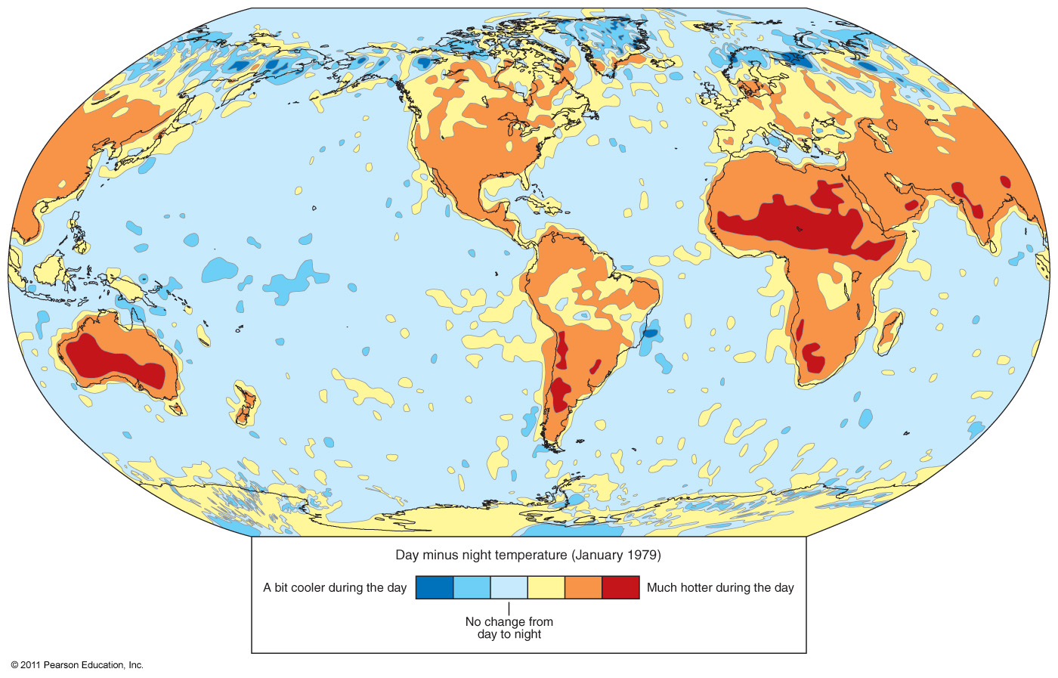
Day/Night Temperature Differences

Slide 7
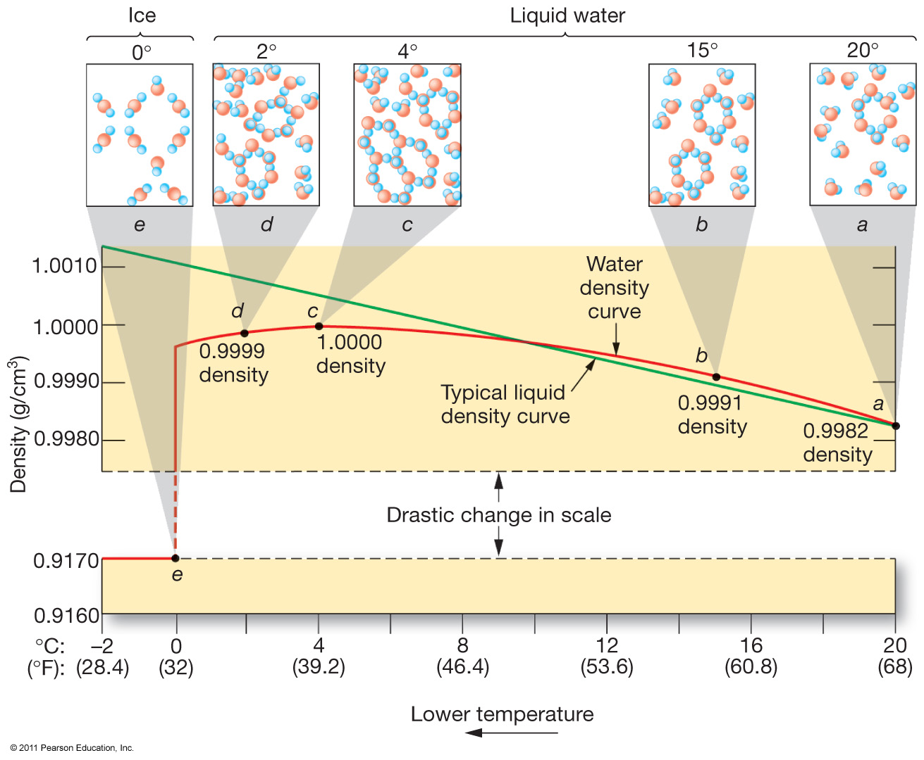
Water Density and Temperature

Slide 8
Water Density
Increasing pressure or adding dissolved substances decreases the maximum density temperature.
Dissolved solids also reduce the freezing point of water.
  Most seawater never freezes.

Slide 9
Salinity
Total amount of dissolved solids in water including dissolved gases
  Excludes dissolved organics
Ratio of mass of dissolved substances to mass of water sample

Slide 10
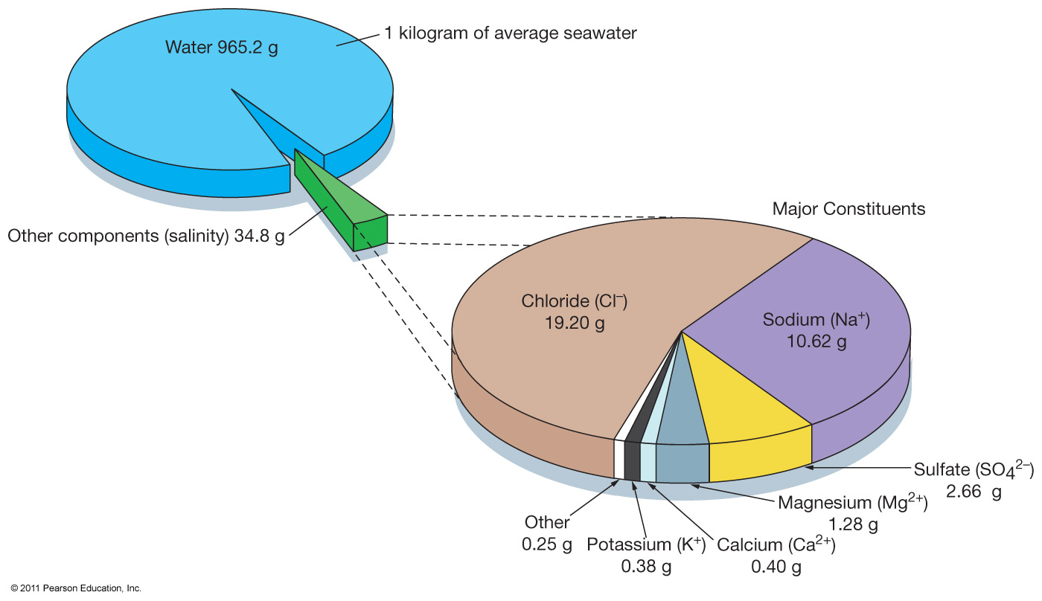
Salinity
Expressed in parts per thousand (ppt)
Typical ocean salinity is 35 ppt (º/_{oo})

Slide 11
Salinity Variations
Open-ocean salinity is 33–38 º/_{oo}
In coastal areas salinity varies more widely.
  An influx of freshwater lowers salinity or creates brackish conditions.
  A greater rate of evaporation raises salinity or creates hypersaline conditions.
  Salinity may vary with seasons (dry/rain).

Slide 12
Processes Affecting Salinity
Decreasing salinity – adding fresh water to ocean
  Runoff, melting icebergs, melting sea ice
  Precipitation
Increasing salinity – removing water from ocean
  Sea ice formation
  Evaporation

Slide 13
Earth’s Water
97.2% in the world ocean
2.15% frozen in glaciers and ice caps
0.62% in groundwater and soil moisture
0.02% in streams and lakes
0.001% as water vapor in the atmosphere

Slide 14
Surface Salinity Variation
High latitudes
  Low salinity
  Abundant sea ice melting, precipitation, and runoff
Low latitudes near equator
  Low salinity
  High precipitation and runoff
Mid latitudes
  High salinity
  Warm, dry, descending air increases evaporation

Slide 15
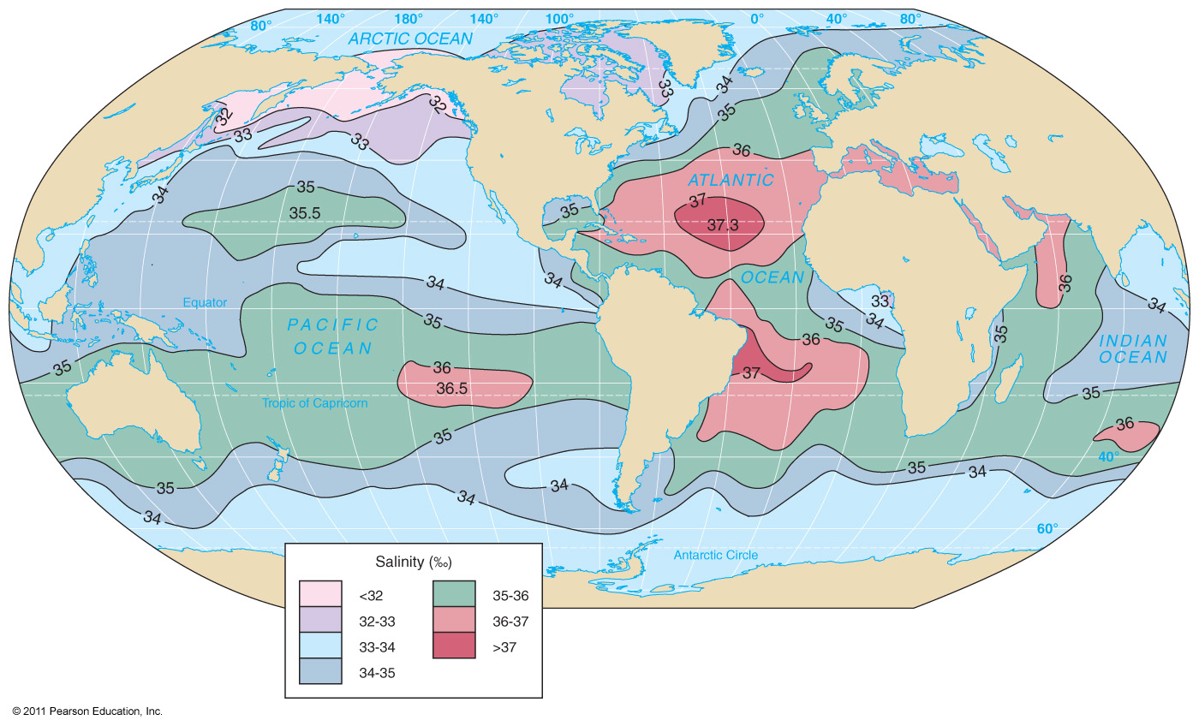
Global Salinity

Slide 16
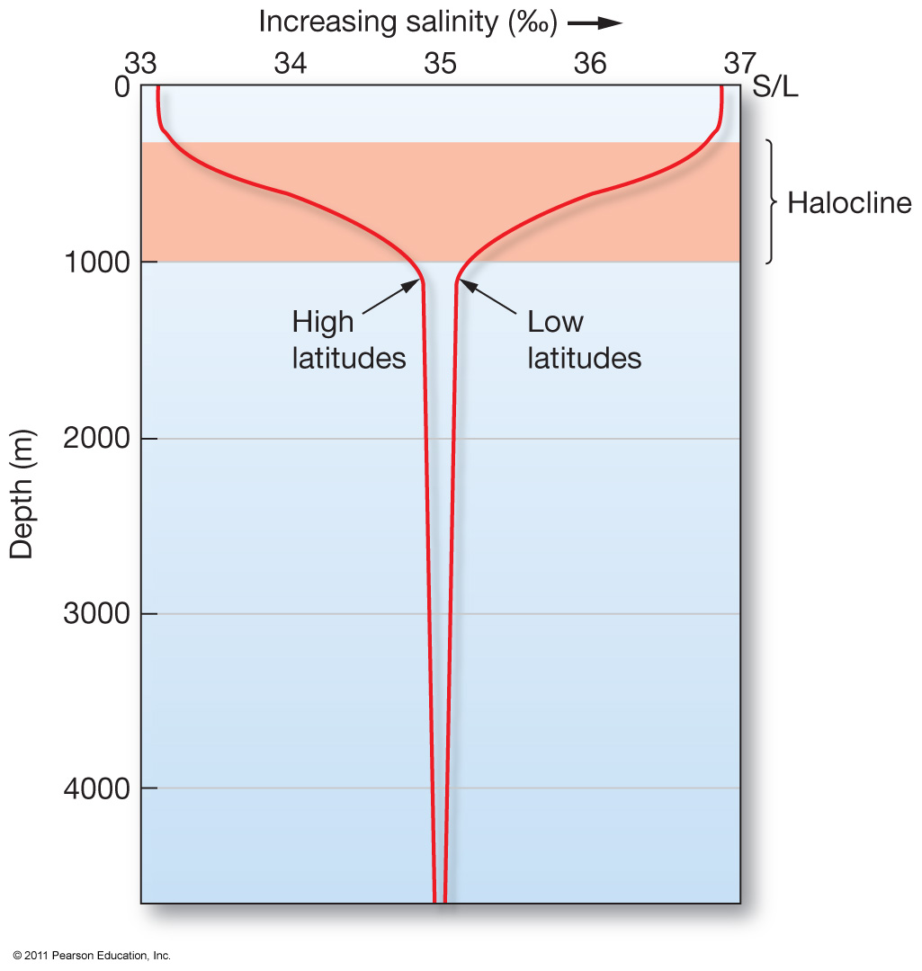
Salinity Variation with Depth
Low latitudes – salinity decreases with depth
High latitudes – salinity increases with depth
Deep ocean salinity fairly consistent globally
Halocline – separates ocean layers of different salinity

Slide 17
Seawater Density
Density increases with decreasing temperature
  Greatest influence on density
Density increases with increasing salinity
Density increases with increasing pressure
  Does not affect surface waters

Slide 18
Osmoregulation
Living organisms must maintain the level of water in their cells
  Water travels down the concentration gradient, so in a hypersaline environment, water rushes out of the cells
Must either actively pump salt out of cells, or actively pump water into cells.
  Marine reptiles and birds have special glands that remove salt and other electrolytes
  Marine mammals have specialized kidneys to remove salts and flush them out with their urine
  Marine invertebrates can generally match their internal salinity to their surrounding environment, but cannot adapt quickly to changing salinity.
  Most fish can either live in salt water or freshwater, but not both.

