Slide 1
Starter Questions Yes, you may use your notes.
Which is more dense: cold salty water, warm salty water or cold freshwater? What does that look like in the ocean?
cold salty water
What does halocline mean? What does it look like?
The layering of the ocean’s waters due to differing salinity
What causes waves?

Slide 2
Water in the World’s Ocean

Slide 3
The World Ocean
How many oceans are there on the planet?
Just one!

Slide 4
The 5 Ocean Basins
Pacific
Atlantic
Arctic
Indian
Southern

Slide 5
Ocean Circulation
Some of the differences seen in different parts of the ocean are due to circulation patterns.
Circulation can occur in the form of waves, currents, and gyres.
Oceanic circulation is significantly driven by wind patterns.
Winds are ultimately driven by sunlight energy.
The circulation of the ocean’s water is crucial to the stability of the climate on Earth

Slide 6
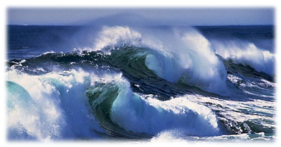
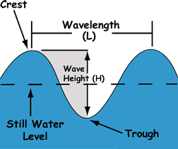
Waves
Waves are the result of wind blowing over the water’s surface.
The size of waves depends on how long and fast the wind blows: longer and faster equals a larger wave.
The size of waves is also larger when the fetch, the amount of open water a wind blows over, is larger.
Crest: highest part
Trough: lowest part
Wavelength: distance between waves
Video! Another video!
One more…

Slide 7
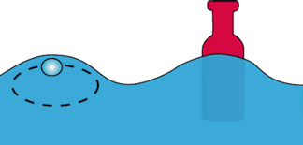
Energy in Water
When energy as a wave passes through the ocean, individual water molecules move up and down but they do not move forward or backward
Water travels in vertical circular orbits
Wave moves, particles don’t (bobbing)

Slide 8
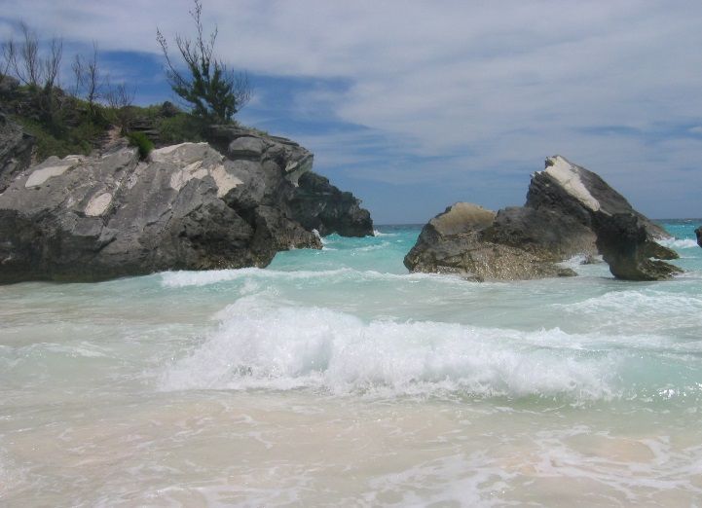
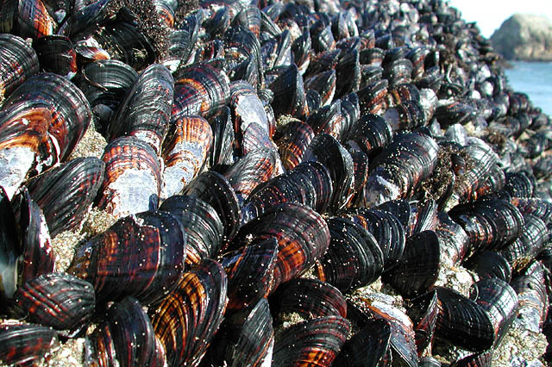
Importance of Waves
Shaping Coastlines
Erode cliffs
Grind rock into sand
Create beaches
Ecology
Returns O₂ to water
Stir up food for filter feeders

Slide 9
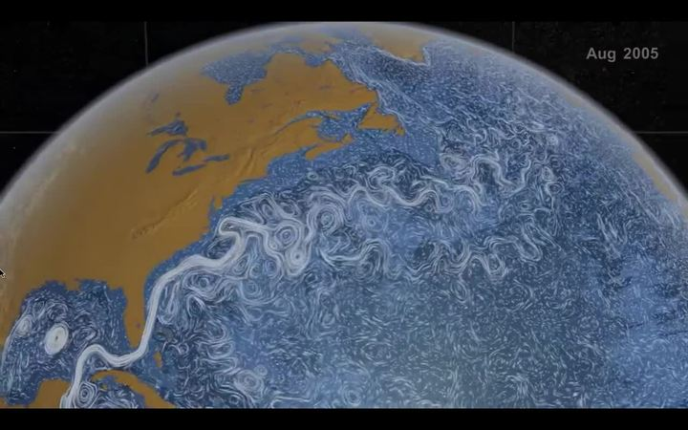
Ocean Circulation: Currents
Surface currents (up to 400 m deep) are also a product of the wind.
Large currents are driven by differences in temperature and salinity. In the Arctic, cold salty water is left behind when ice freezes, and this denser water sinks towards the seafloor.

Slide 10
Currents and the Coriolis Effect
Both winds and currents are affected by the Coriolis Effect:
As the Earth spins on its axis, anything above its surface is deflected, and that object’s path looks curved.
In the Northern Hemisphere, winds and currents are deflected to the right.
In the Southern Hemisphere, winds and currents are deflected to the left.
VIDEO

Slide 11
Ocean Circulation: Gyres
Gyres are large circular currents
Result from accumulating water movement and energy from surface currents
Gyres VIDEO
Notes:
Switch to SOS here!!!

Slide 12
Ocean Circulation: The Great Ocean Conveyor
Thermohaline circulation: deep water circulation driven by salinity and temperature
Brings cold, nutrient-rich water to the surface
Stabilizes global climate
Takes 4,000 years to completely remix the oceans.

Slide 13
The Great Ocean Conveyor
Video!

Slide 14
GOC causes Upwelling
Carries cold, nutrient-rich water from the deep ocean to the surface

Slide 15
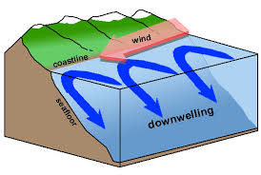
On the opposite side, the GOC causes downwelling
Carries oxygenated water down to the sea floor
Flushes out anaerobic bacteria

Slide 16
Summary of water movement in the ocean:
The sun heats the atmosphere, causing wind
Wind pulls on surface water, creating waves
Wave patterns cause currents
Currents and the Coriolis effect drive gyres
Great Ocean Conveyor: Due to accumulation of currents, gyres, and thermohaline effects, all the water in the ocean is mixed every 4,000 years.

Slide 17
Assignment
1. Ocean Current Worksheet
2. Investigate: Choose to research one of the two topics listed below. Write a 2-3 paragraph summary of what you found, and why you think it might be important. Be sure to include your sources (at least 2, with a link). Submit on Canvas in the assignment.
Topics:
Nike shoe spill
Turtle migration and currents
Slowing of the Great Ocean Conveyor
El Nino

