Slide 1
Starter Questions
1. What are the four parts of the continental margin?
Continental shelf, shelf break, continental slope, abyssal plain
2. How do currents affect landmasses?
Landmasses near warmer currents will have a more mild climate, and landmasses near colder currents will have a colder climate
3. What is the giant circulating current that mixes the entire ocean every 4,000 years?
Great Ocean Conveyor

Slide 2
Ocean Zones

Slide 3
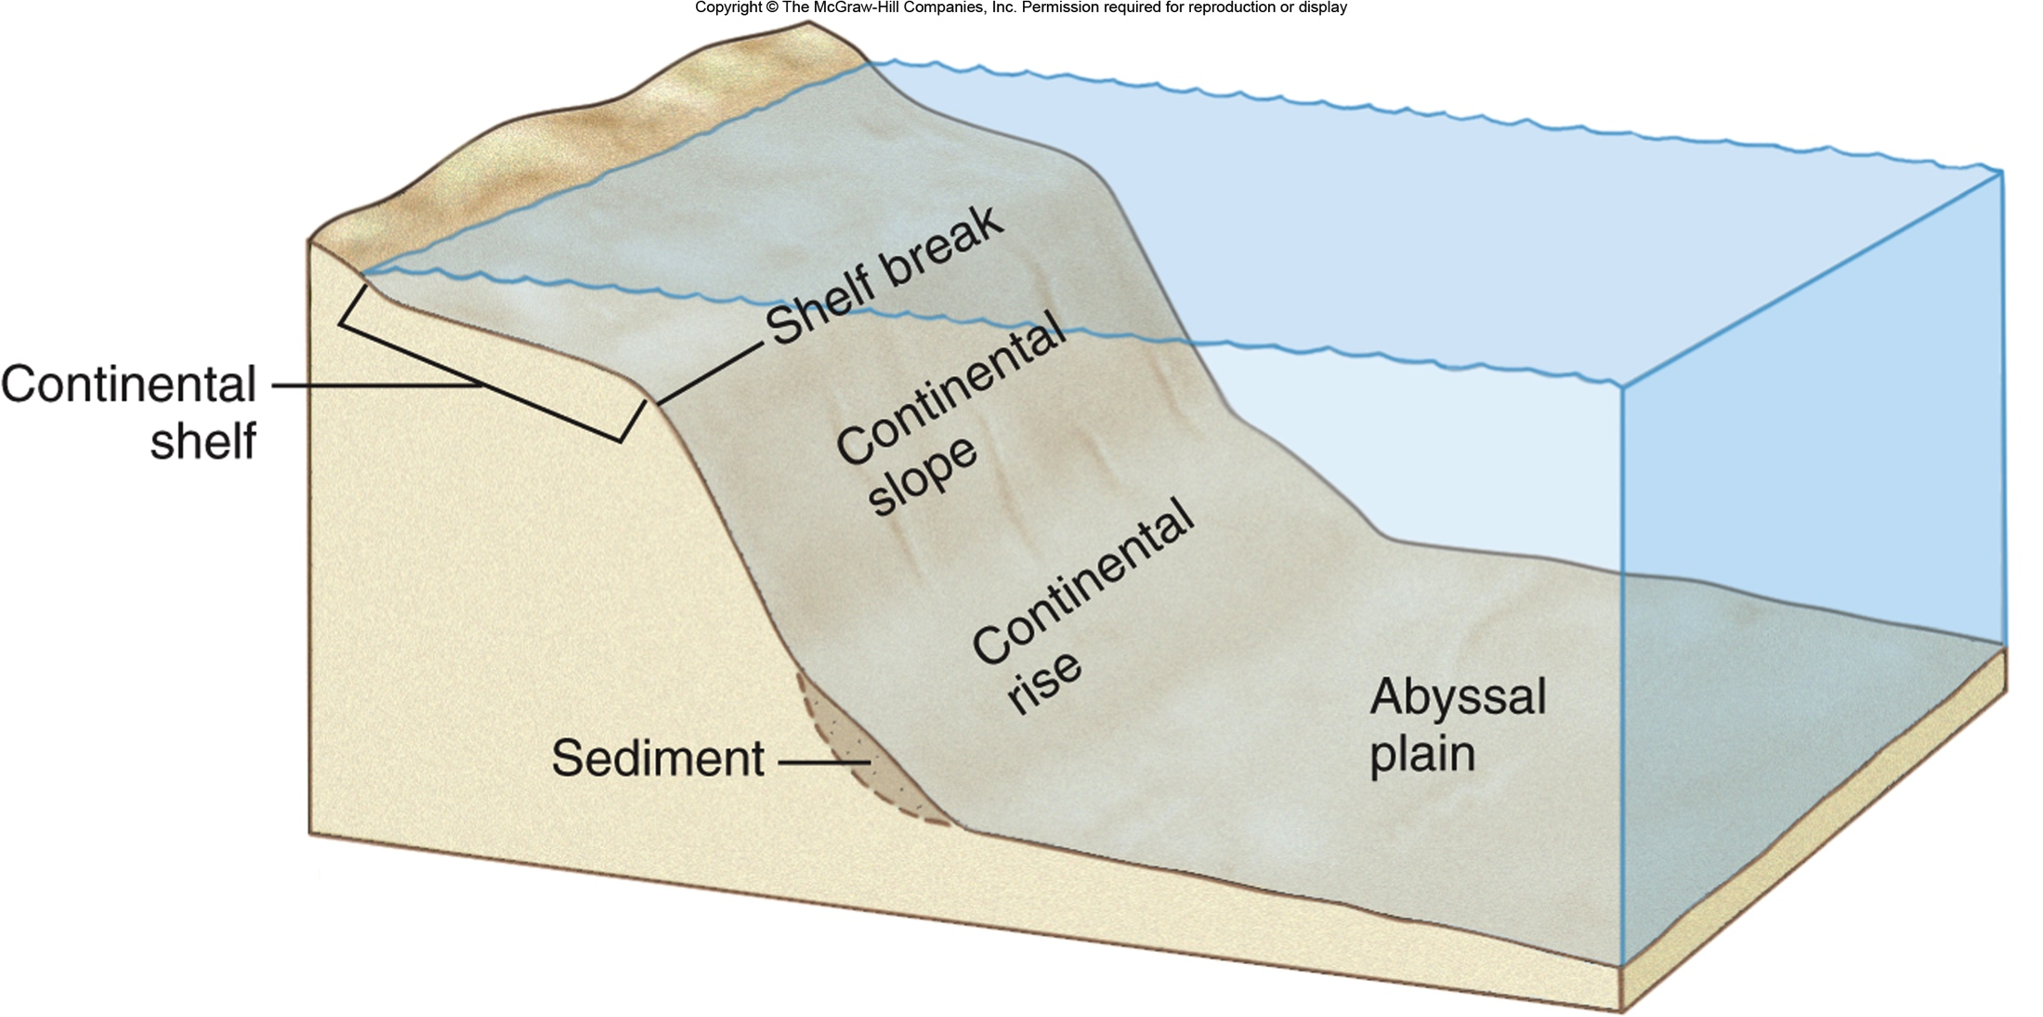
Remember the sea floor and continental margins?
Continental shelf
Shelf break
Continental slope
Continental rise
Abyssal plain

Slide 4
There’s more!
Both the sea floor and the open ocean environments are divided into provinces and those provinces are divided into zones.
Benthic Environment = sea floor
Pelagic Environment= open water from the surface to the sea floor

Slide 5
Benthic Provinces and Zones
Benthic means on the sea floor
Subneritic province: sea floor on continental shelf
Littoral zone: region between high and low tide marks
Sublittoral zone: region extending from low tide mark to shelf break
Suboceanic province: sea floor beyond the shelf break
Bathyal zone: (200-4000 m) sea floor on continental slope
Abyssal zone: (4000-6000 m) sea floor on abyssal plains
Hadal zone: (6000+ m) sea floor in trenches

Slide 7
Pelagic Environment: Provinces and Zones
Neritic province: water above continental shelf
Oceanic province: water above the continental slope and abyssal plains
Epipelagic zone: (0-200 m) 1, 9
Mesopelagic zone: (200-1000 m) 2, 4, 5, 6, 7
Bathypelagic zone: (1000-4000 m) 3, 8
Abyssopelagic zone: (4000-6000 m) 8
Hadal zone: (6000+ m) 8

Slide 8
Benthic, Pelagic and Neritic Zones all put together look like this: (label yours on your notes)
Neritic zones are split between 1 and 5.
I. Pelagic Zones:
Epipelagic
Mesopelagic
Bathypelagic
Abyssopelagic
The area under 4 is the Hadopelagic zone
II. Benthic Zones:
5. Subneritic zone (this is separated into the littoral and sublittoral zones)
6. Bathyl zone
7. Abyssal zone
8. Hadal zone

Slide 9
Lights, please.
Photic: most sunlight penerates. Epipelagic zone, littoral and sublittoral zones.
Disphotic: light penetrates, but is insufficient for photosynthesis. Mesopelagic zone
Aphotic- no light penetrates . Bathypelagic and Abyssopelagic and below.
Notes:
Where would you find the most life?

Slide 10
And because singing helps memory: Mr. Ray sings the zones!
Hadal

Slide 11
1111

