Slide 1
Read Around Groups & World Café
Facilitating student conversations about their writing.

Slide 2
Think-pair-share
Please respond to the following question:
Why is it important to have students discuss their writing with their peers?

Slide 3
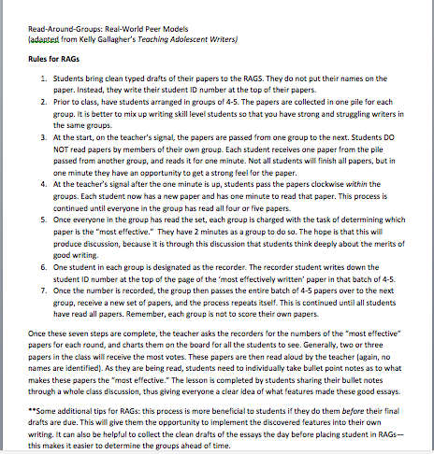
RAGs (Read Around Groups)

Slide 4
RAGs process
Distribute one essay to each group member
You will have approximately one minute to read as much of the essay as you can
Once the time is up, pass the essays clockwise (to the person on your left)
After all essays are read, discuss with your group which one is the most effective & record the number
Pass your pile of essays to the next group
Repeat the process with a new set of essays

Slide 5
Essay Prompt
Analyze the rhetorical strategies used by Clarence Darrow to address a jury in a notorious murder case.
Identify the three strongest arguments in his closing speech to the jury. Acting as a prosecuting attorney, how would you counter and refute Darrow’s arguments?
Write paragraph for each argument you intend to refute, using effective rhetorical strategies such as ethos, logos, pathos, etc. to support your position and procure a guilty verdict.

Slide 6
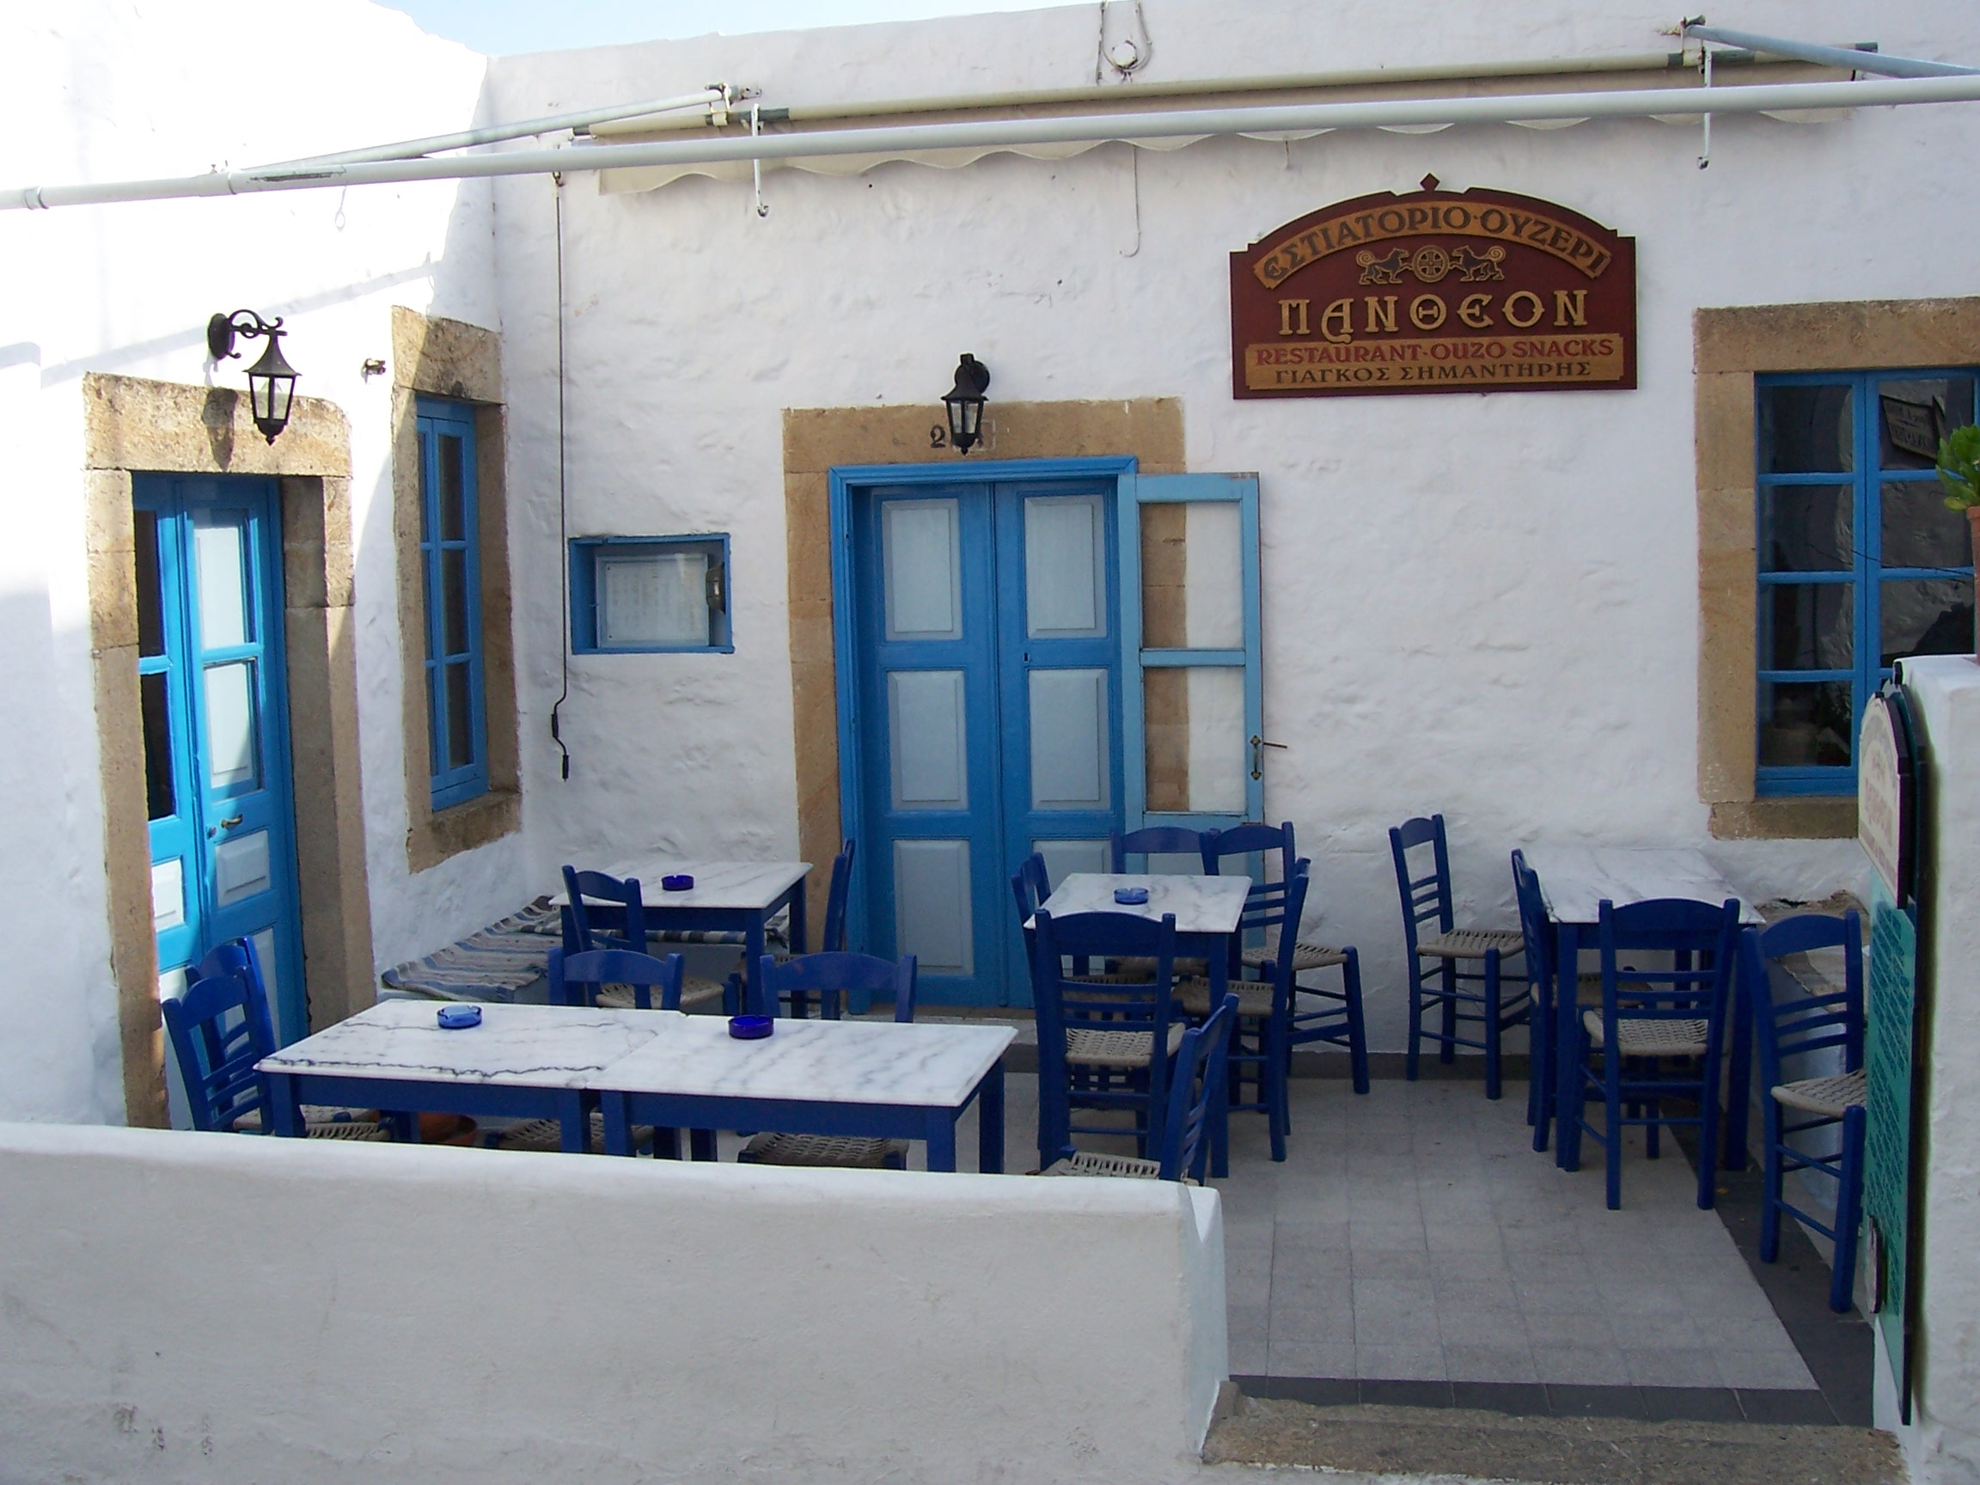
WORLD CAFÉ

Slide 7
What is a World Café?
An “open space” protocol for talking and thinking more deeply about a particular issue
World Café is designed primarily to generate collective knowledge sharing, webs of personal relationships, and new possibilities for action

Slide 8
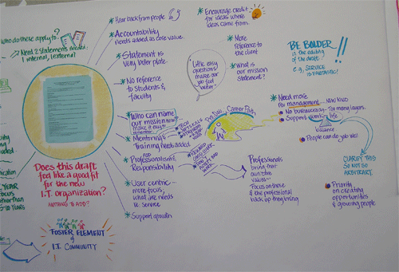
Café Etiquette & Tips
CONTRIBUTE your thinking and experience
LISTEN to understand
CONNECT ideas
LISTEN TOGETHER for patterns, insights, and deeper questions—notice that individual conversations are part of and contribute to a larger field of collective knowledge and wisdom.
Have materials available for visually representing key ideas – markers and paper.
Honor the social nature of learning and community building.

Slide 9
World Café Protocol
Provide a challenging, open-ended question to the whole group, or provide a different question at each table
At your table share and discuss your responses to this question. Use the chart paper to organize and represent your ideas – use symbols, organizers, pictures, words.
Choose a “host”, someone who will stay at the table and articulate what was discussed with the next group.

Slide 10
World Café Protocol
When time is signaled, everyone moves to new tables, mixing with whoever shows up.
The host of each table shares what was discussed and new participants add their thoughts and ideas to what was previously discussed; add the ideas to the chart paper.
Continue until the time is up.

Slide 11
Round 1 Question
How does the writer effectively use rhetorical devices to argue their point?

Slide 12
Resources
http://www.theworldcafe.com
http://kellygallagher.org
**The above resources and all handouts are on Canvas. ☺

