Slide 1
SOCRATIC SEMINAR
June 10, 2014

Slide 2
Pedagogy of the Oppressed
Notes:
Pedagogy of the Oppressed is one of the foundational texts in the field of critical pedagogy, which attempts to help students question and challenge domination, and the beliefs and practices that dominate.
First published in Portuguese in 1968, Pedagogy of the Oppressed was translated and published in English in 1970. The methodology of the late Paulo Freire has helped to empower countless impoverished and illiterate people throughout the world.
Over one million copies of Pedagogy of the Oppressed have been sold worldwide since the first English translation in 1970. It has been translated into many languages, including German, Italian, Spanish, Korean, Japanese, and French. [Description from http://www.pedagogyoftheoppressed.com/]
ISBN: 9780826412768 | Published by the Catalyst Center.

Slide 3
Answer the following questions:
According to Friere, what should be the goal of the teacher? Do you agree or disagree?
Friere wants students to achieve “concientizacao”. What does this mean and whom does it affect?
Are any parts of the text relevant to our system public education in the United States?
When appropriate, include phrases or statements from the text that support for your response.

Slide 4
The “N”-word
Why is it helpful to explicitly focus on academic transitions?
Notes:
Lesson Objective
Use textual evidence to evaluate arguments presented in articles
Length
6 min
Questions to Consider
Ms. Wu says "Whoever is doing the talking is doing the learning." How can you facilitate learning through speaking in your own classroom?
What can you learn from Ms. Wu about using the Common Core when lesson planning?
Common Core Standards
ELA.RI.11-12.7, ELA.SL.11-12.1c, ELA.SL.11-12.2

Slide 5
Patience & Practice
Ms. Price says that it's our responsibility to make it their responsibility. How does she do this?
Notes:
Lesson Objective
Discuss the meaning and importance of poetic language
Length
7 min
Questions to Consider
How do students develop discussion skills by participating in both the inner and outer circles?
What can you learn from Ms. Price about using the language of the Common Core with students?
Ms. Price says that it's our responsibility to make it their responsibility. How does she do this?
Common Core Standards
ELA.RL.9-10.1, ELA.RL.9-10.4, ELA.SL.9-10.1c

Slide 6
Socratic Seminar:
Claims & Counterclaims
What strategies encourage higher student engagement and individual participation?
Notes:
Lesson Objective
Use debate to help students support claims and address counterclaims
Length
5 min
Questions to Consider
What strategies encourage higher student engagement and individual participation?
In what ways do sentence stems help students learn to respectfully express ideas?
How might you use a Socratic seminar with the content you are currently teaching?
Common Core Standards
ELA.W.9-10.1a, ELA.W.9-10.1b

Slide 7

Suggestions for text

Slide 8
Suggestions for poetry
“Birches”
“Come In” (can be paired with “Stopping by Woods on a Snowy Evening”)
“Choose Something Like a Star” (can be paired with “Bright Star” by John Keats)
“The Death of the Hired Man” (works well after reading Death of a Salesman by Arthur Miller)
“Desert Places”
“Design” (can be paired with “A Noiseless Patient Spider” by Walt Whitman)
“Fire and Ice”
“Mending Wall”
“Nothing Gold Can Stay” (can be paired with any number of “carpe diem” Elizabethan poets)
“Out, Out-“ (works well after reading Macbeth)
“The Pasture”
“Provide, Provide”
“Reluctance”
“The Road Not Taken” (can be paired with the 1st paragraph of Walden by Henry David Thoreau)
“Stopping By Woods on a Snowy Evening” (can be paired with “There are Roughly Zones”)
“There are Roughly Zones” (an interesting pairing with “pity this monster, manunkind” by e.e. cummings, or can be paired with a discussion of climate change, too)
“To Earthward”
“The Tuft of Flowers”

Slide 9
Suggestions for Social Studies
Primary documents
Speeches
Photographs
Video clips
Respond to a question: did Abraham Lincoln deserve the title “The Great Emancipator”
http://www.ted.com/talks/aaron_huey

Slide 10
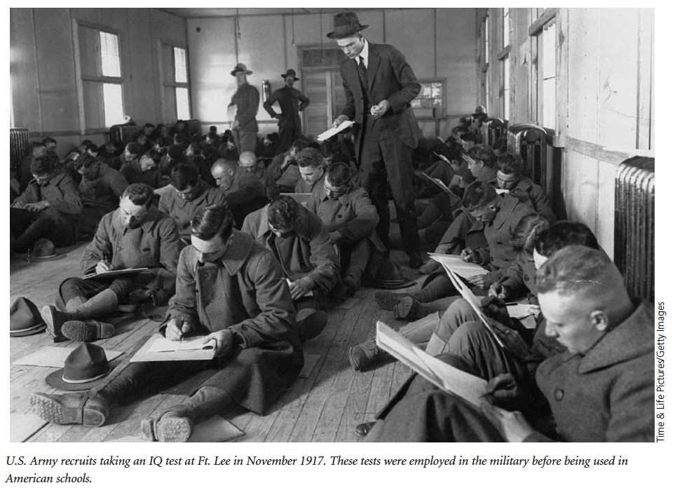

Slide 11


